Slide 1
Academic Mindset
Dr. Tristan Denley
Vice Chancellor for Academic Affairs
Tennessee Board of Regents
Tristan.Denley@tbr.edu
Twitter: @TDenley

Slide 2
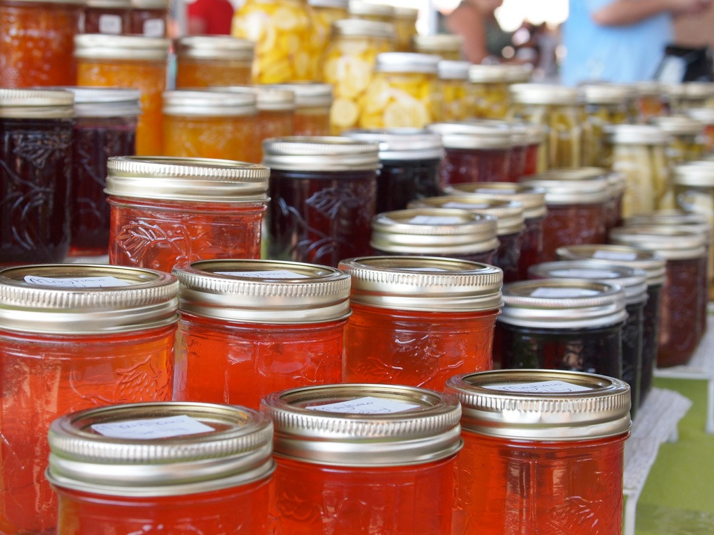
ARCHITECTED CHOICE

Slide 3
Health Professions
Academic Foci
Applied
Technology
STEM
Humanities
Business
General Education
Social Sciences
Arts
Education

Slide 4
How did the existence of academic foci
affect student program choice?
Why did you pick your program or academic focus?
Only 0.2% of students chose an academic focus because they “had to pick something"

Slide 5
Enrollment Patterns for Incoming Community College Freshmen

Slide 6
Creating a Clear
Path to Success

Slide 7
The effect of course enrollments in the first year
on the Community College graduation rates

Slide 8
Incoming Freshmen who successfully completed at least 9 hours in their focus
during their 1st Academic Year
56 % increase

Slide 9
Incoming Minority Freshmen who successfully completed at least 9 hours in their focus
during their 1st Academic Year
93 % increase

Slide 10
Co-requisite Remediation
Full System
Implementation
Fall 2015

Slide 11
Completion of Gateway Math by ACT Sub-score Community College Pre-requisite Model vs. Co-requisite Model
9479 Students
7422 Students

Slide 12
Completion of Gateway English by ACT Sub-score
6071 Students
7147 Students

Slide 13
Completion of Gateway English by ACT Sub-score
Pass Rate in English Composition II
68%
6071 Students
7147 Students

Slide 14
Disaggregation by Student Group

Slide 15
Students who Failed Both Courses

Slide 16
Natural order
Global centrality
Major centrality
Grade prediction
Academic Mindset

Slide 17
Primary Drivers of Productive Persistence
Believe they are capable of learning the material…
Feel connected to their institution
and that they belong…
Believe their coursework has value…
Believe they have the skills, habits
and knowhow to succeed

Slide 18
Believe they are capable of
learning the material…
FIXED
MINDSET
NEUTRAL
MINDSET
GROWTH
MINDSET
Mathematics

Slide 19
Feel connected to their institution
and that they belong…
DOUBT
THAT THEY BELONG
BELIEVE THAT THEY BELONG
NEUTRAL
Mathematics

Slide 20
Believe their coursework has value…
DOUBT THE VALUE
AFFIRM THE VALUE
NEUTRAL
Mathematics

Slide 21
Believe they have the skills, habits
and knowhow to succeed
NEUTRAL
STRONG
CONFIDENCE
LITTLE
CONFIDENCE
Mathematics

Slide 23
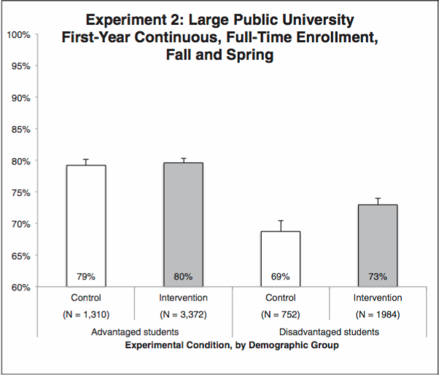
Results
Yeager et al. (2016) Teaching a lay theory before college narrows achievement gaps at scale,
Proceedings of the National Academy of Sciences of the United States of America

Slide 24
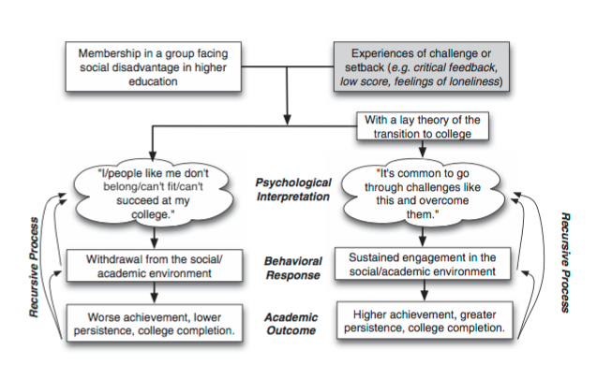
The Theoretical Model

Slide 25
TBR ACCESSIBILITY
INITIATIVE
TBR ACCESSIBILITY
INITIATIVE

Slide 30
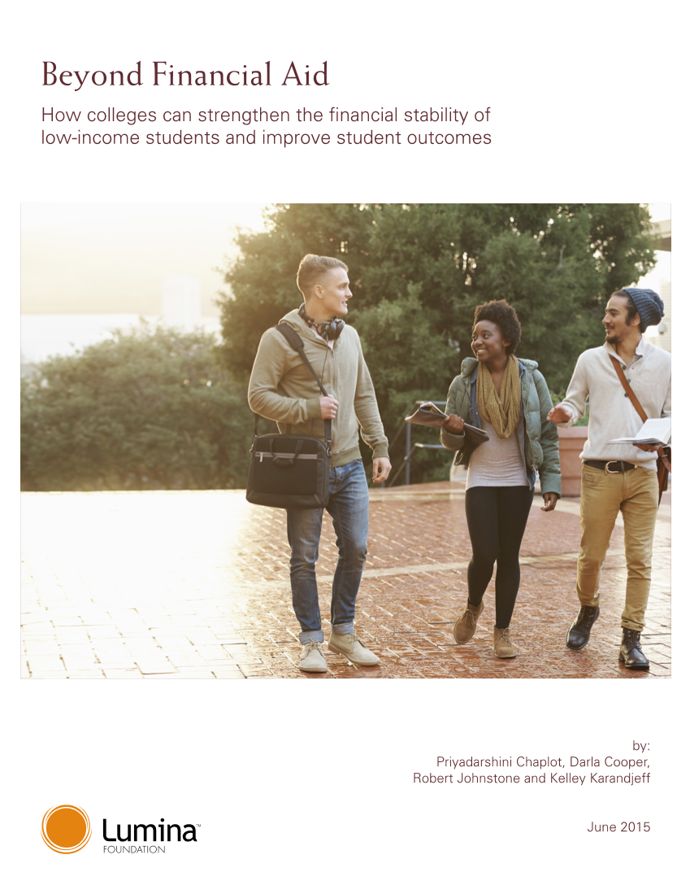
Beyond Financial Aid
Teams representing all universities, community colleges and TCATS
Two day event with support from Lumina and the Bill and Melinda Gates Foundation
Each institution made their own implementation plan

Slide 31
Thank you

