Slide 1
Training Presentation Submitting a Requisition

Slide 2
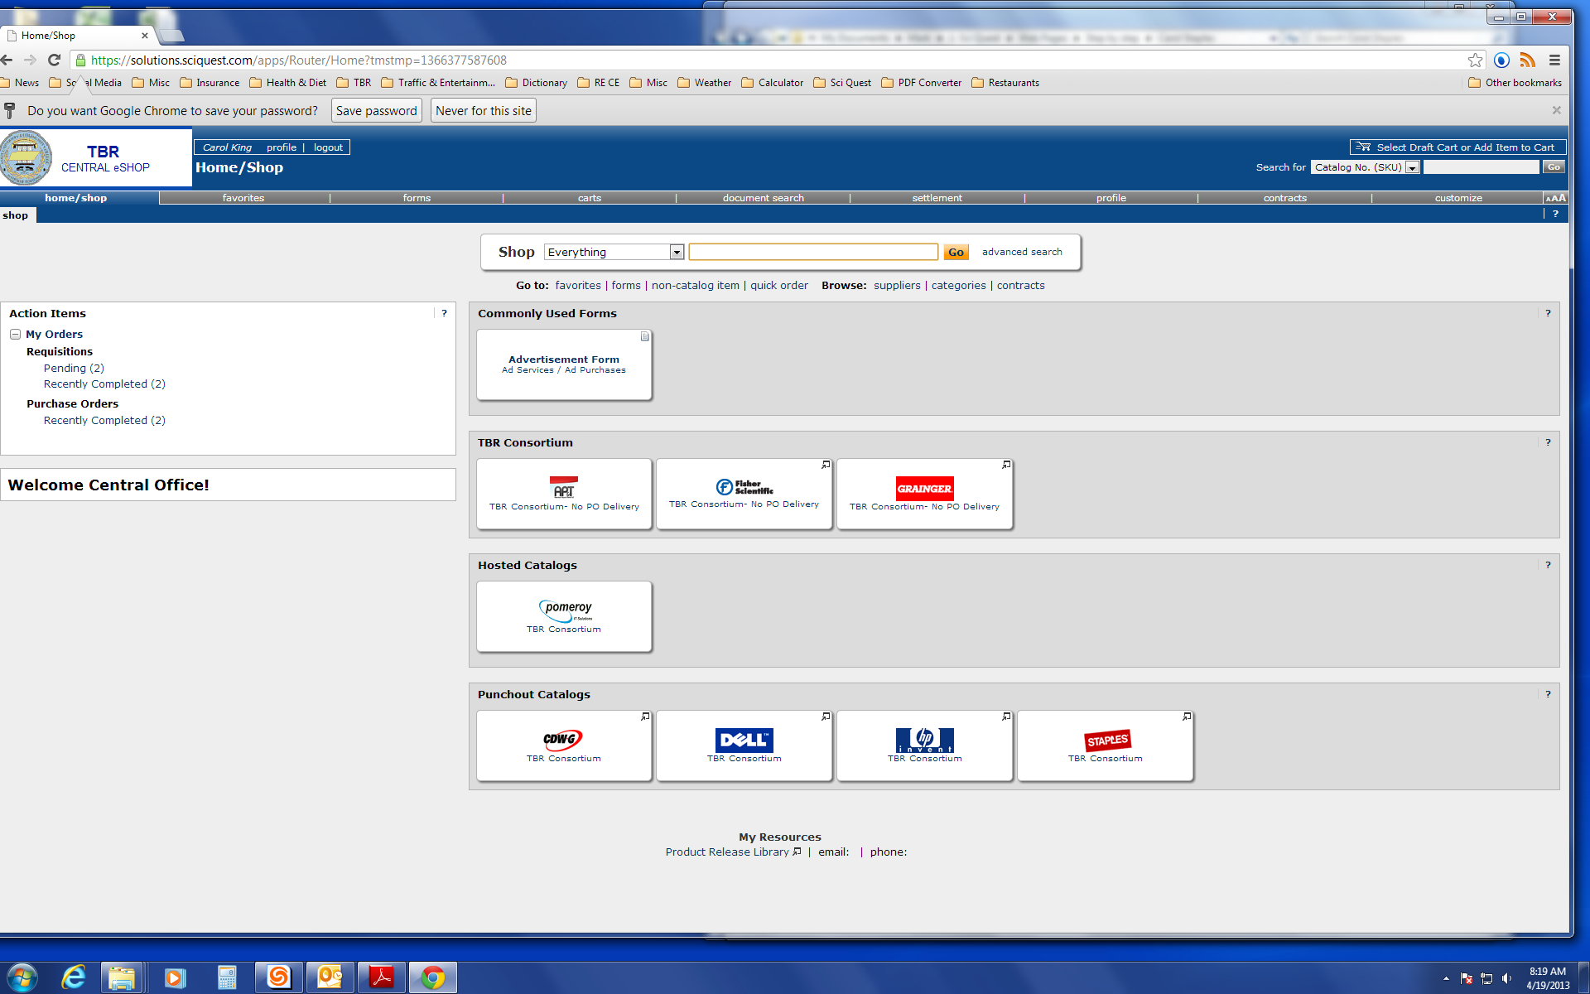
The training for submitting a requisition begins with the creation of a shopping cart. As a Requestor, you may have created the cart or a Shopper may have created the cart and assigned the cart to you. Either way, you see what carts you have by clicking on the Carts tab on the Navigation Tabs bar or the carts window in the top right of the screen.

Slide 3
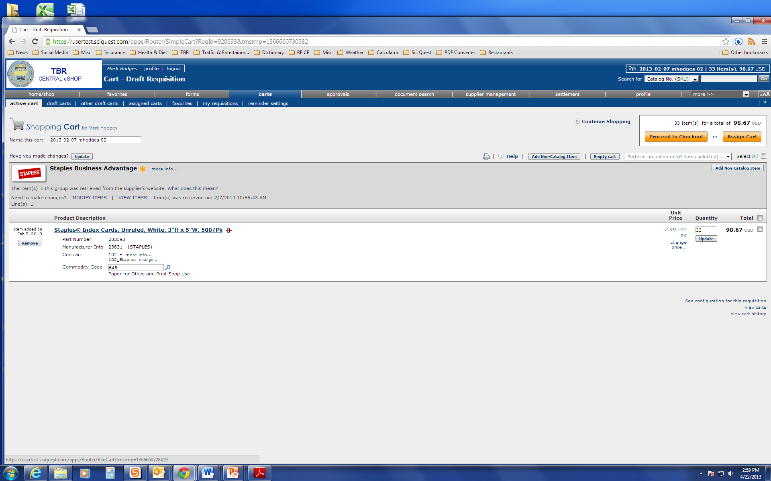
From this page, you can remove the cart if it was created in error, name the cart or Proceed to Checkout.

Slide 4
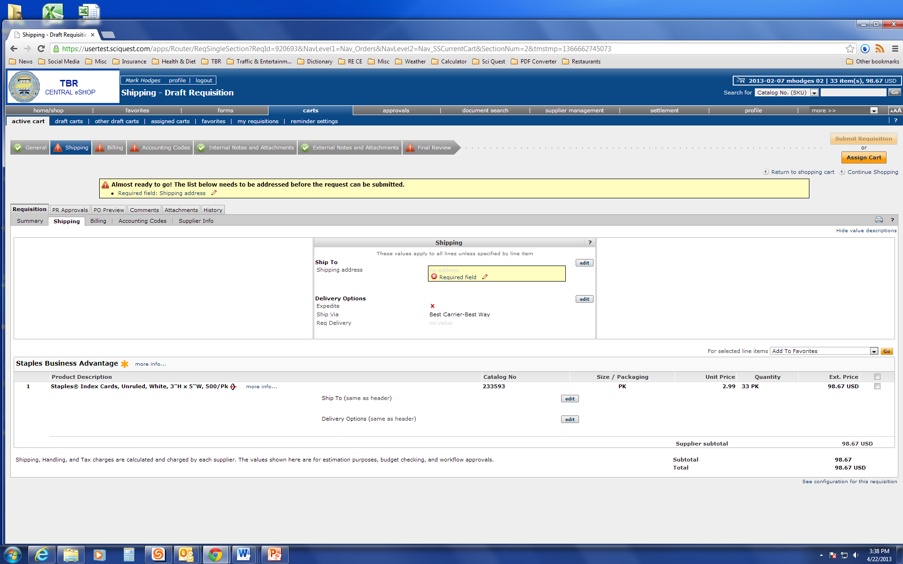
Once you select Submit Requisition, the next step is to fill in the Shipping, Billing and Accounting Codes information.

Slide 5
Please note that if the Ship To and Bill To addresses have been set, as covered on slides 9 – 13 of the of the User Registration and Login Training Presentation, it will not be necessary to fill in the Shipping and Billing information.

Slide 6
Click edit in the Shipping box to fill in the required shipping information.

Slide 7
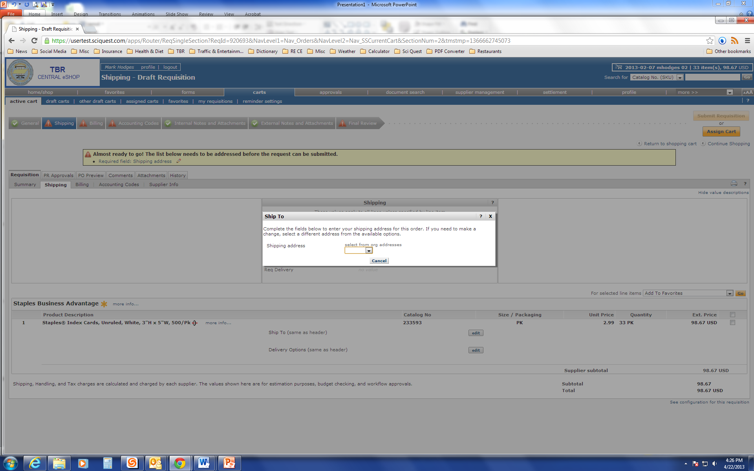
A Ship To box will pop up with a drop menu. Select the correct suite number for the order to be shipped to.

Slide 8
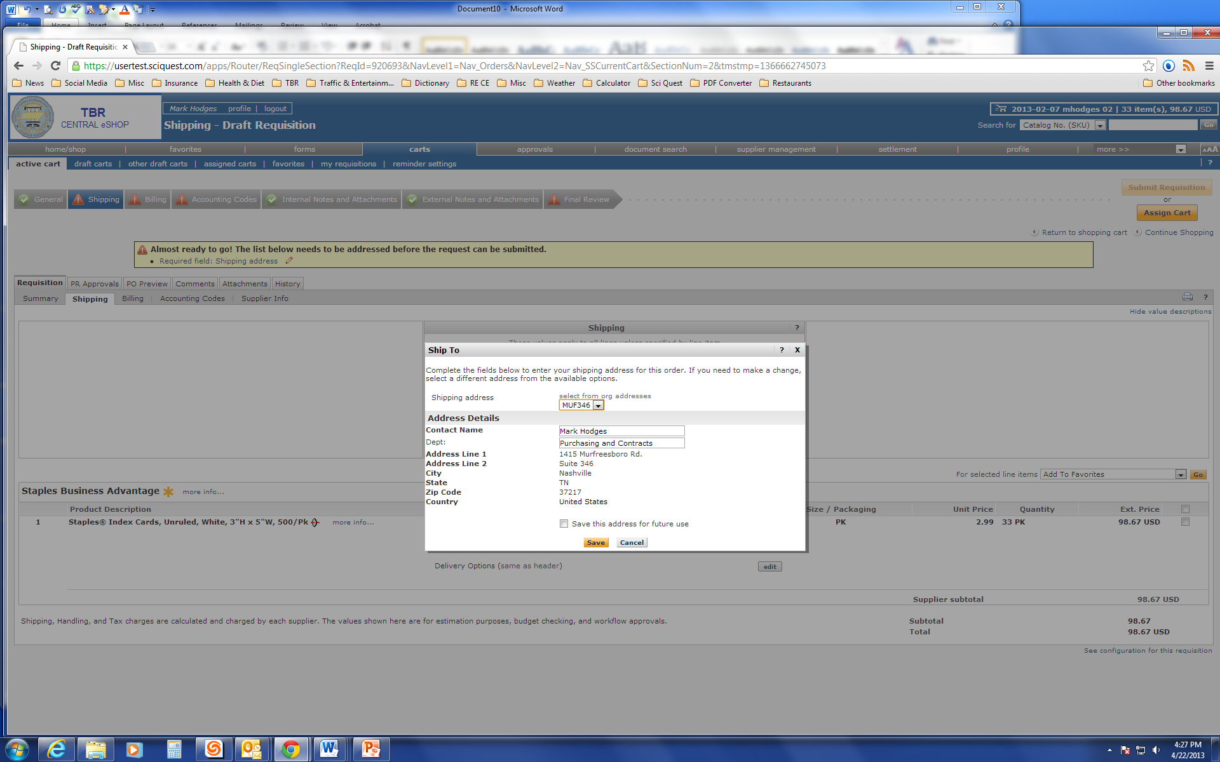
Once you have selected the appropriate suite, click on save.

Slide 9
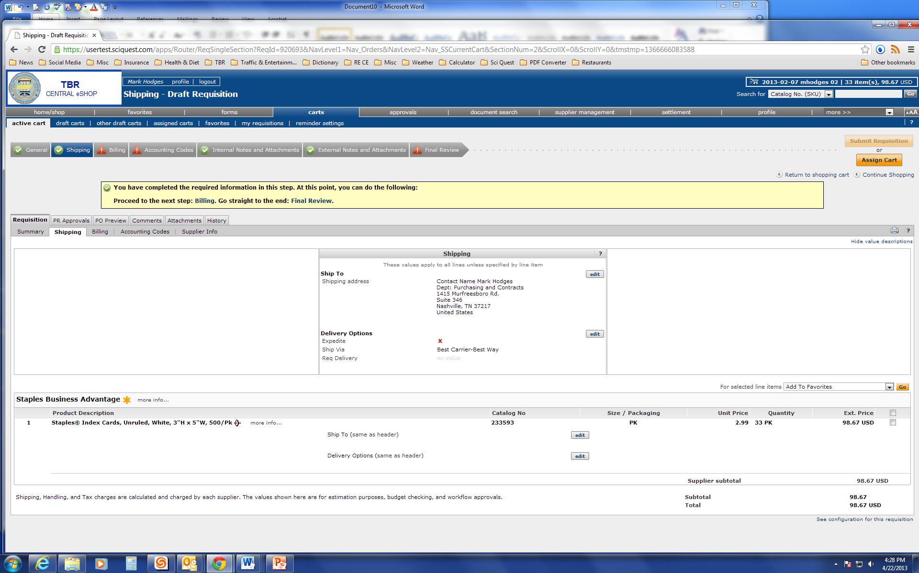
Notice shipping has changed from red to green. Next the Billing must be filled in. Billing can be selected from three different locations.

Slide 10
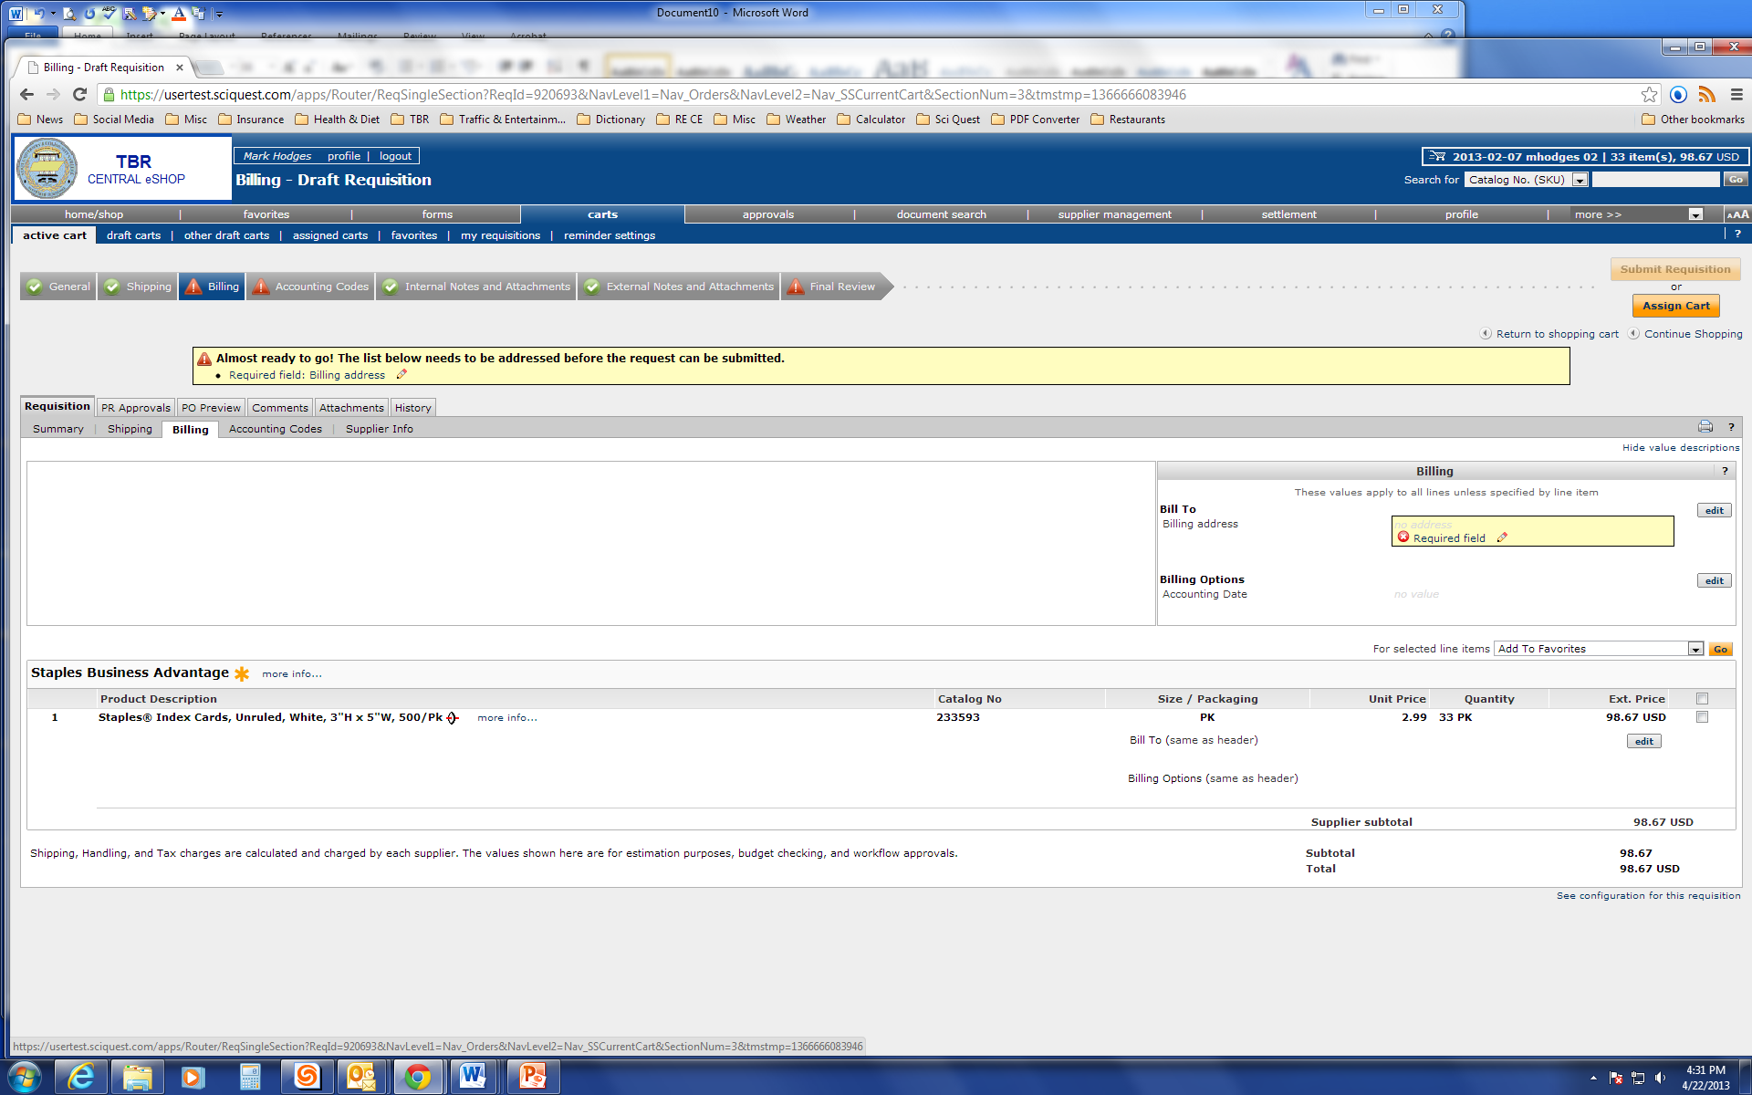
When you select on Billing the Billing box to the right opens up and displays an edit button to click.

Slide 11
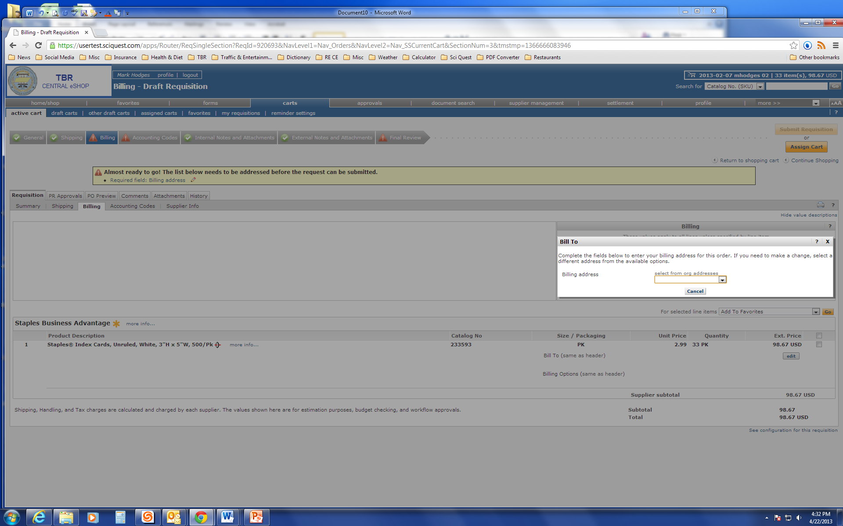
Clicking on the edit button in the Bill To box opens up a drop down menu. Select Accounts Payable.

Slide 12
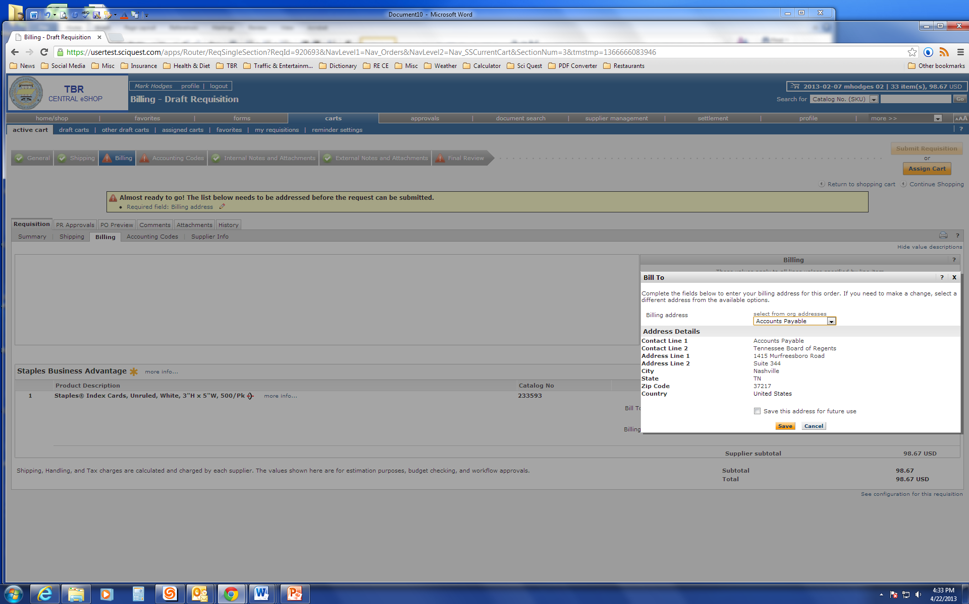
Once you click on Accounts Payable, click on save.

Slide 13
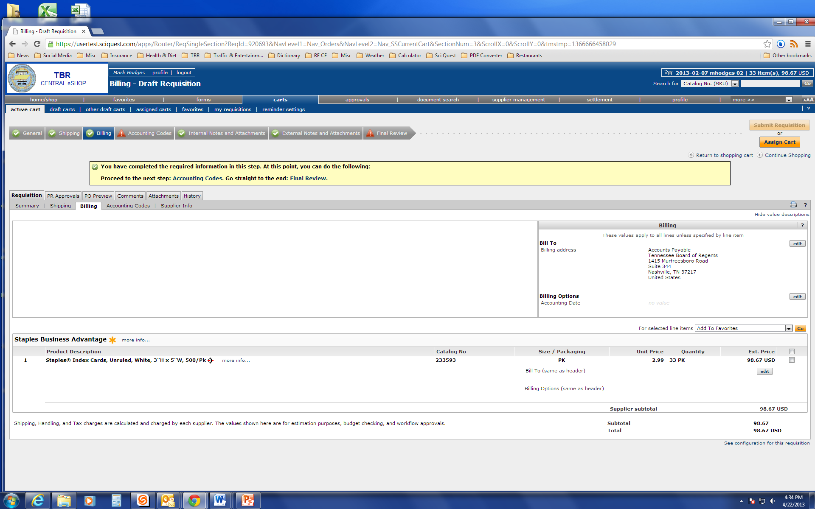
Next the Accounting Codes must be filled in. Like Shipping and Billing, the Accounting Codes can be selected from three different locations.

Slide 14
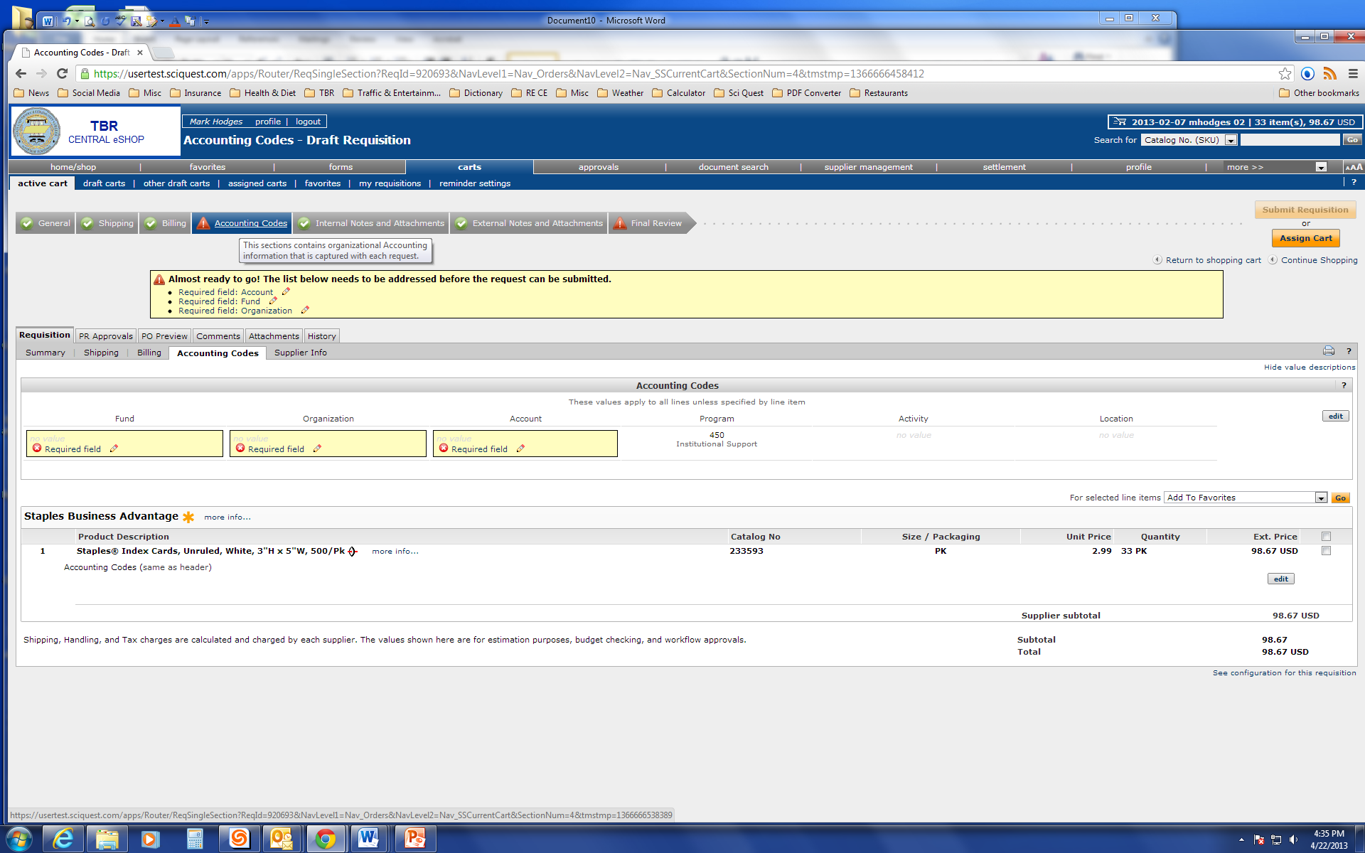
Click on the edit button in the Accounting Codes box.

Slide 15
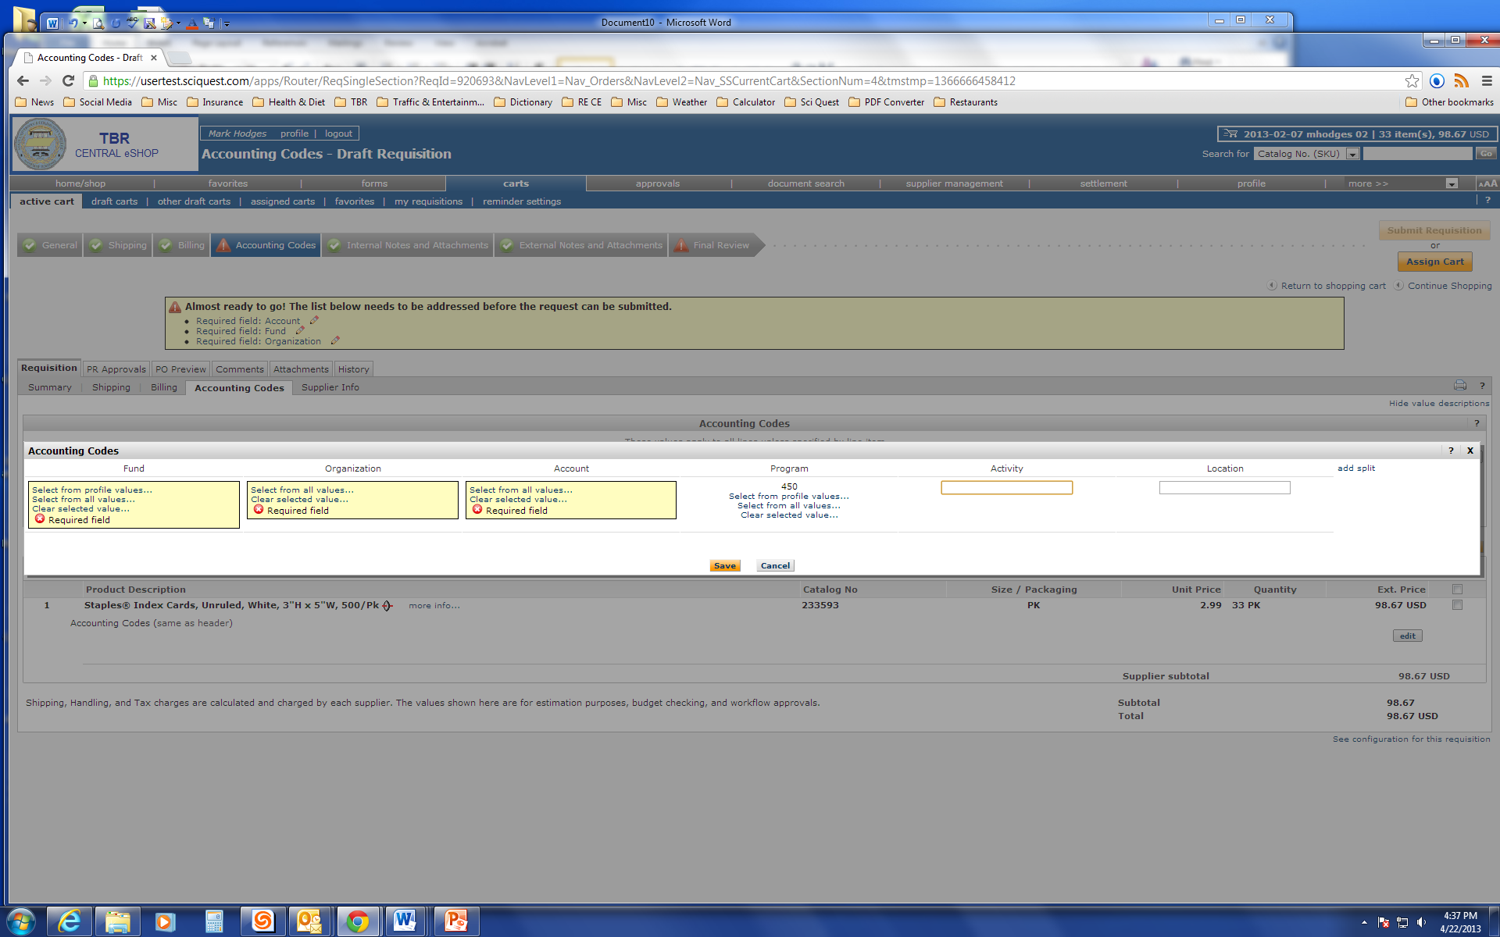
Select from Profile Values for Fund.

Slide 16
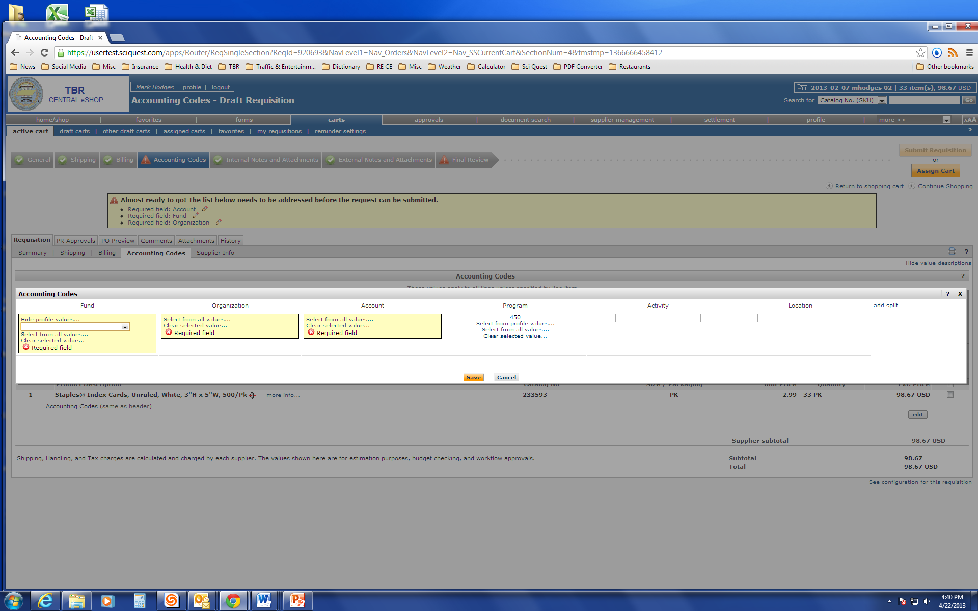
Notice the drop down menu in the Fund box. Scroll down and select the appropriate fund value.

Slide 17
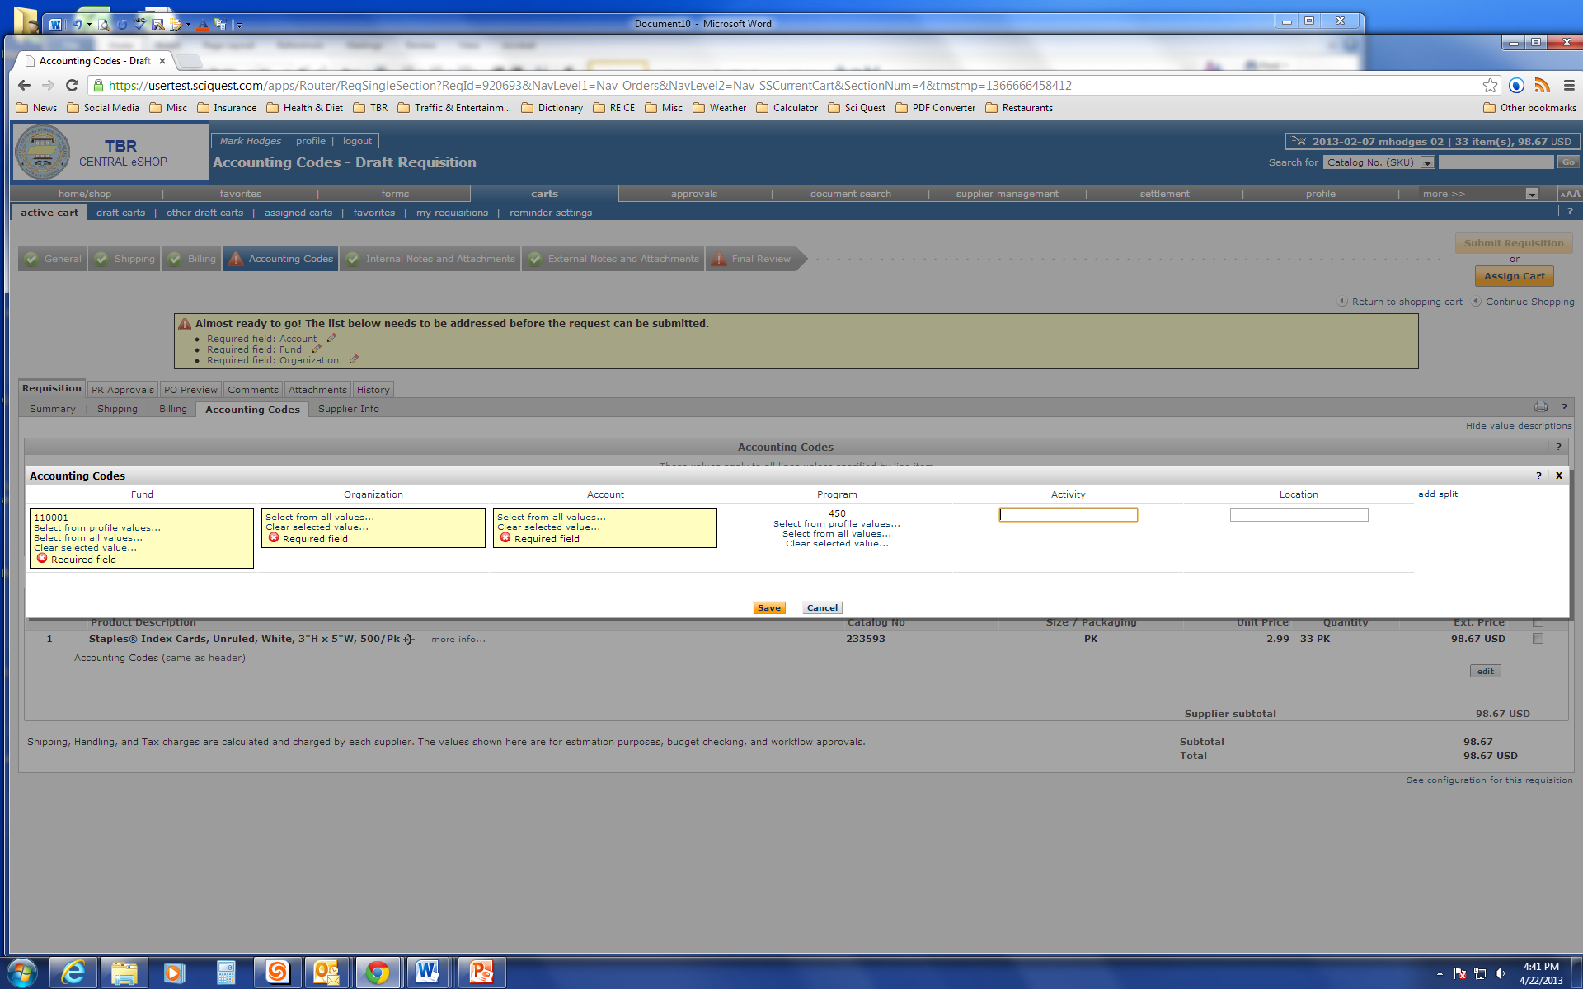
Select from All Values on Organization. Once again a drop box will appear. Select the appropriate Org value.

Slide 18
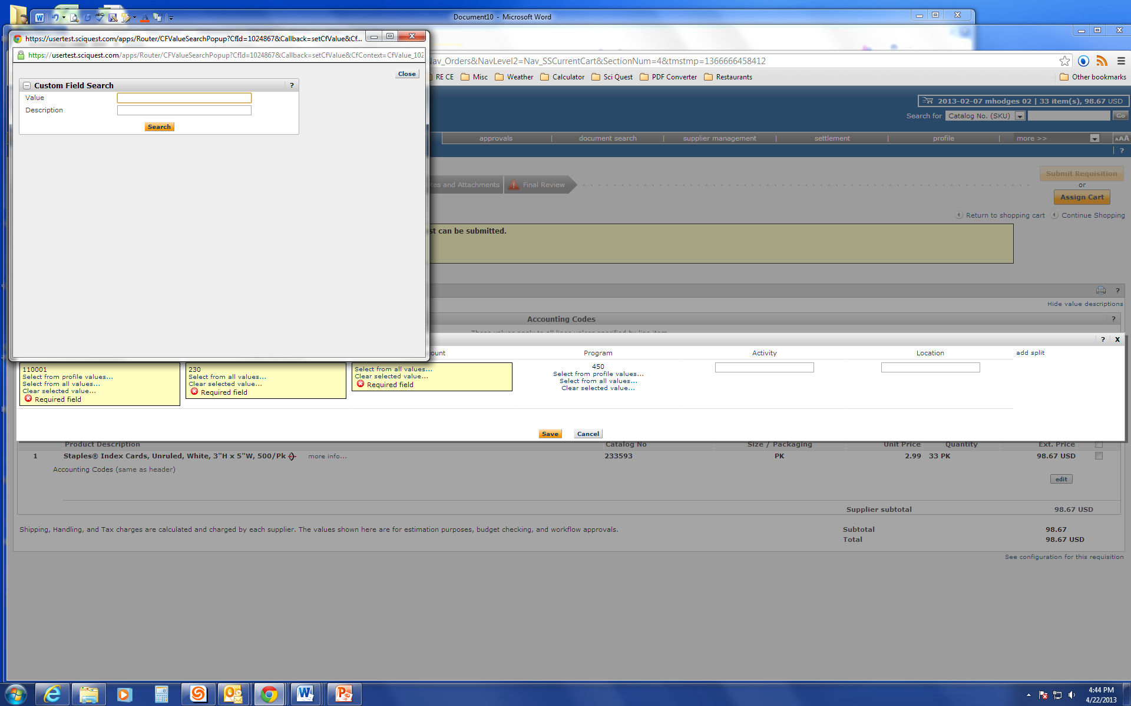
If you know the correct Organization value, type it in the Value box and hit search, then select. If you do not know the correct Organization value, leave the value box blank and hit search and they will all appear. Scroll down until you find the correct Organization value and hit select.

Slide 19
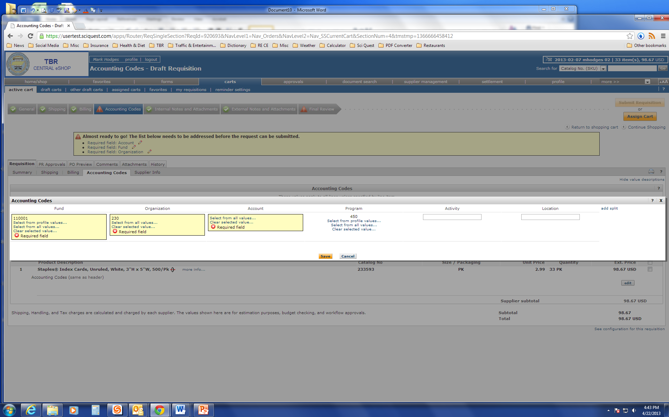
Select from All Values on Account. This time a drop down menu will not appear.

Slide 20
If you know the correct Account value, type it in the Value box and hit search, then select. If you do not know the correct Account value, leave the value box blank and hit search and they will all appear. Scroll down until you find the correct Account value and hit select.

Slide 21
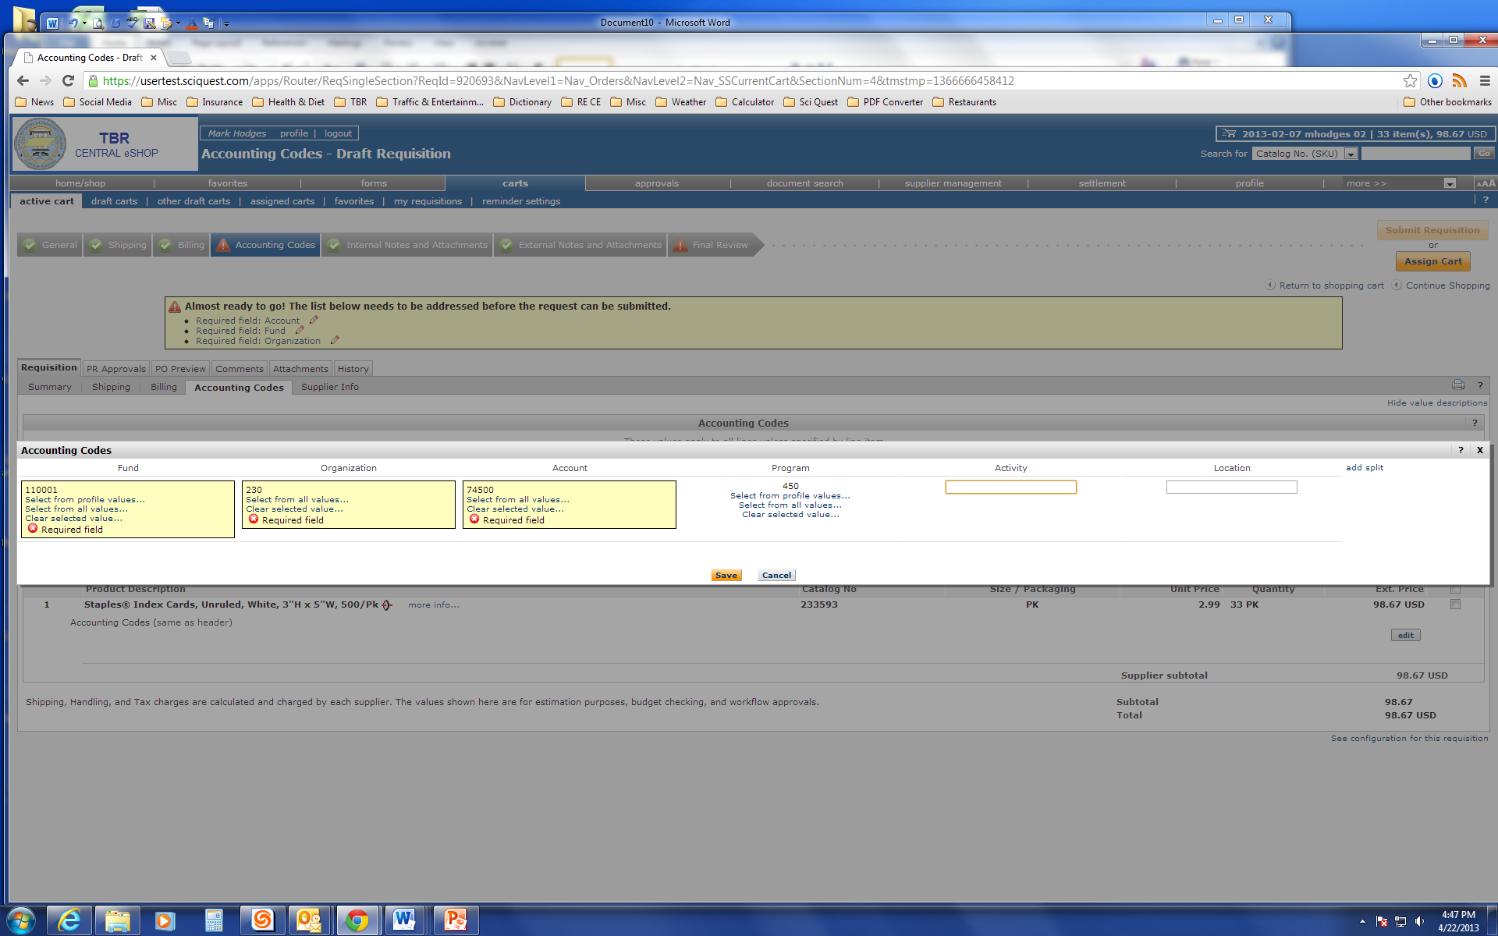
With the Fund, Organization and Account codes in place, hit save.

Slide 22
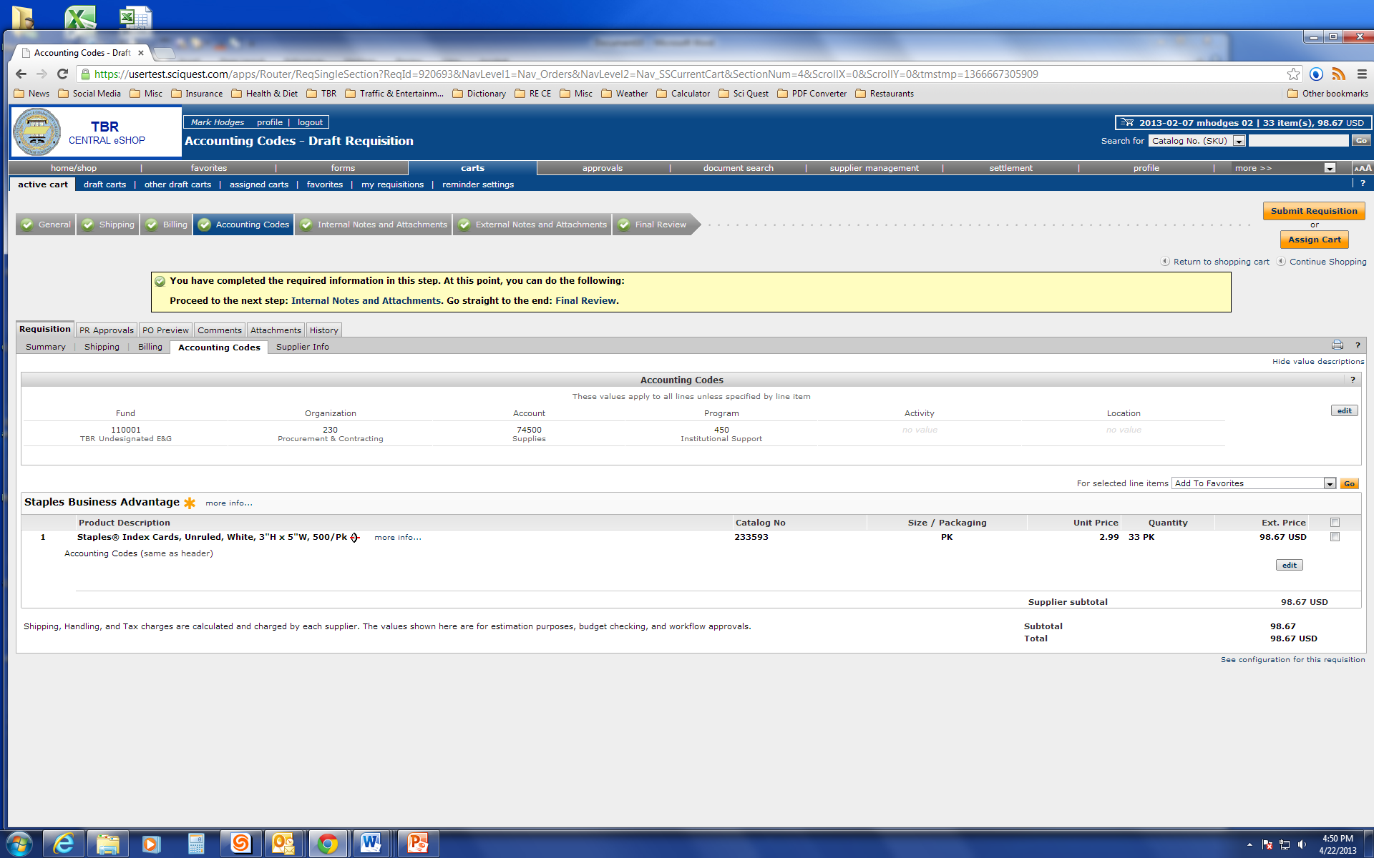
Click on Internal Notes and Attachments to add pertinent notes and/or to add supporting documentation such as invoices. Please note, Internal Notes and Attachments do not go to the vendor. These are only available to approved TBR Central eSHOP users.

Slide 23
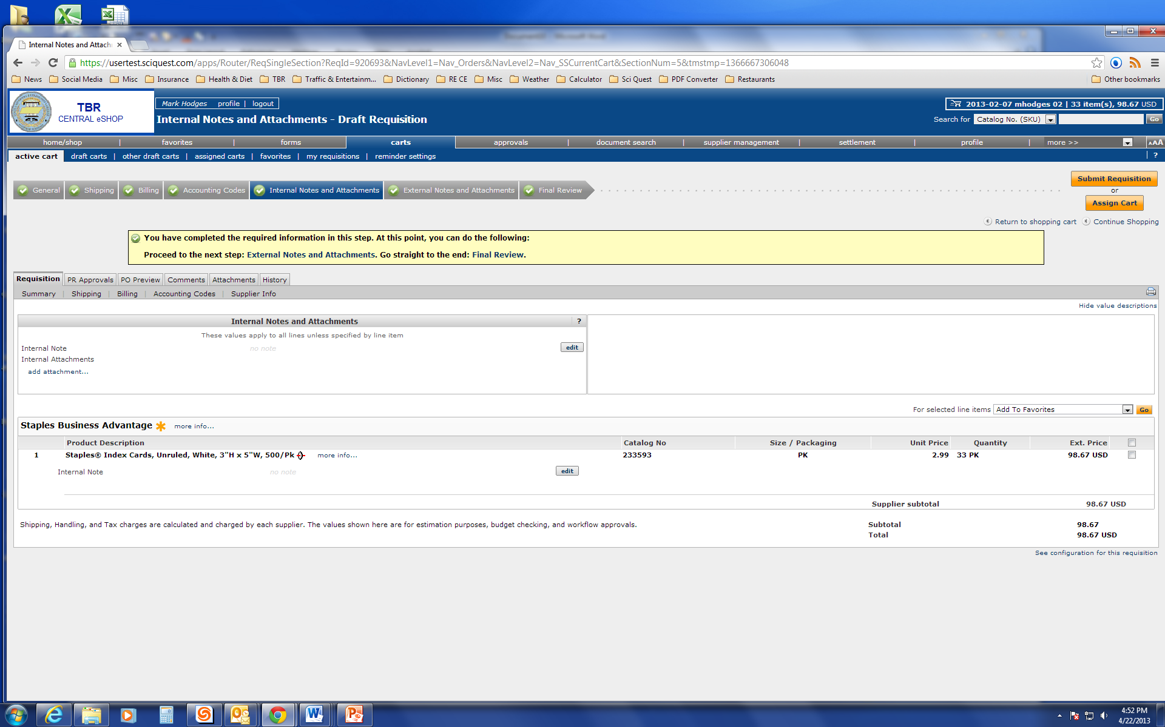
Click on External Notes and Attachments if you have notes and/or attachments that need to go to the supplier, such as the supplier’s quote. Please note, if you add these to Internal Notes and Attachments, the Supplier will note see them.

Slide 24
Click on Final Review.

Slide 25
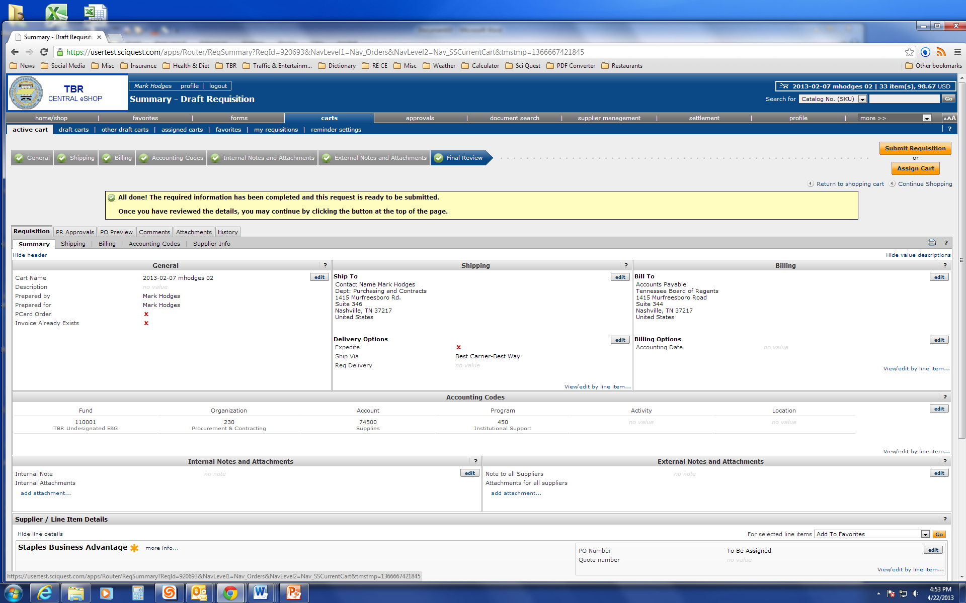
Click on the edit button in the General box to check Pcard Order or Invoice Already Exists.

Slide 26
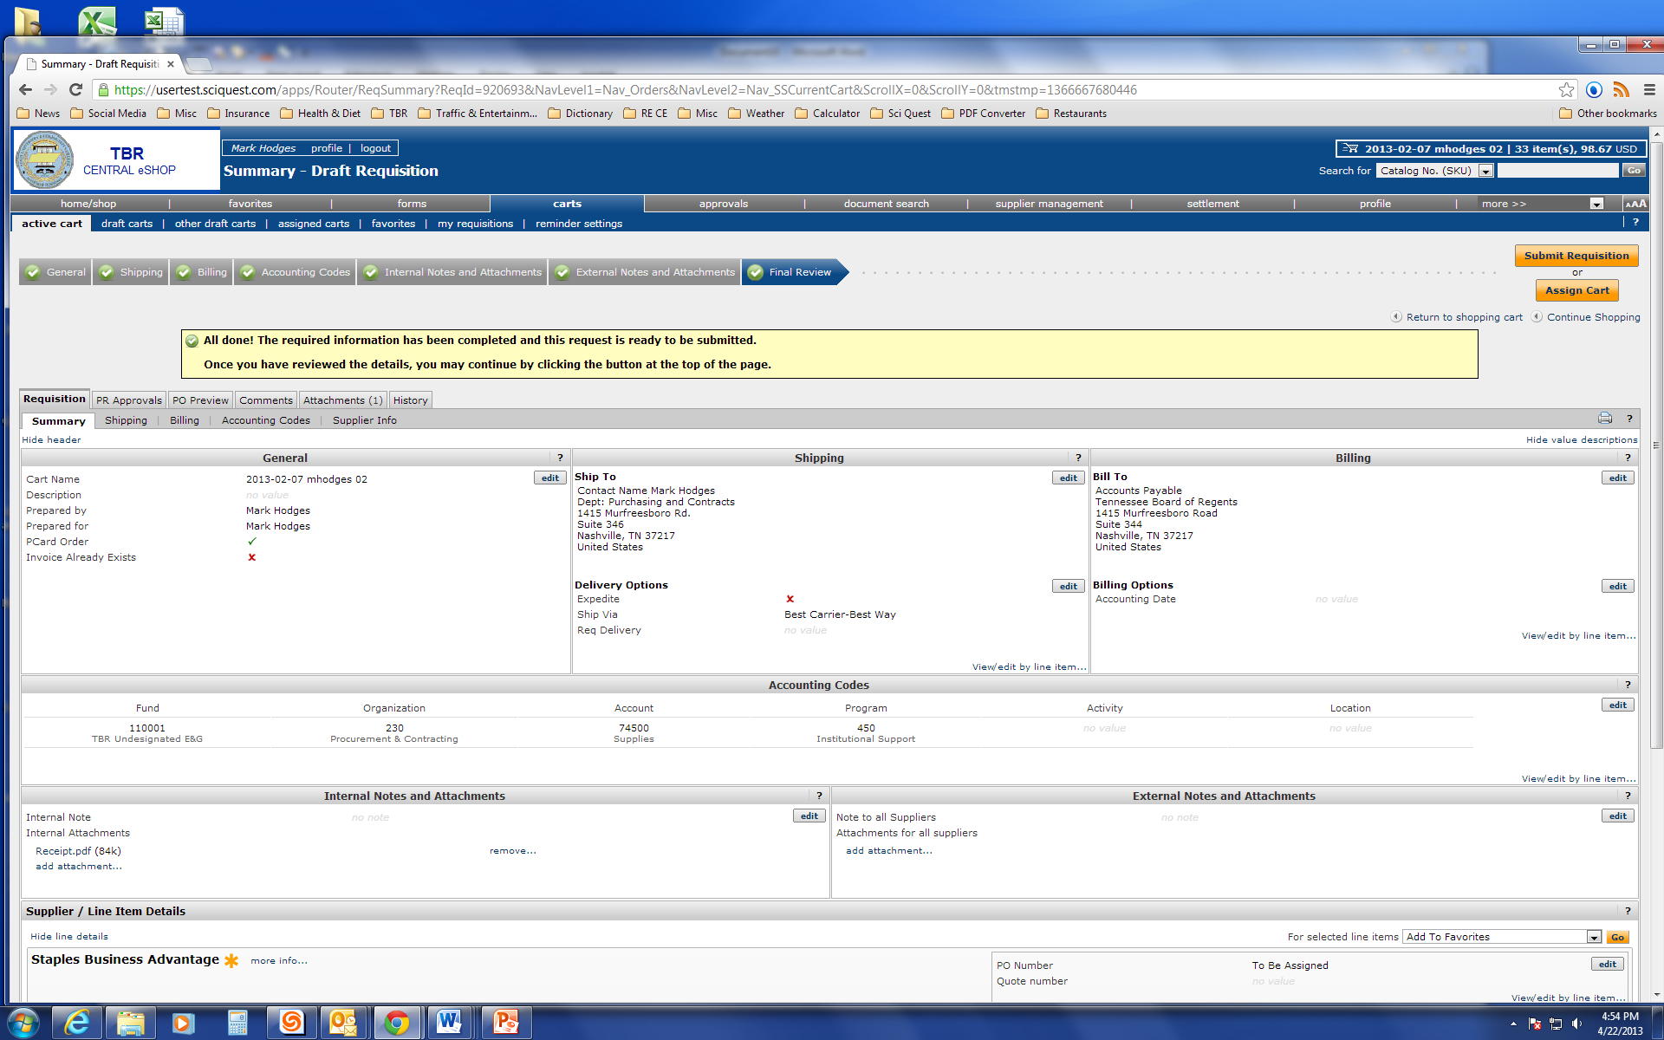
Click on the Submit Requisition button.

Slide 27
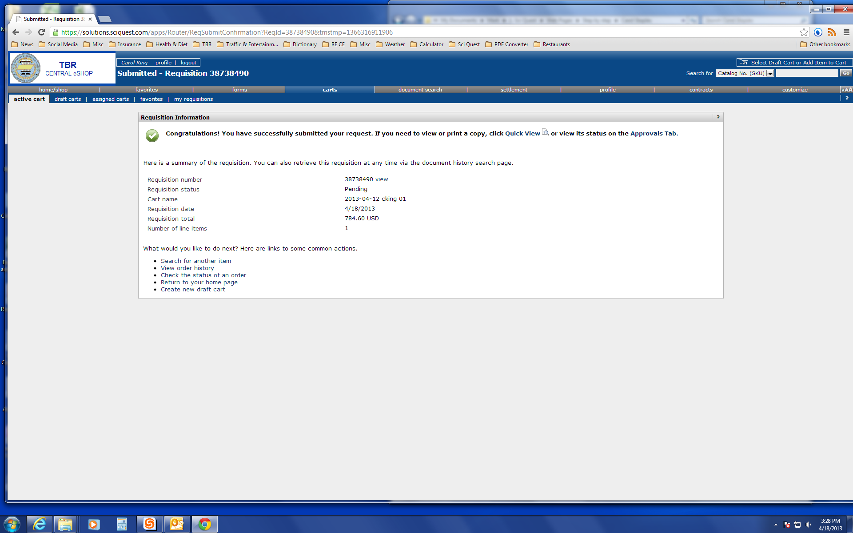
Congratulation, you have successfully submitted a requisition in the TBR Central eSHOP!

