Slide 1
December Quarterly Board Meeting
Nashville State Community College
Nashville, Tennessee

Slide 2
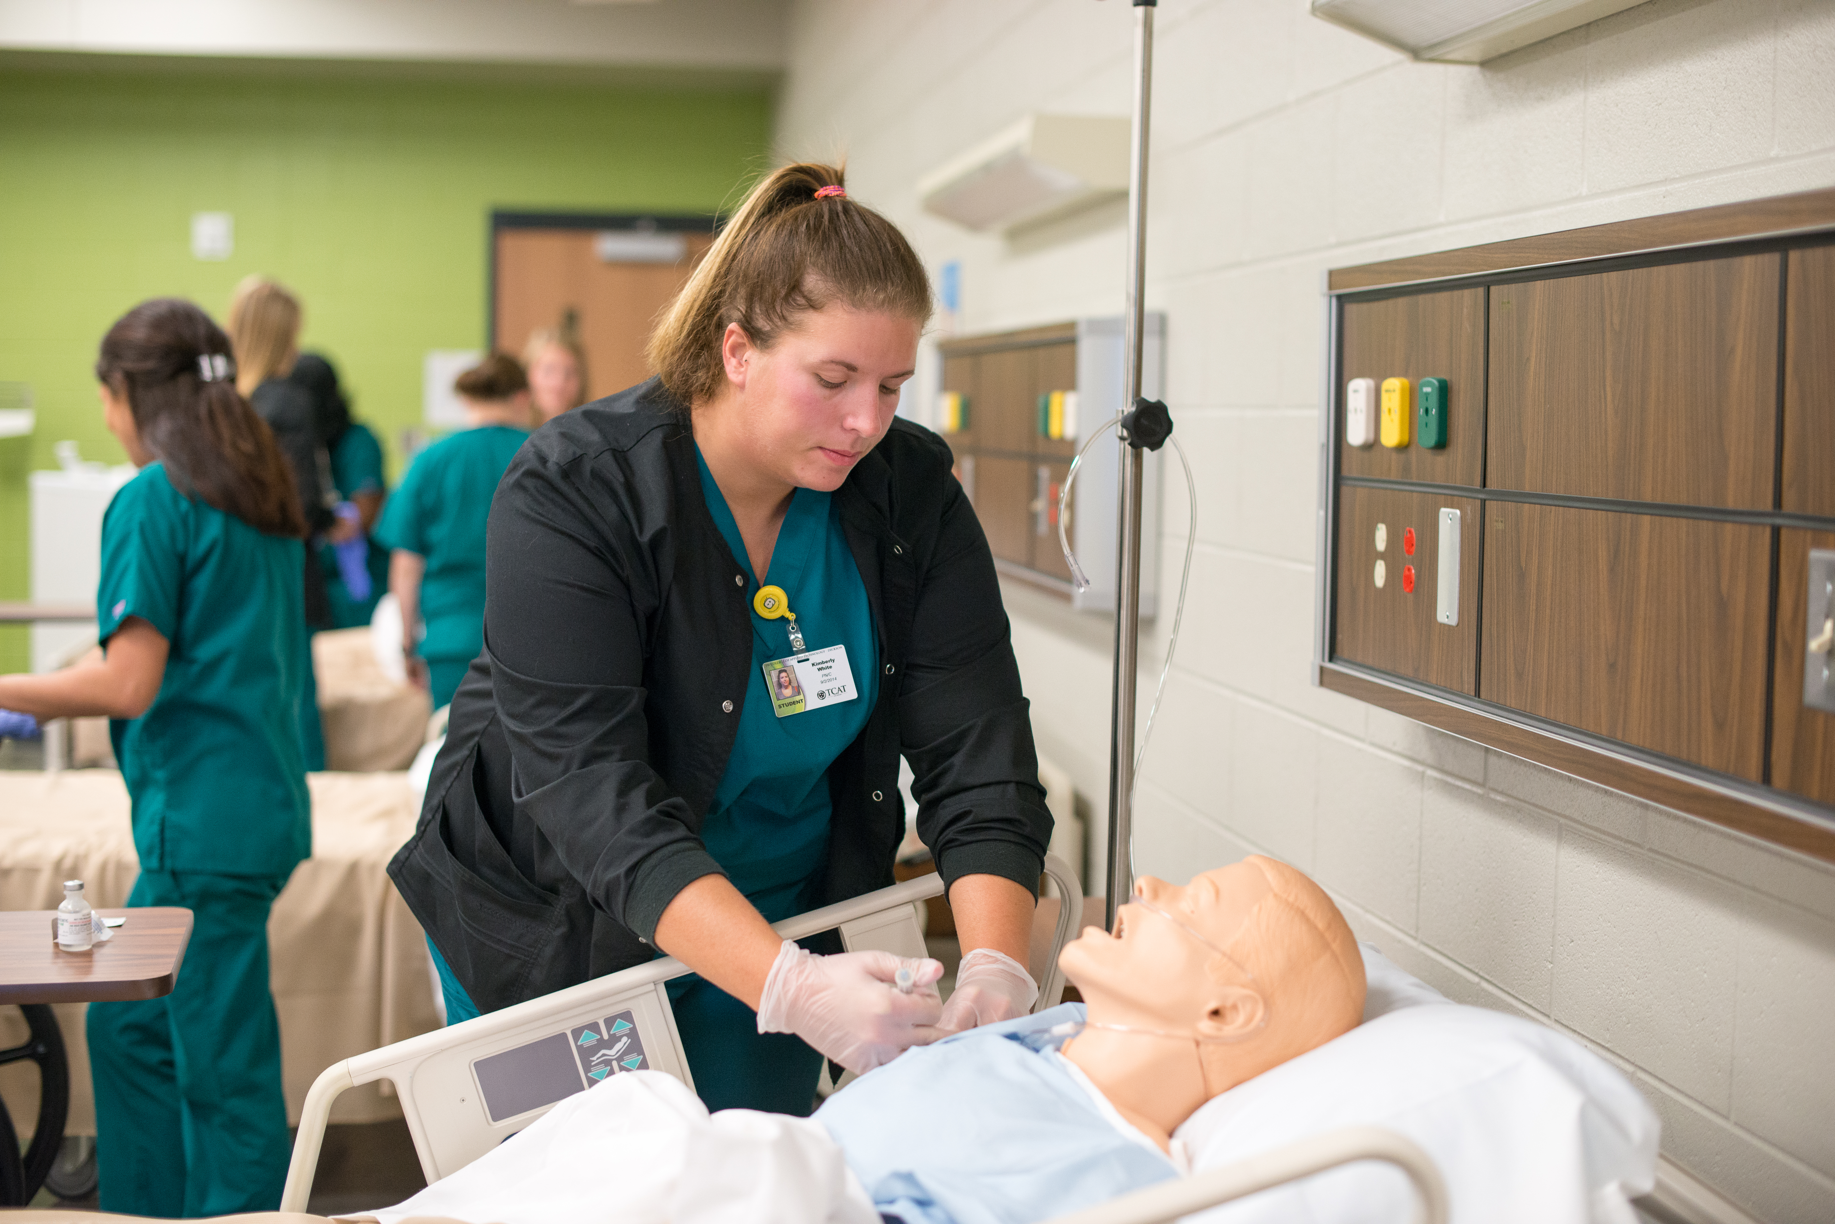
We Have it Going On
And we have more text to prove it with a pretty picture that has a shape mask.

Slide 3
We Even Have Dark Backgrounds
For content, of course.
  Which I think actually looks better.
But, yeah. Here it is for ya if you’d like.

Slide 4
THIS STUFF HAPPENS
And it happens here. Over and over and over and over and over and over and over and over and over and over and over and over and over and over and over and over and over and over and over and over and over andover and over and over and over and over and over and over and over and over and over and over and over and over and over and over and over and over and over and over and over and over and over and over and over and over and over and over and over and over and over and over and over and over and over and over and over and over and over and over again.

Slide 5
Something
Or Another. Just because.

Slide 6

Titles Shouldn’t Have Periods at the End
And more information. We also have laptop and phone masks so you can represent websites and things.

Slide 7
Dark, too?
Yes, we have this for the dark background too. And it’s totally OK to put a question mark at the end of the title.

Slide 9
ATTENTION PEOPLE.
LET’S GET STARTED.
This matters a lot. We should all pay attention.

Slide 10
Because it matters
This is a simple slide with a headline.
  You can even have more items here.
    And here.
      Really?
Pretty nifty, right?

Slide 11
Matthew Gann
Associate Director of Web Services and Digital Strategy
615-366-4412
matthew.gann@tbr.edu

