Slide 1
Council of Buyers
Year to Date Purchase and Spend Report by Supplier
Steps:
Reporting->Purchasing and Spending Reports->Spend Summary Reports->Spend by Supplier->Document Type is PO->Date Range->Apply->Export->Submit Request->Close->Reports->Report Exports and Extracts->Download Report Export & Extract Files->Click to Download->OK->Click to Open

Slide 2
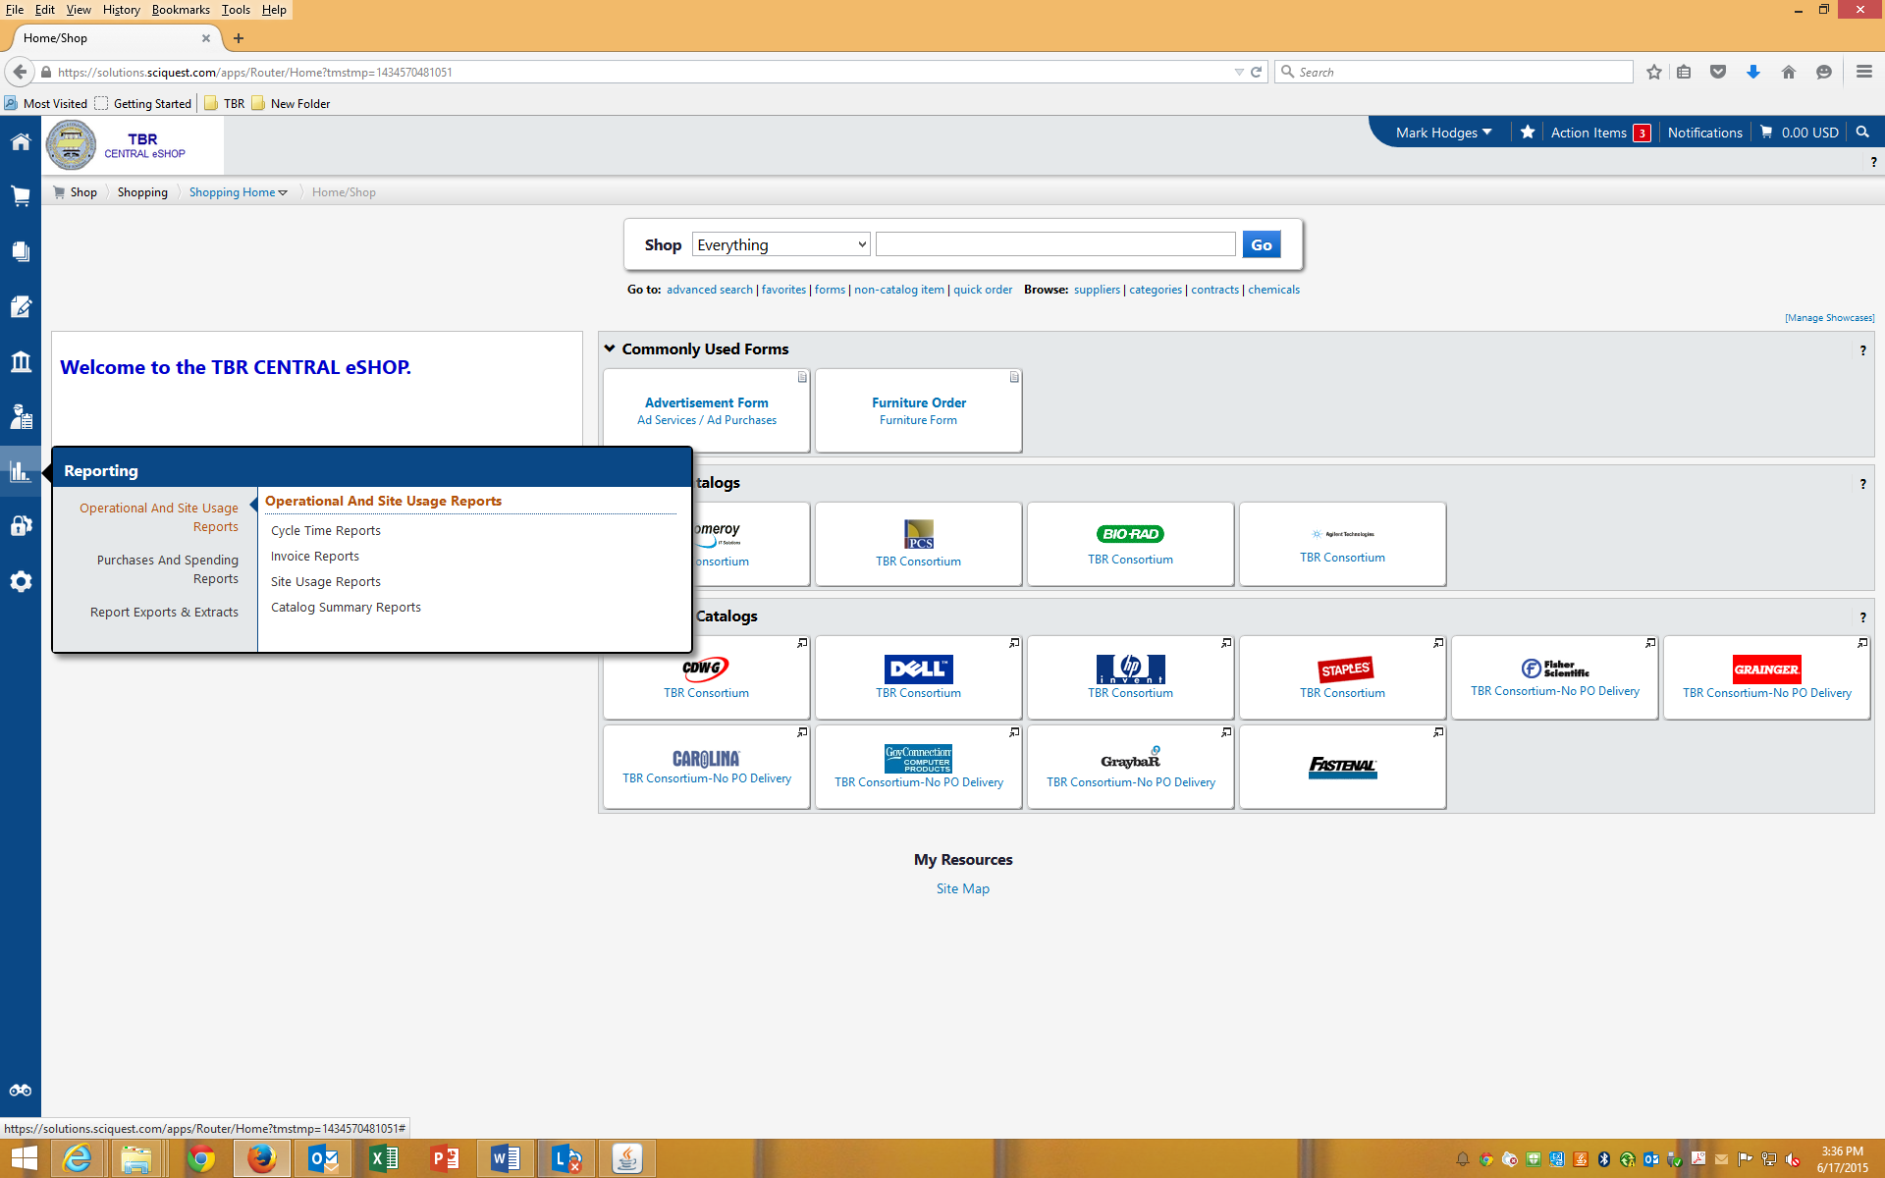
Click on Reporting

Slide 3
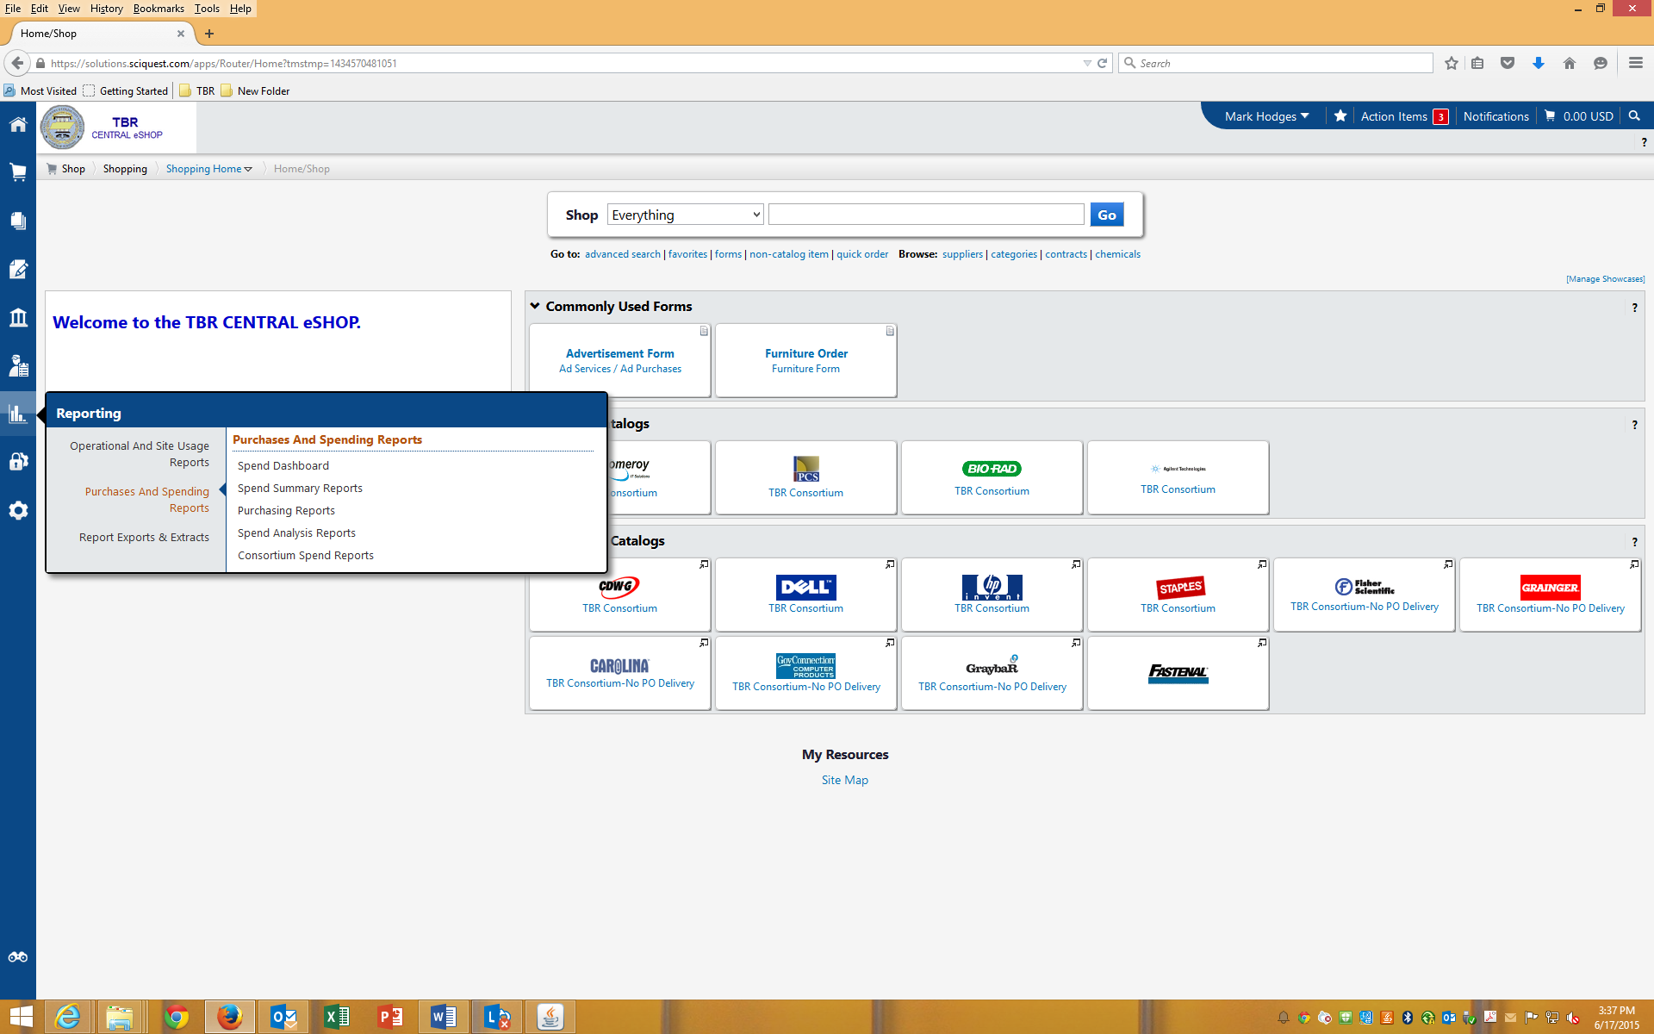
Click on Purchasing and Spending Reports

Slide 4

Click on Spend Summary Reports

Slide 5
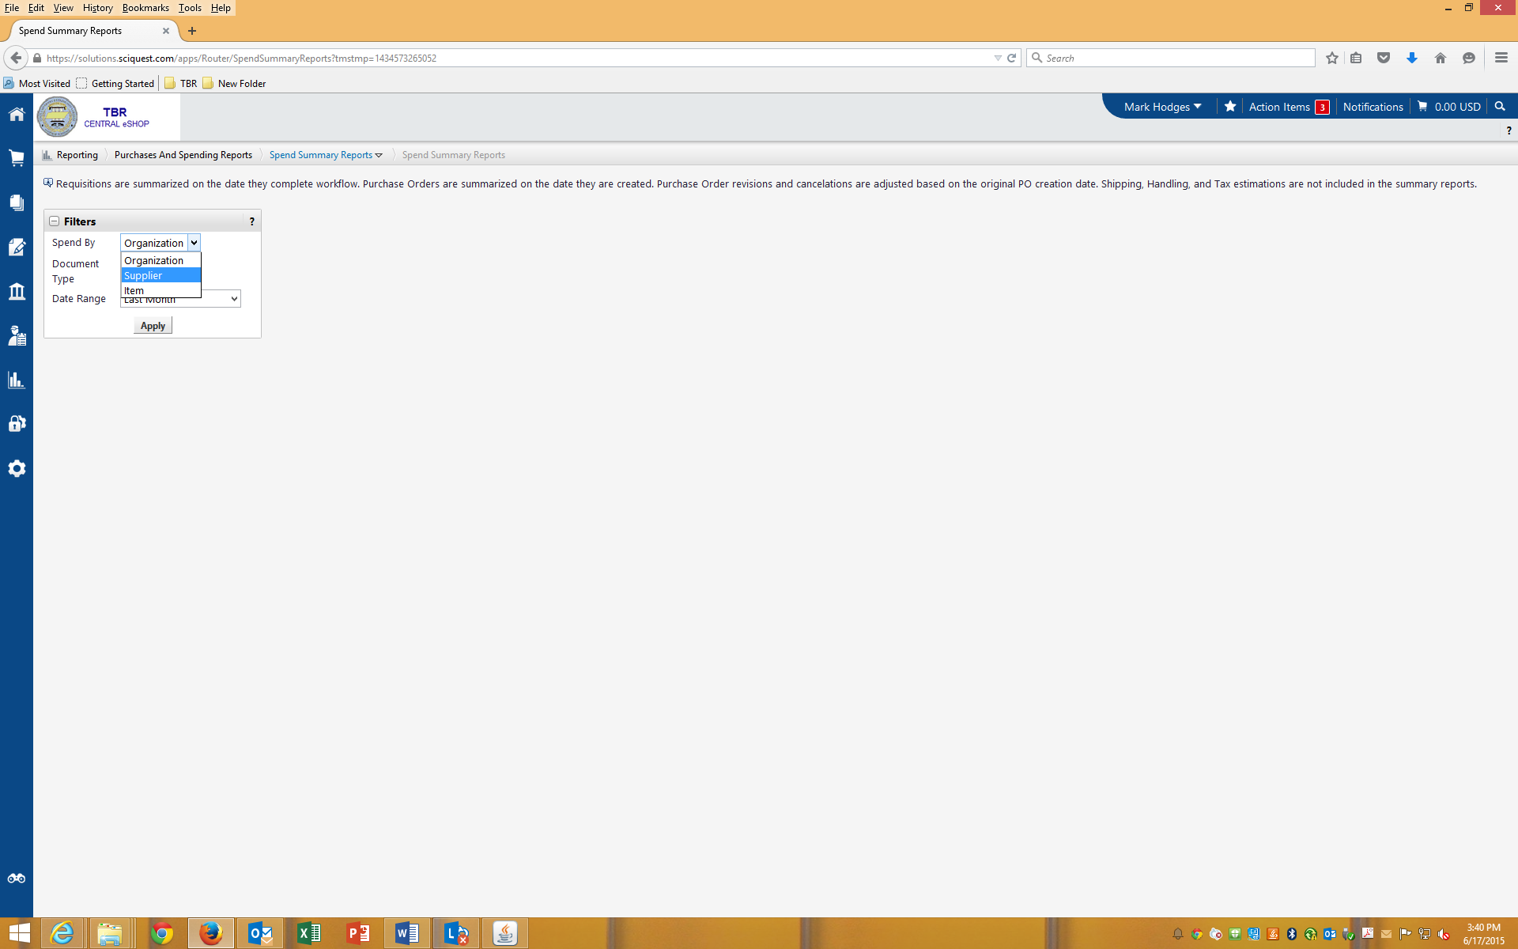
“Spend By” select “Supplier”.

Slide 6
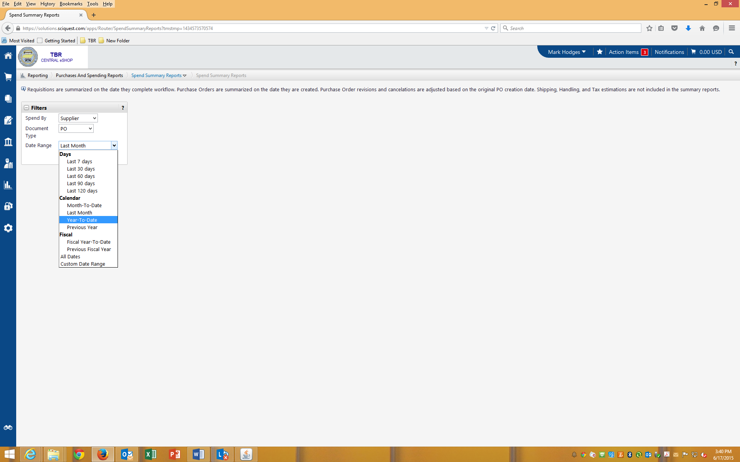
If you are able to run this report on 06/30/2015, select “Year to Date”. If you are unable to run this report on 06/30/2015, use the custom date range.

Slide 7
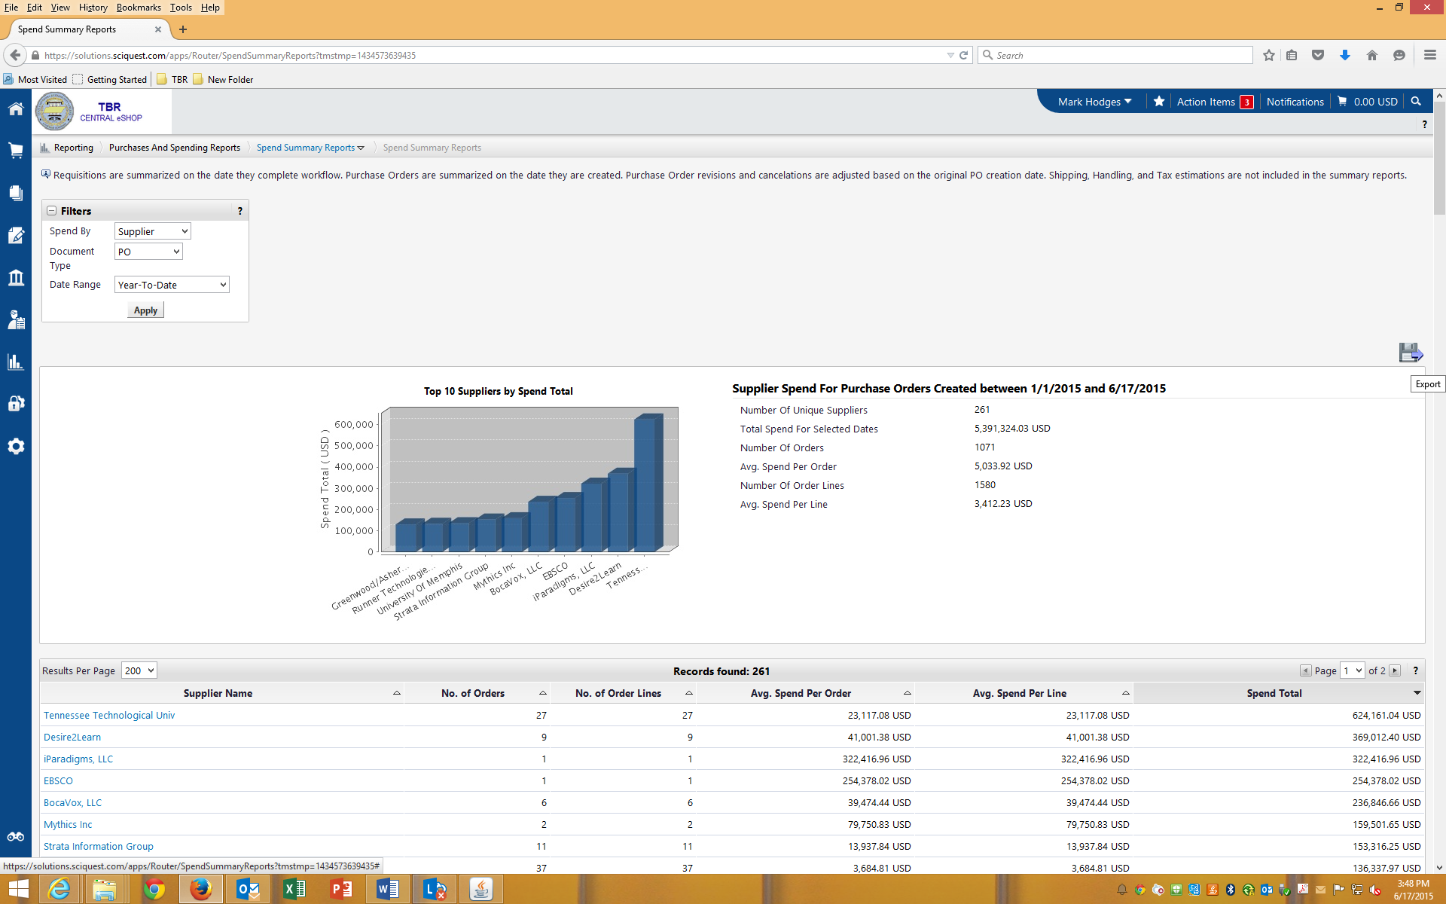
Click on Apply then Export

Slide 8
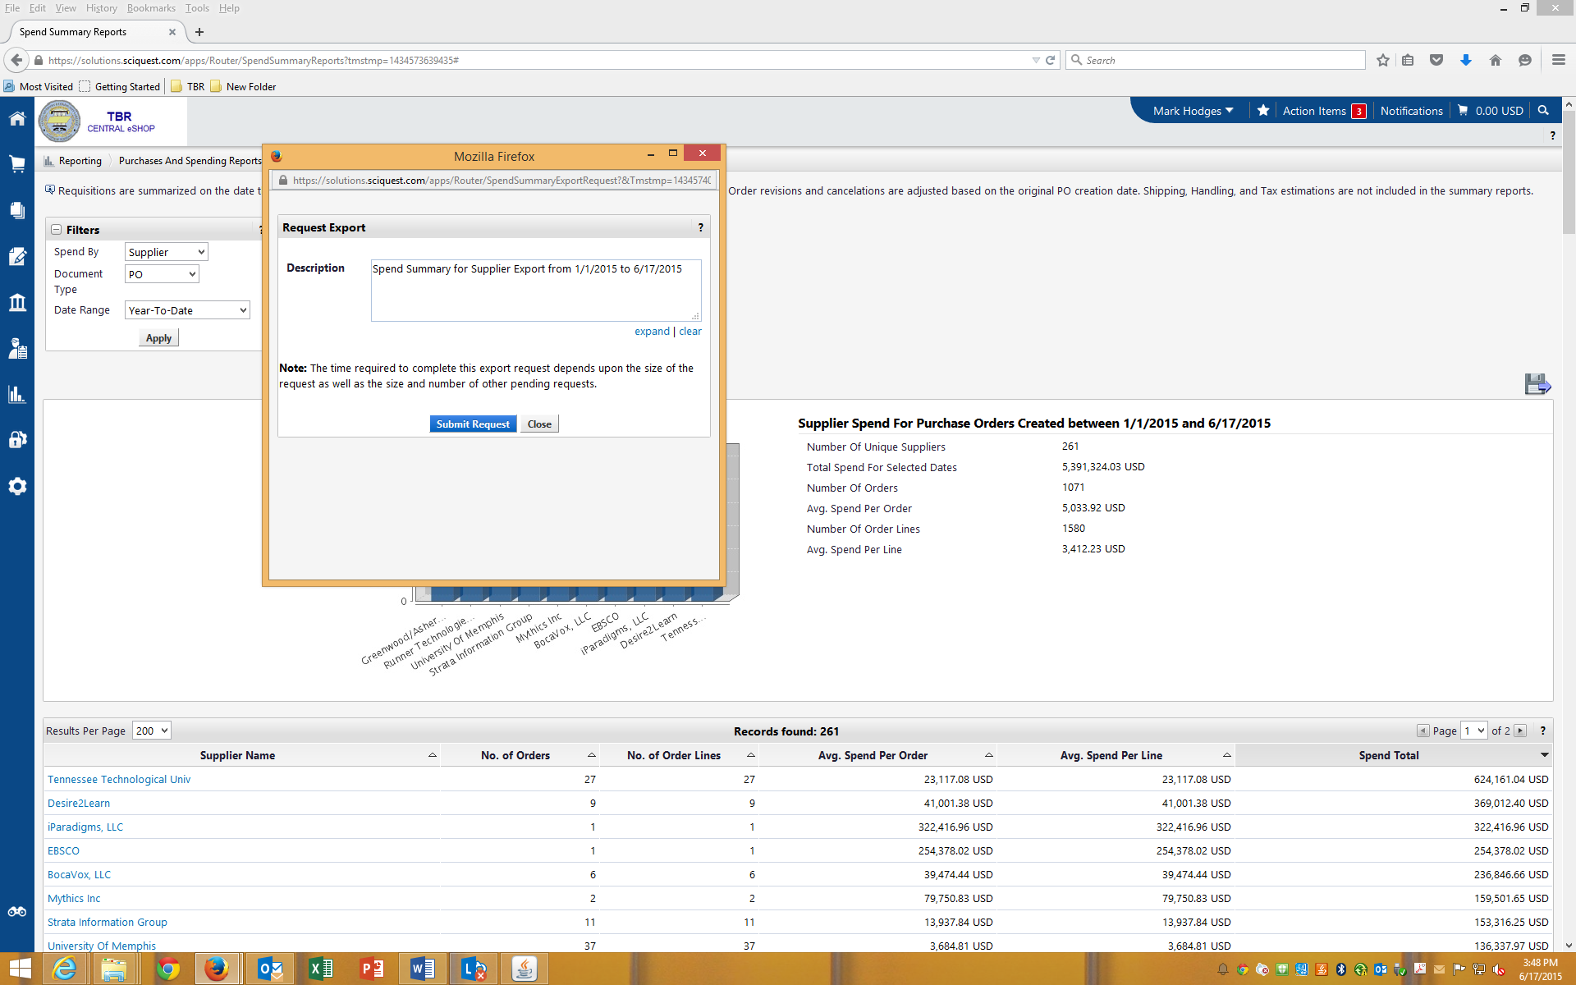
Click on Submit Request

Slide 9
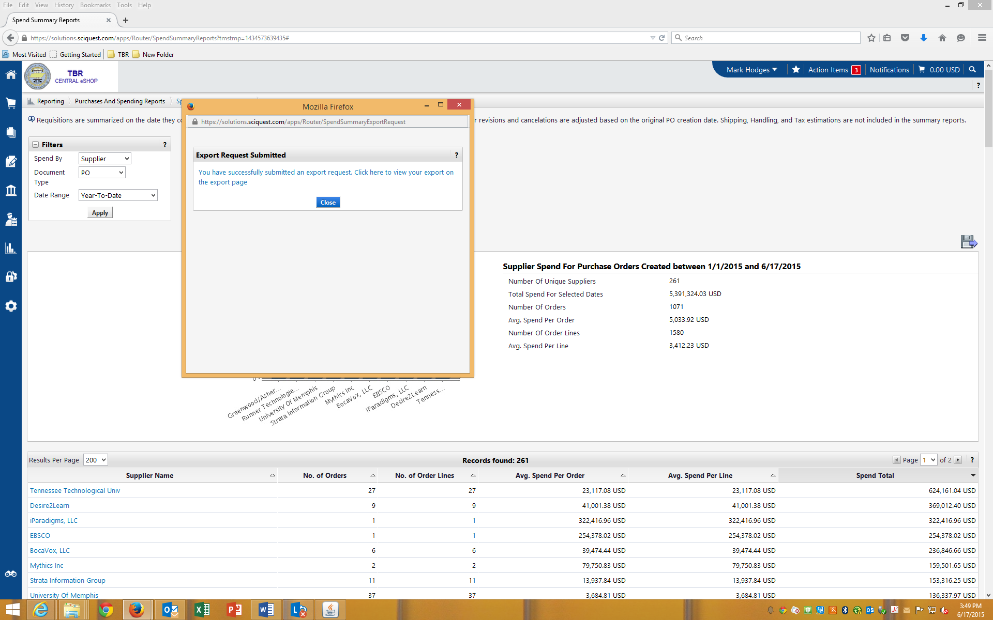
Click on Close

Slide 10
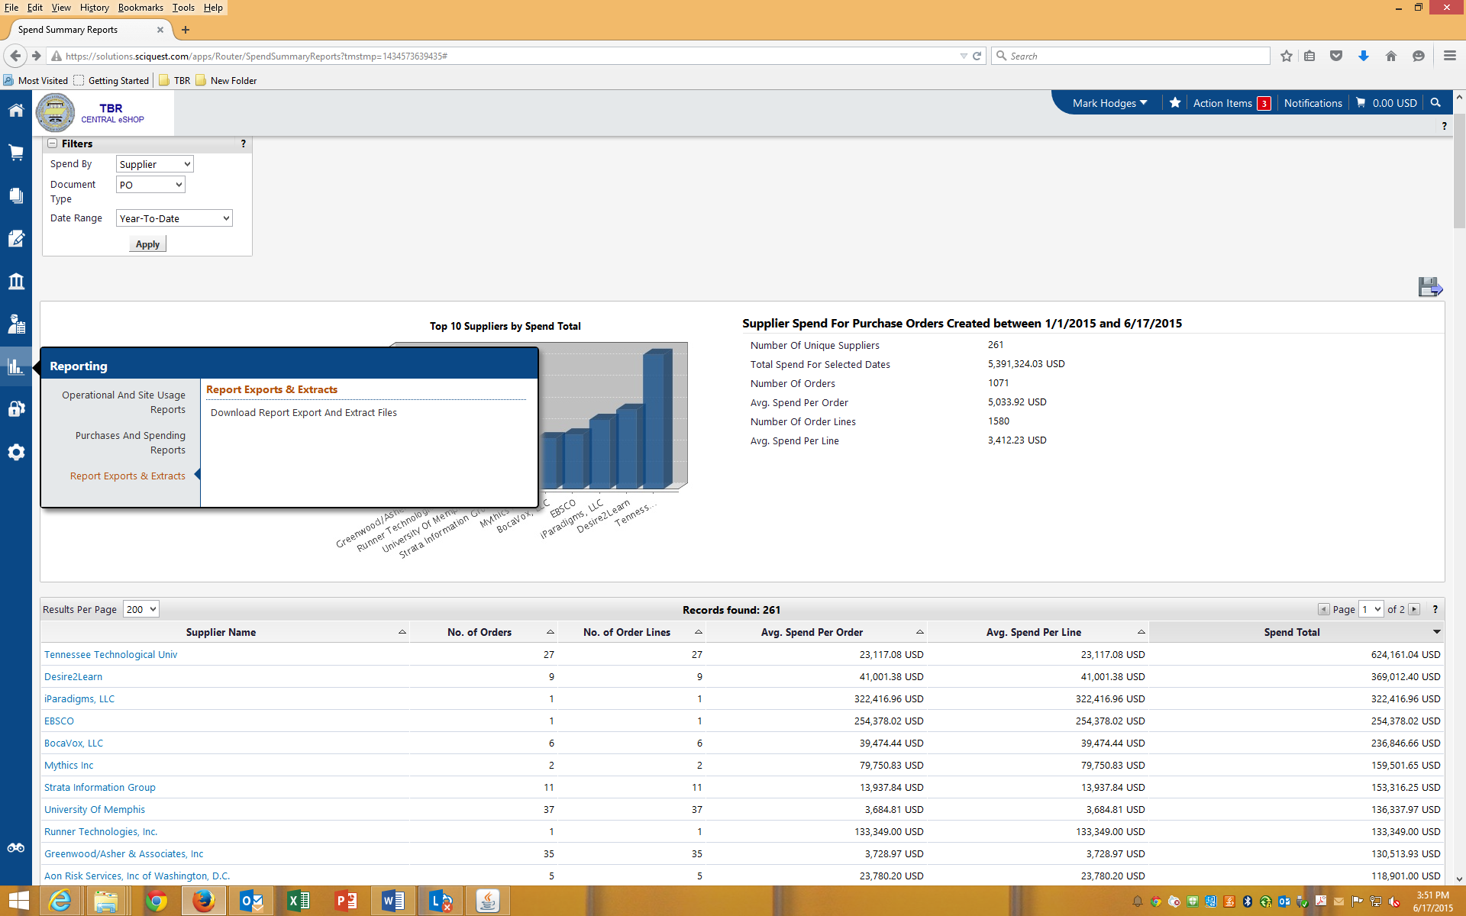
Click on Reporting->Report Exports and Extracts->Download Report Export & Extract Files

Slide 11
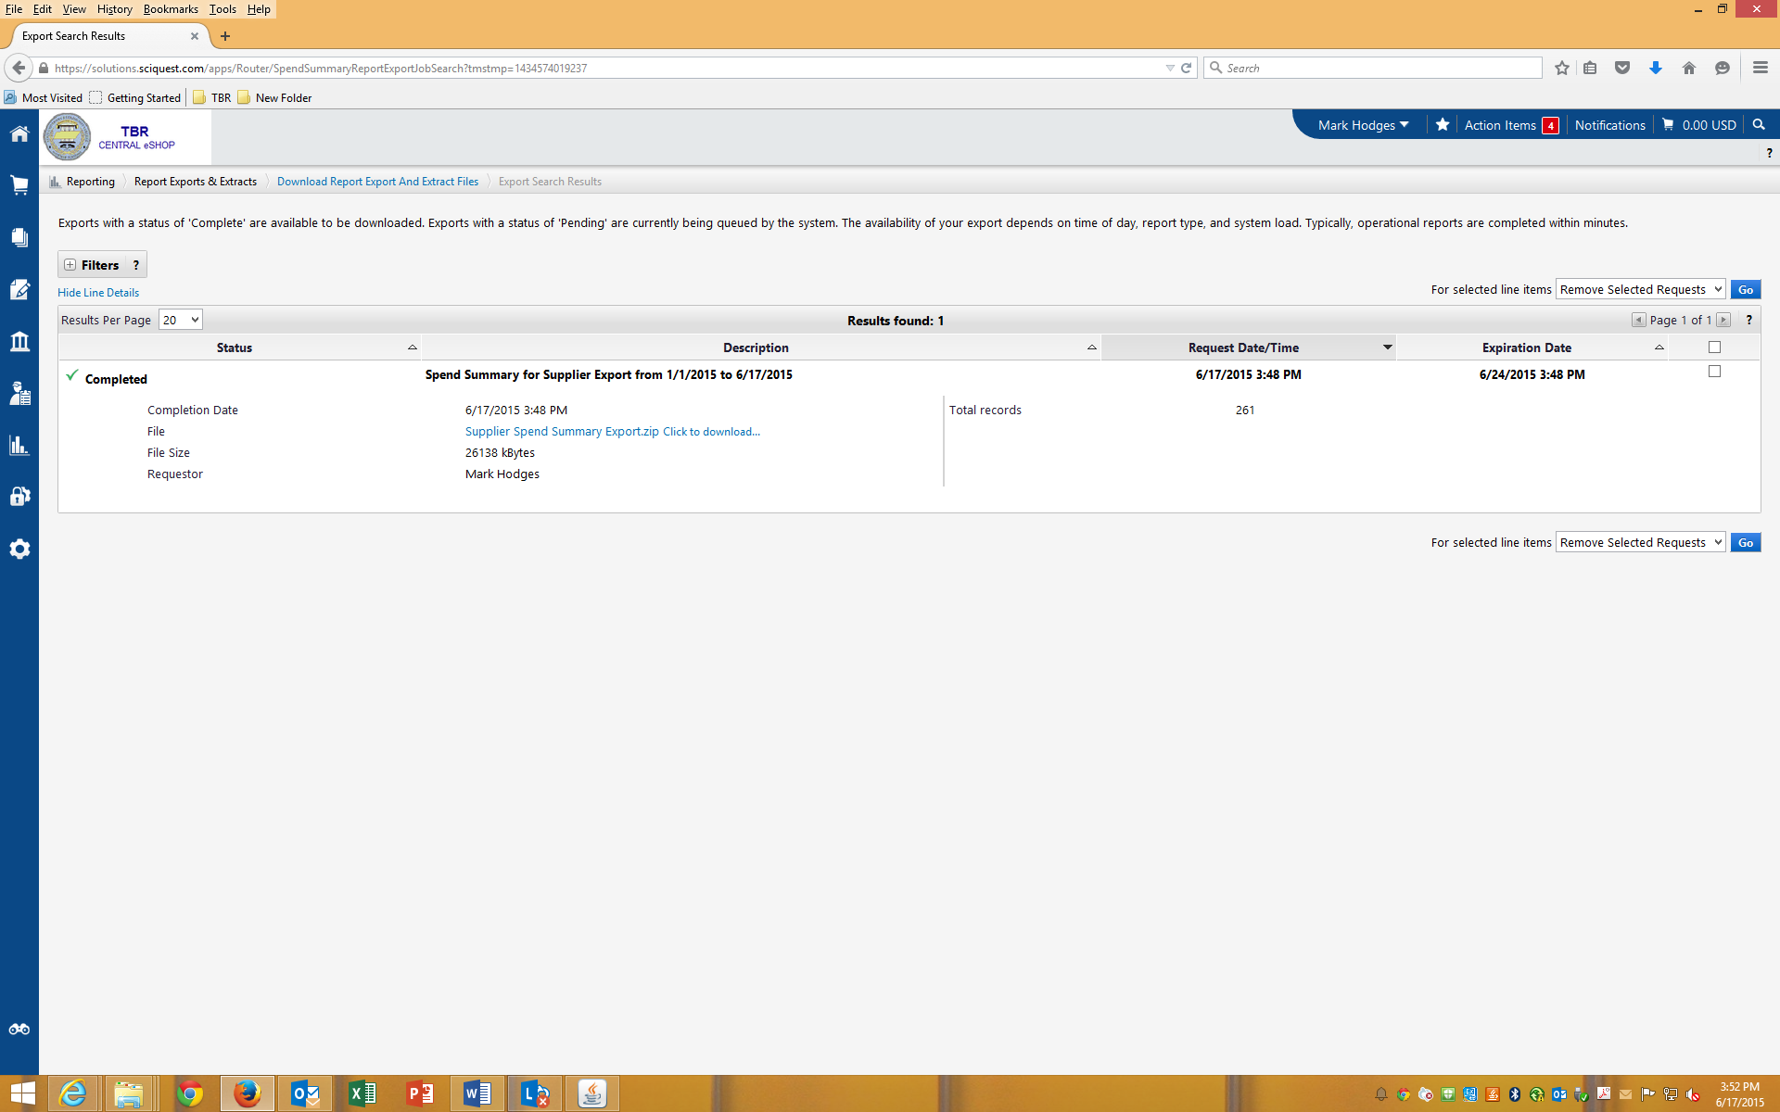
Click to Download

Slide 12
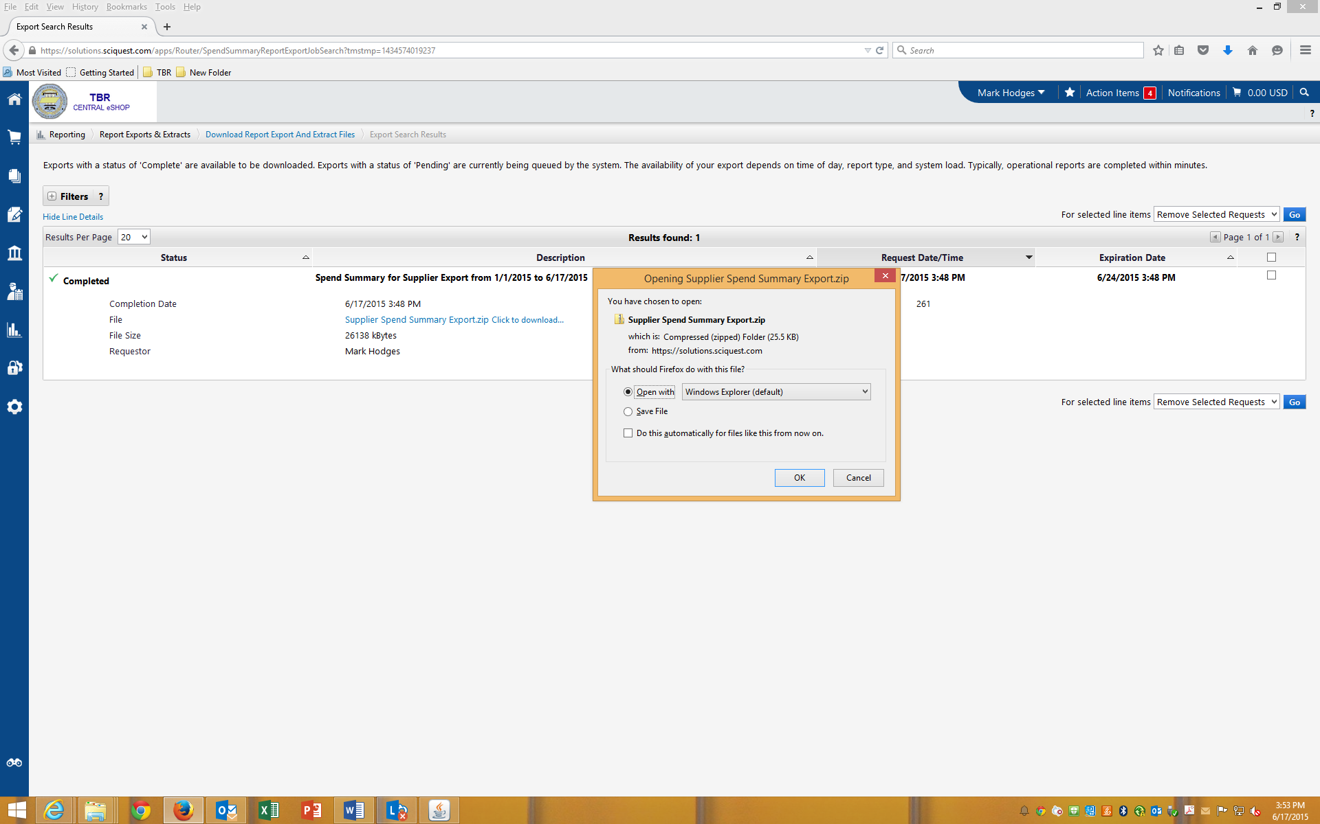
Click OK

Slide 13
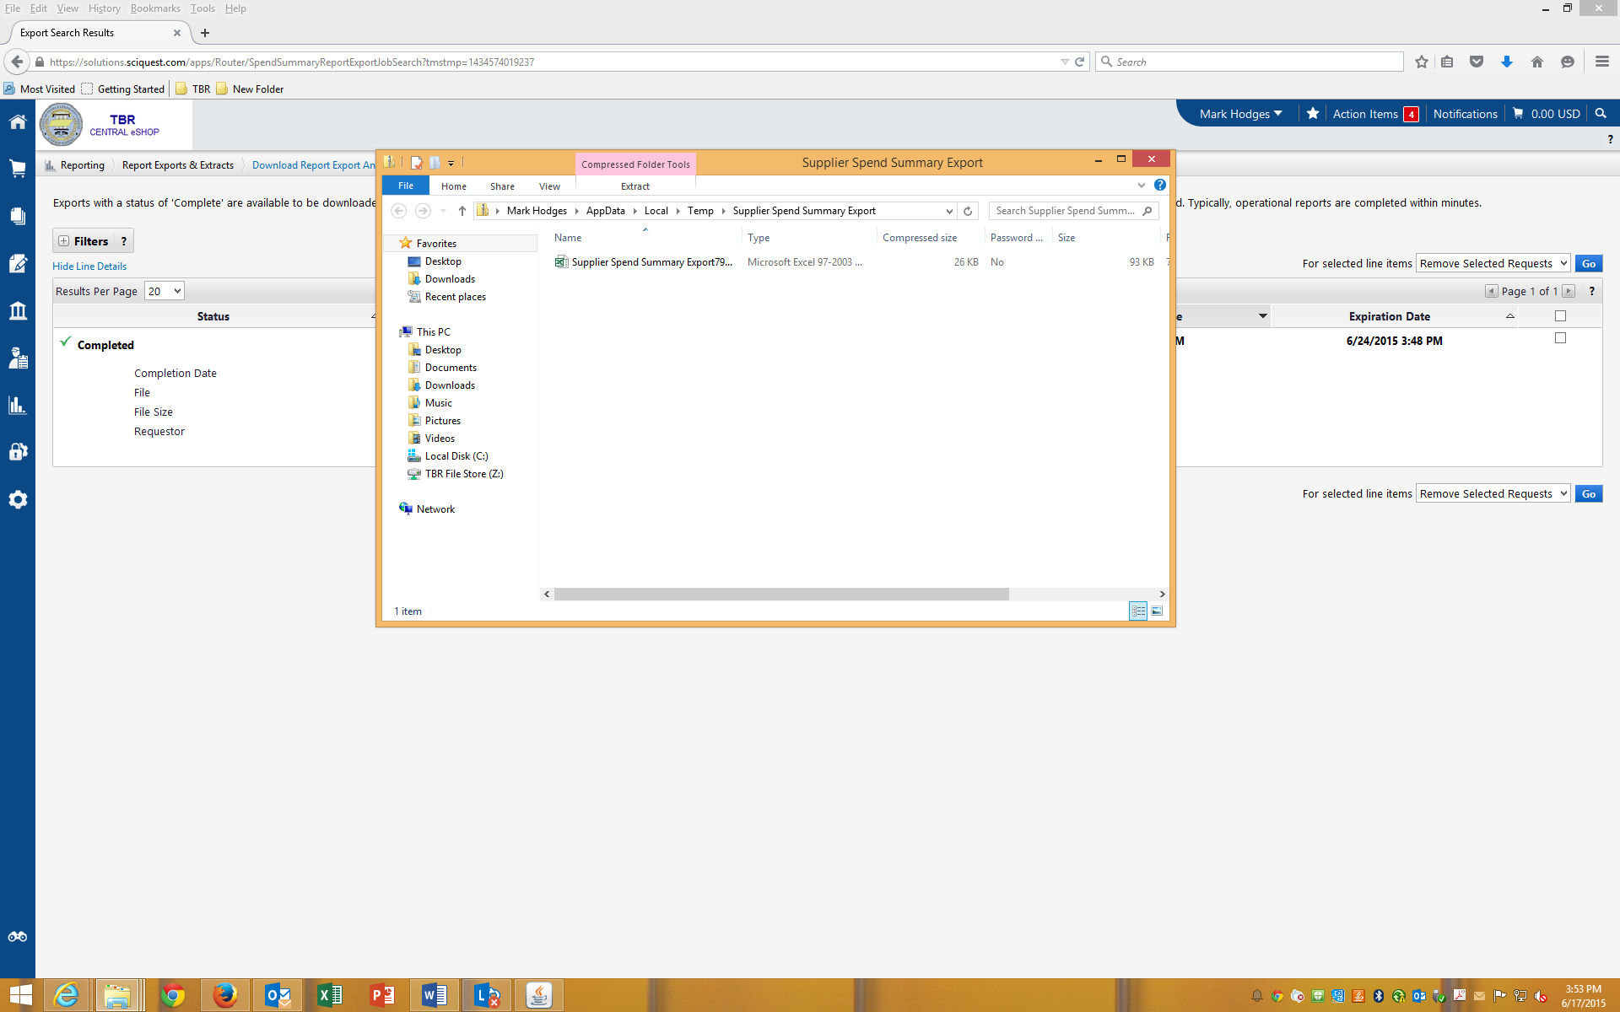
Click to Open

Slide 14
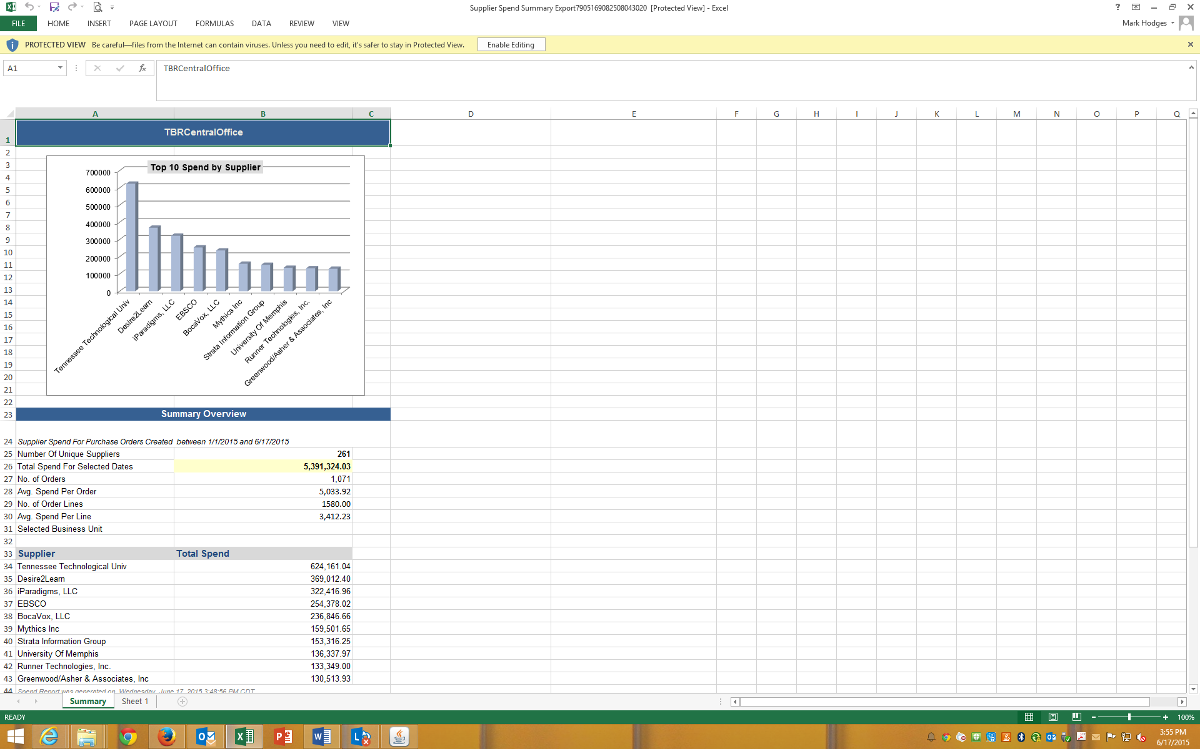
Sheet 1 of this Purchase and Spend Report by Supplier.

Slide 15
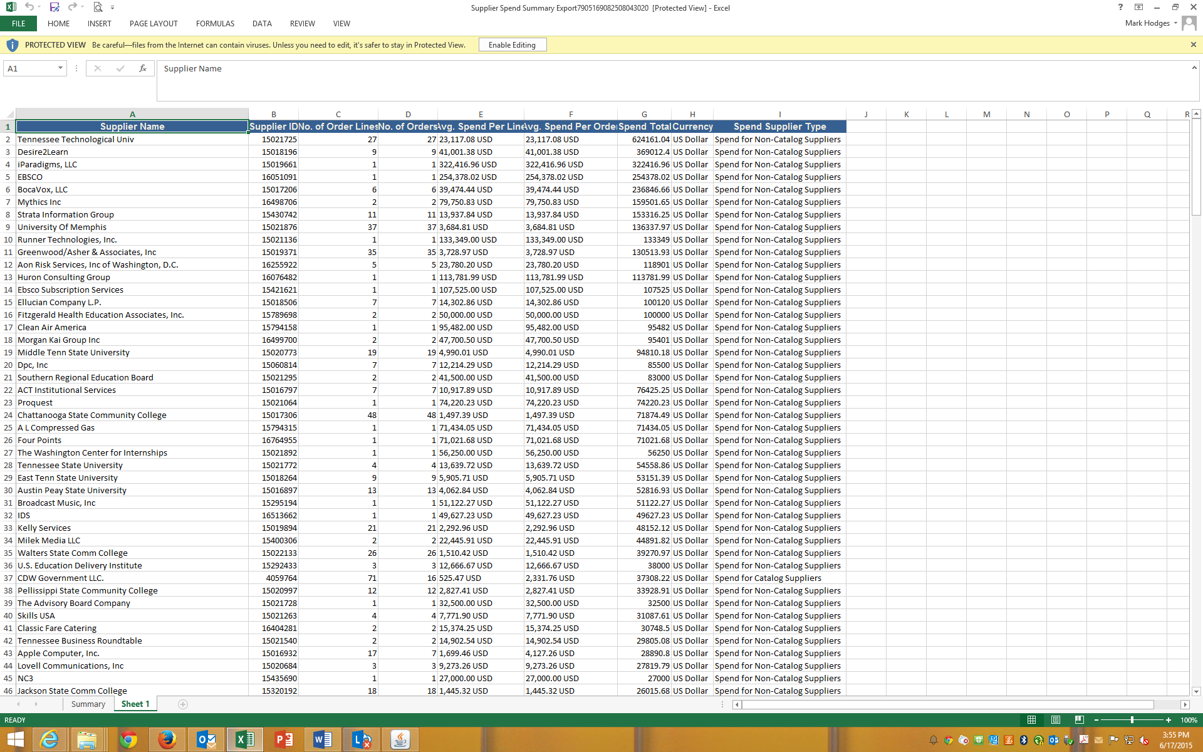
Sheet 2 of this Purchase and Spend Report by Supplier.

Slide 16
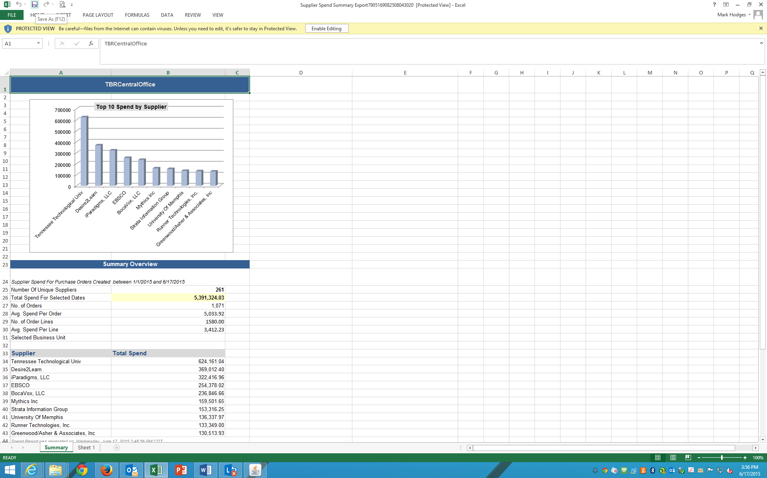
Save and name your file according to your institution and report type. As an example, this report would be named: TBR Systems Office Purchase and Spend Report by Supplier. Email this file to: Angela.Flynn@tbr.edu; Mark.Hodges@tbr.edu; Anita.Jansen@tbr.edu

