Slide 1
TBR Institution Guide to Updating Existing TSM Vendors and Entering New TSM Vendors Existing in Banner

Slide 2
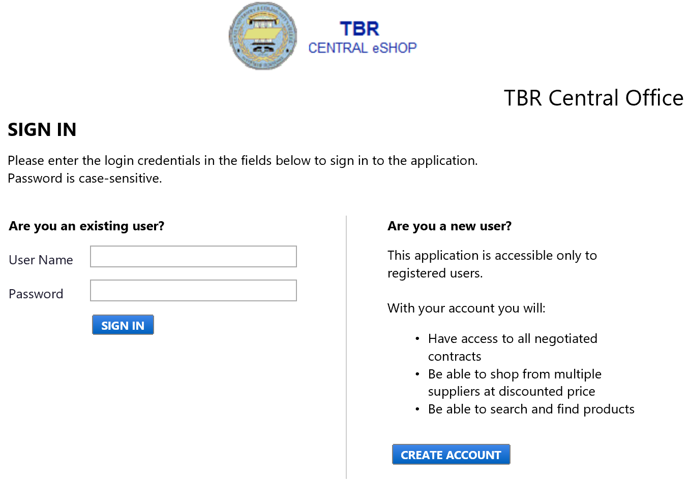
Accessing TSM
Visit the TBR Central eShop website via the link below
https://solutions.sciquest.com/apps/Router/Login?OrgName=TBRCentralOffice&URL=
Log in with you assigned User Name and Password

Slide 3
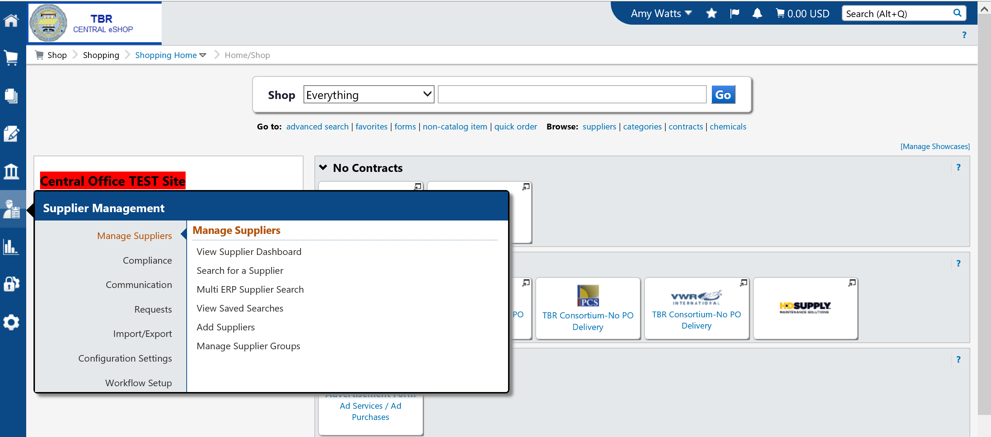
Perform a Supplier search before creating a new vendor!

Slide 4
Selecting Search for a Supplier will search all vendors system-wide. Selecting Multi ERP Supplier Search will search within your institution up to 4,000 vendors. SciQuest only has 4,000 loaded in this section for performance purposes.

Slide 5
Select search system-wide: Type the name of the vendor in the search field and select ‘GO’.

Slide 6
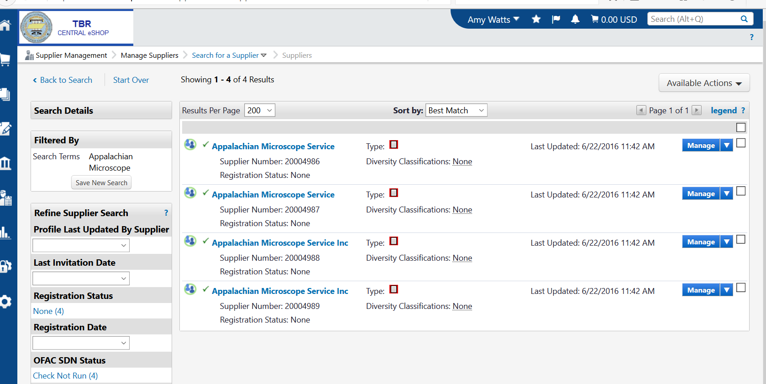
View the History of all vendors listed to see which one is linked to your school. Select the supplier linked to your school by double clicking on the name.
UPDATING EXISTING VENDORS

Slide 7
Select the sections in the left hand column to update specific vendor information. Do not select ‘View Supplier Registration’ if the vendor has not registered. Doing this will force you to complete information you do not know for the vendor. Updating from the side sections will allow you to only update with the information you have on hand.

Slide 8
View History once all corrections/updates have been made.

Slide 9
Changes will automatically sync and update the vendor record for the institutions linked in the history with this vendor .

Slide 10
Entering a New TSM Vendor who already exists in your Banner System Option 1 – Institution enters the information (new to your Banner since initial data upload to SciQuest in Spring 2016)

Slide 11
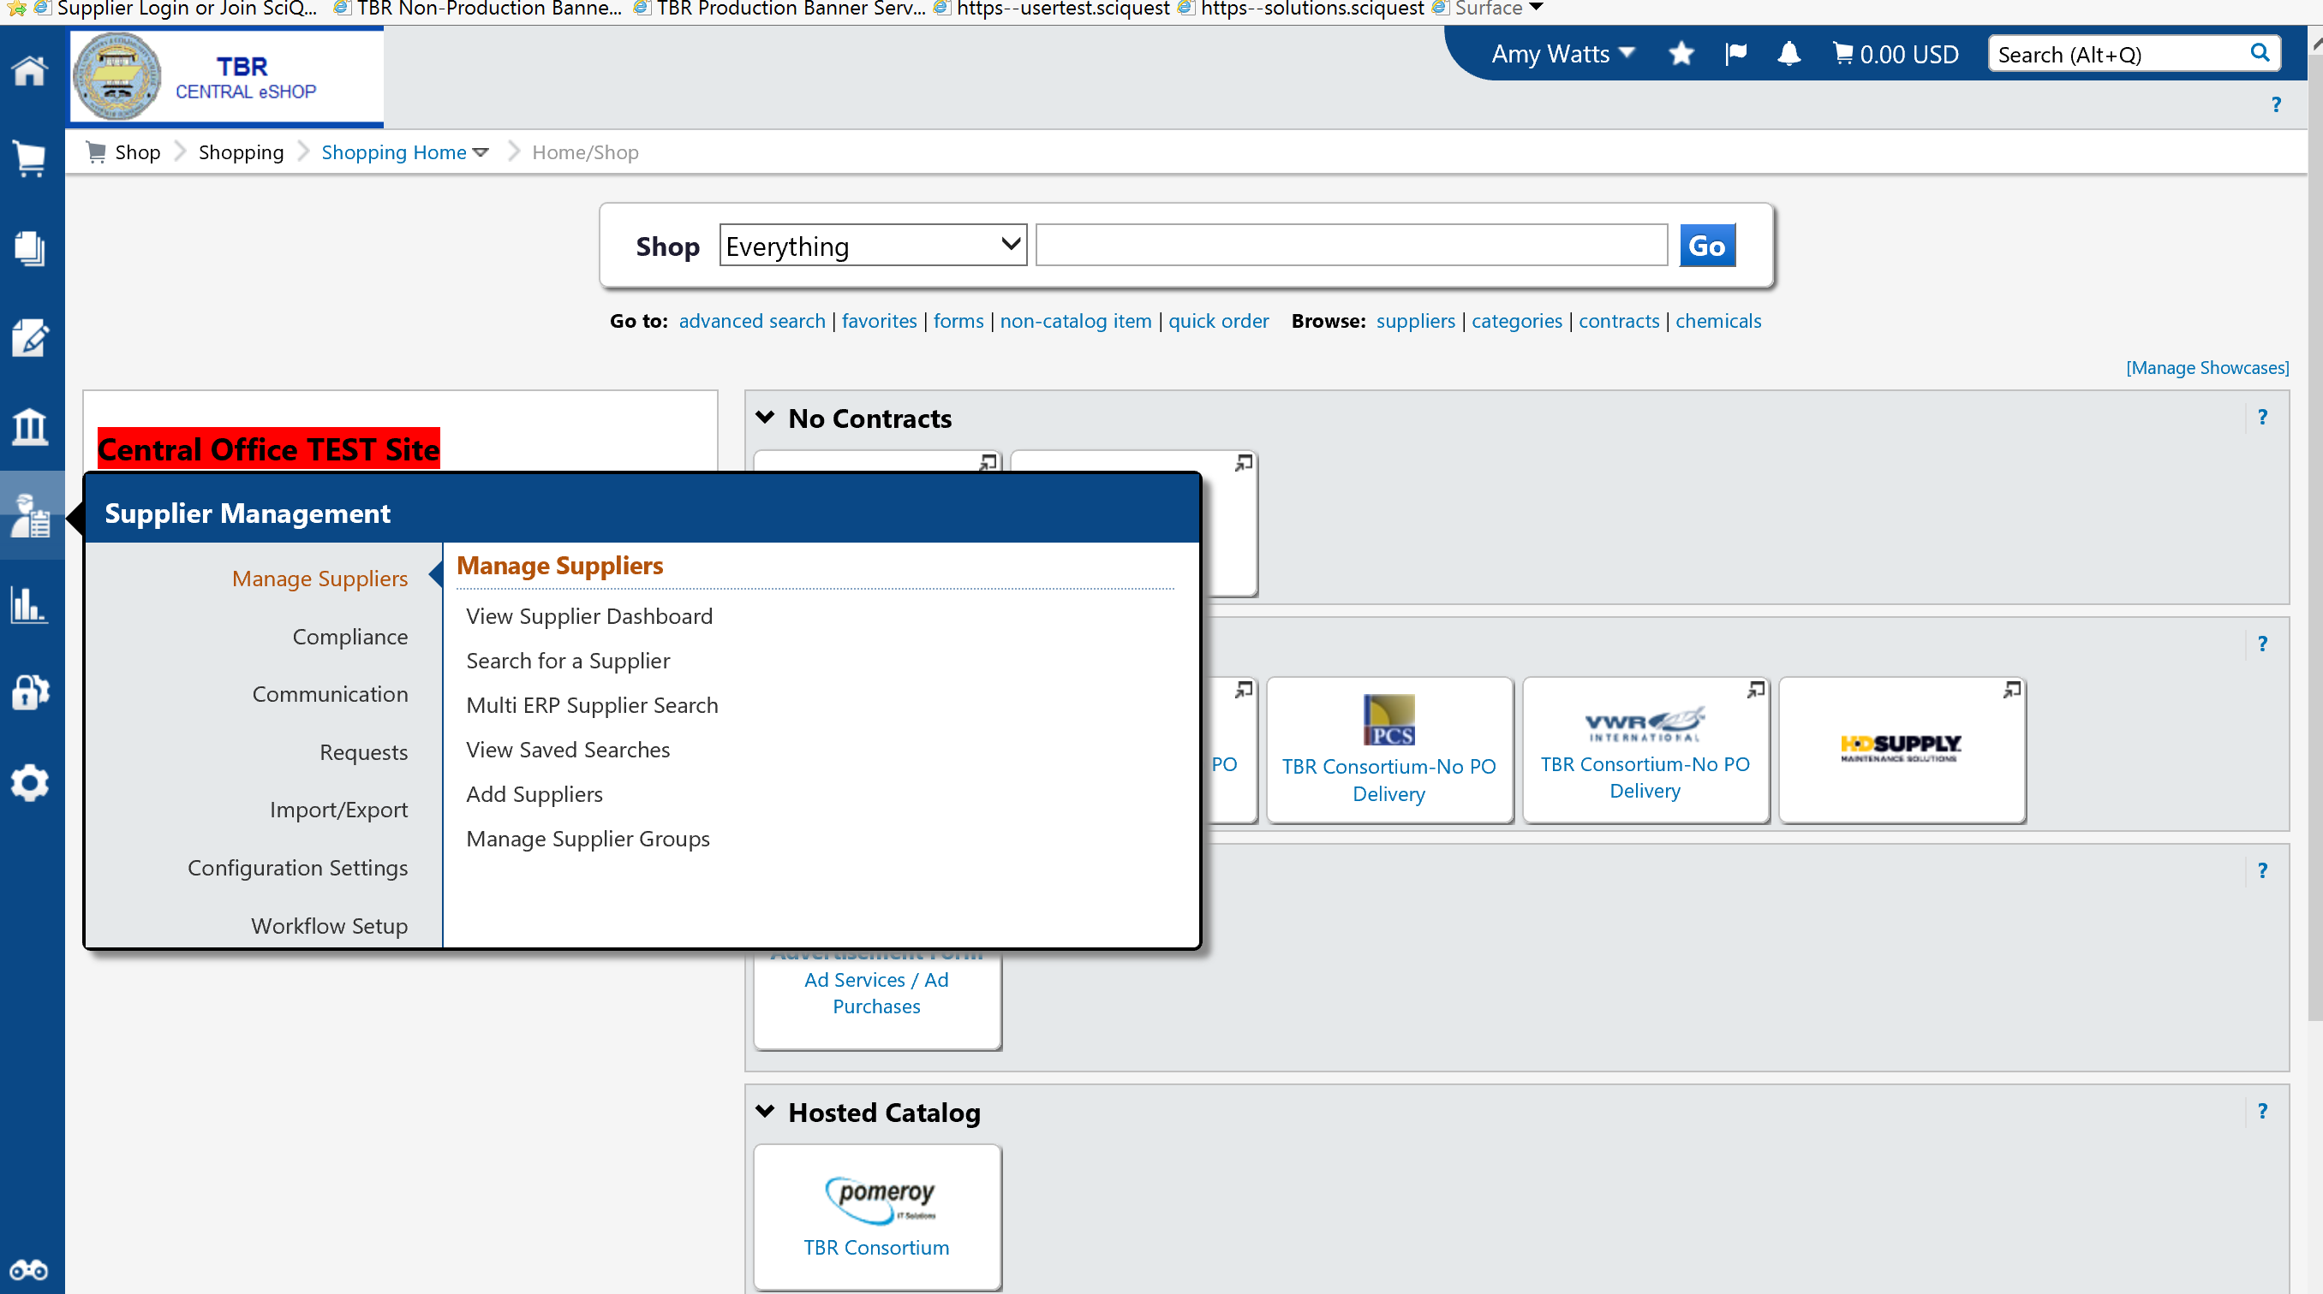
Select Add Suppliers

Slide 12
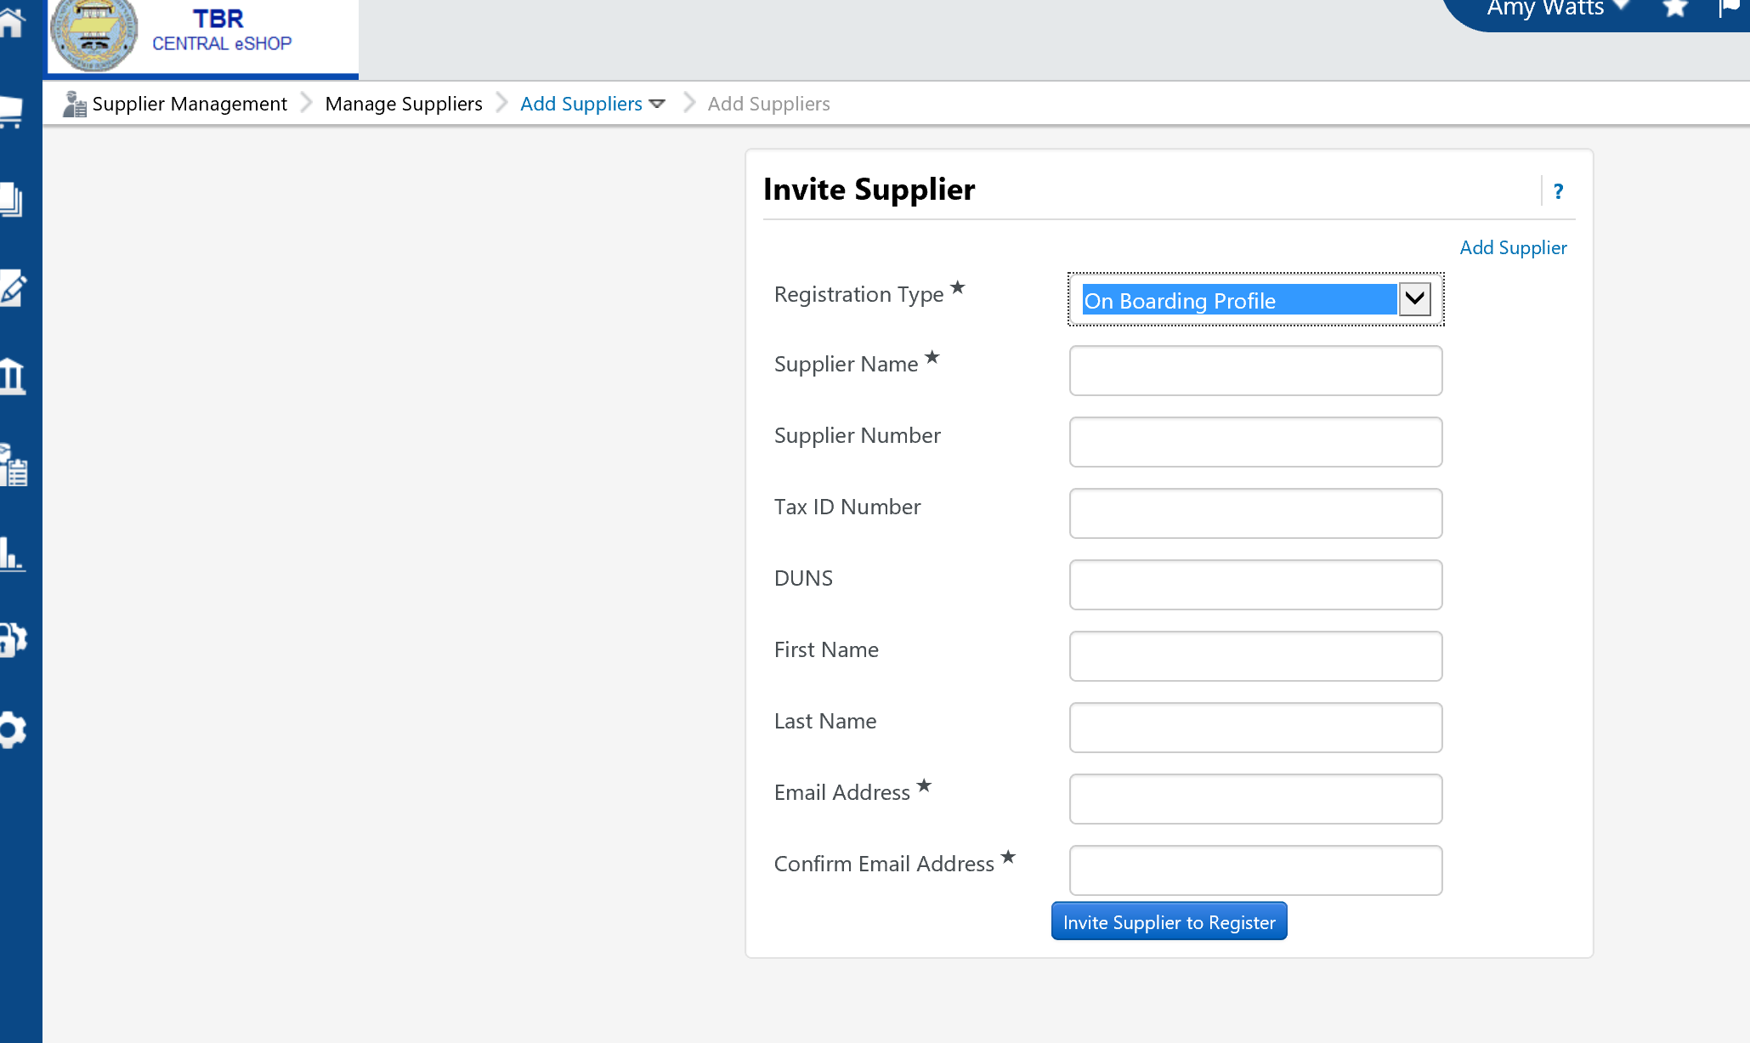
Select Add Supplier and select On Boarding Profile Registration Type

Slide 13
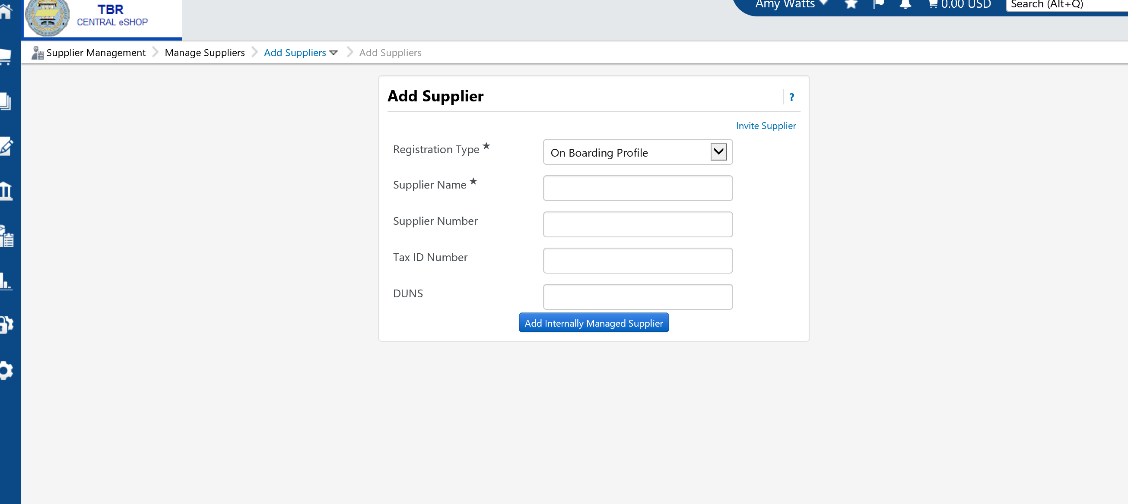
Add the Supplier Name, Banner ID, and Click Add Internally Managed Supplier
Enter Supplier Name here
Enter your Banner ID here

Slide 14
Select sections on the left side to enter vendor information you have on file.

Slide 15
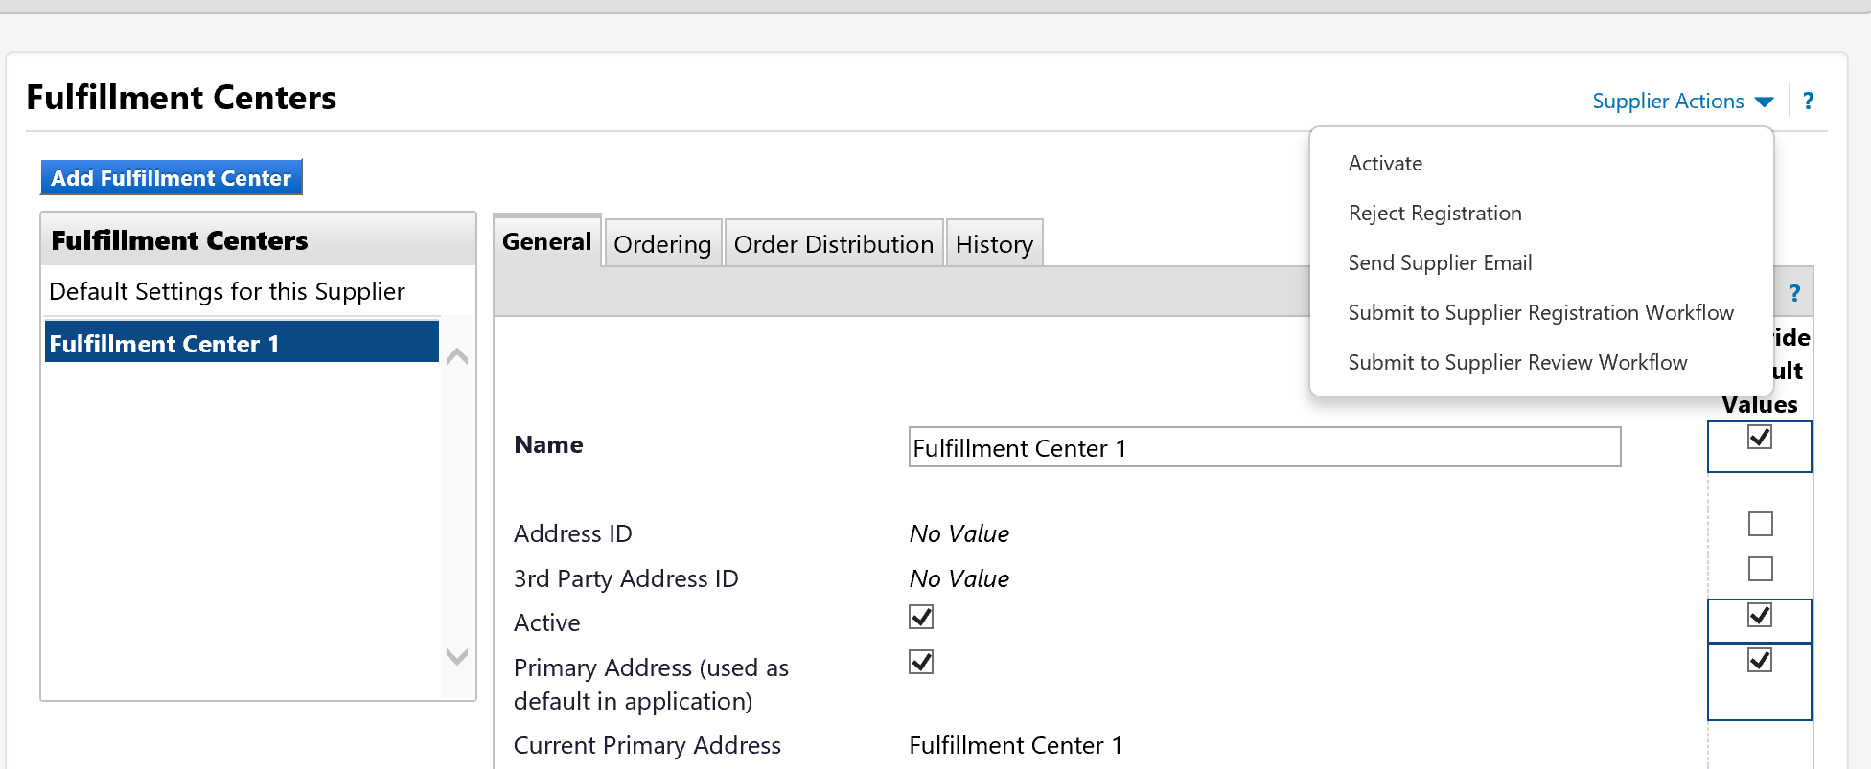
When all the information you have is entered, go to Supplier Actions and select Submit to Supplier Registration Workflow

Slide 16
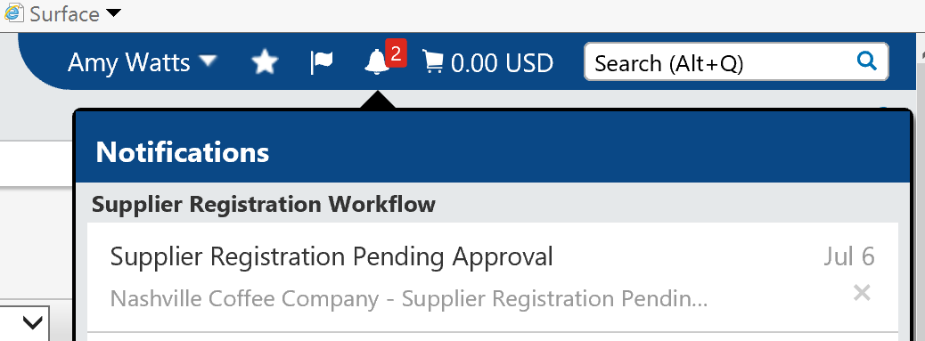
The TBR System Office will receive a notification and approve the vendor.
You will then receive an email/notification that the vendor has been approved and the vendor is now ready for you to perform the sync to your school.

Slide 18
Entering a New TSM Vendor who already exists in your Banner System Option 2 – invite the supplier to update/complete their registration

Slide 19
Select Add Suppliers

Slide 20
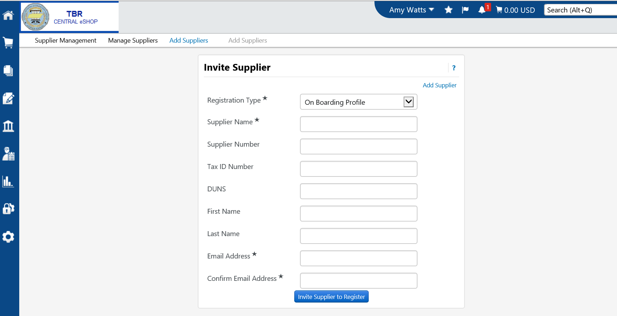
Registration Type = On Boarding Profile. Enter Supplier name, your school’s Banner ID & other information if you have it. Confirm email address and click Invite Supplier to Register. The vendor will receive an email with directions to register. You will receive email notification when the vendor has completed registration.
Vendor Banner ID goes here

Slide 21
The TBR System Office will receive a notification and approve the vendor.
You will then receive an email/notification that the vendor has been approved and the vendor is now ready for you to perform the sync to your school.

