Slide 1
Quarterly Board Meeting
Chattanooga State Community College
September 16, 2016

Slide 2
Report of Interim Action

Slide 3
Report of the Committees

Slide 4
Report of the Regents Award in Excellence in Philanthropy
Regent Fran Marcum
September 16, 2016

Slide 5
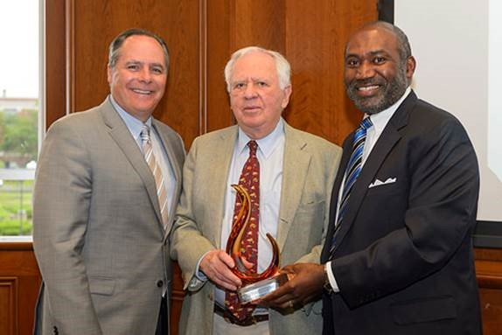
The University of Memphis
Regents Award Ceremony
President David Rudd, Mr. Robert Fogelman and Regent Greg Duckett

Slide 6
Report of the Chancellor

Slide 7
AT&T Aspire Scholarship Presentation

Slide 8
Quarterly Board Meeting
Chattanooga State Community College
September 16, 2016

Slide 9
Report of the Chancellor

Slide 10
Completion Update
1. Progress Towards the 2025 Goal
2. Completion Agenda Update
3. Strategy Highlight
Notes:
Each September you receive a full report on the system’s completion agenda. There are 3 parts – a look at how we did the past year in terms of progress on our trajectory to 43,202 credentials in 2025
As well as an update on specific programs or challenges. And finally, we try to highlight one of our completion priority strategies for you.

Slide 11
Progress Towards the 2025 Goal
Notes:
In terms of our progress towards our goal, Dr. Denley gave a comprehensive look at our credential production over the past year.

Slide 12
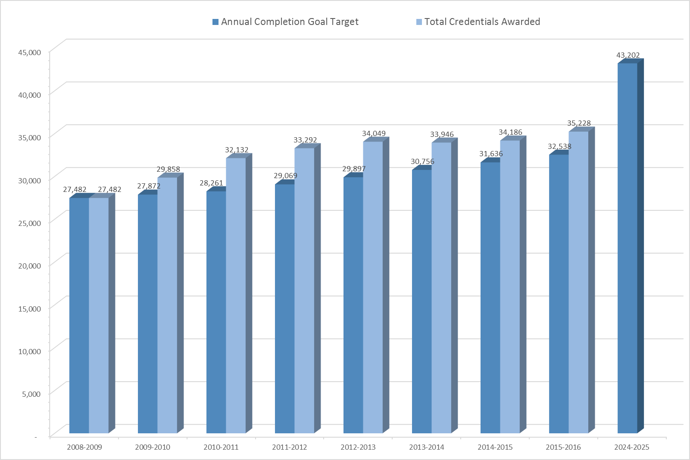

2015-2016 COMPLETION GOAL PROGRESS
Notes:
But when we our institutions excel we like to celebrate their accomplishments, As we say often, the Tennessee Board of Regents system does not award any degrees or credentials. That work is done on our campuses and hopefully, with our help and support. I am pleased to report that our institutions collectively exceeded our target of 32,538 and awarded 35,228 credentials.

Slide 13
Completion Agenda Update
Notes:
So, that was last year and while we are pleased, we are looking forward. I want to now update you on some specific work going forward..

Slide 14
GUIDING POLICIES:
TBR 2010-2015
Strategic Plan
(2009)
Drive to 55
(2012)
TBR 2015-2025 Strategic Plan
(2015)
THEC Public Agenda (CCTA)
(2010)
TN Promise
(2015)
TBR
COMPLETION GOAL
FOCUS ACT
(2016)
Notes:
First, I want to give some background to those new to our system and refresher to those who aren’t. The TBR Completion agenda was established in 2011 in response to the CCTA and the TBR Strategic plan. Over time other statewide initiatives have provided additional components to our efforts, but our goal has remained the same.

Slide 15
Notes:
And this chart shows the breakdown between universities and TCATS and Community Colleges

Slide 16
Notes:
This chart shows the breakdown for those credentials between the community colleges and TCATS

Slide 17
Notes:
This chart shows the breakdown for universities by credential type.

Slide 18
TBR
COMPLETION GOAL
Priority Strategies
Completion Agenda
Notes:
So I have shared with you information about our numerical goal. Once we established our goal we set about establishing the ways that we would reach the goal. Our goal plus our strategies equal our completion agenda, So briefly, I want to recap our strategies.

Slide 19
Priority Completion Strategies
System Level Strategies
Architected Choice | Data Driven Decision Making
Articulated Paths | Degree Attainment Efficiencies
Community, Belonging, and Inclusion | Increasing TCAT Capacity
Community College Administrative Efficiencies | Minding the Gap
Community College State-wide Marketing & Advocacy | Online Learning
Notes:
A few years ago we refined a list of strategies that we thought would be priority strategies to drive completion. These are system strategies that we believe would have the most impact on student success and were either 1) lead by the system office or 2) involved multiple campuses. This list of 10 priority completion strategies has changed only slightly over the past few years. The completion goal and these priority strategies have been the basis of our completion efforts. With the passage of the FOCUS Act of 2016 we began to prepare to look forward.

Slide 20
FOCUS ACT of 2016 – TBR Work Sessions
TBR Senior Staff
Regents
Community College Presidents & TCAT Directors
1
What are we trying to do?
2
How are we planning to do it?
3
At any given moment, how will we know whether we are on track?
4
If not, what are we going to do about it?
Notes:
As always, we ask ourselves 4 questions – the first being what are we trying to do? In order to begin to answer that question a series of work sessions we held this past spring and summer. The senior staff and board work sessions helped to frame the answer – create a premiere system of technical and community colleges. The work session with community college presidents and TCAT directors was extremely helpful in identifying what work needs to be done in order to achieve that goal – essentially - question number 2 – how are we planning to do it. At the conclusion of the presidents and directors session we were asked – what happens next? I would like to talk a little about what has happened in the interim.

Slide 21
Transition from
TCAT-CC
Align Policies
and Practices
Change profile
with K-12
Alignment
with
Workforce
Raise Community
Awareness
Optimize
Resource
Sharing
TCAT –
TNeCampus
DOL Data Sharing
Streamline Approval
Processes
Capturing Recurring Themes
System Priority Strategies
Notes:
Staff at the system office who work with the priority completion strategies held our annual Global Stocktake on August 31. After reporting progress on our 10 priority strategies we had a discussion about the outcomes of the work sessions. We thought about the work that had been identified at each session and considered whether there were any recurring themes? We specifically considered the themes raised by the presidents and directors as “next steps toward becoming a premier system” We found that many of the themes were aligned with efforts underway with our 10 strategies. We looked at each idea and determined where the work might fit. As a result – we have tentatively broadened or revised our 10 strategies to encompass the work we need to do.

Slide 22
Priority Completion Strategies
System Level Strategies
Architected Choice | Data Driven Decision Making
Articulated Paths | Degree Attainment Efficiencies
Community, Belonging, and Inclusion | Increasing TCAT Capacity
Community College Administrative Efficiencies | Minding the Gap
Community College State-wide Marketing & Advocacy | Online Learning
Notes:
Our list 10 strategies will now look at little bit like this. There will be strategy teams working in these areas to address the concerns, ideas, and other areas that resulted from our work sessions. This is a structured process that we have that allows us to constantly monitor our progress on achieving our goal and implementing strategies that lead to student success. We will keep you updated on our path forward.

Slide 23
Strategy Highlight
Articulated Paths
Notes:
At this time Chancellor Gregory will highlight one of our newly expanded priority strategies.

Slide 24
Priority Completion Strategies
System Level Strategies
Architected Choice | Data Driven Decision Making
Articulated Paths | Degree Attainment Efficiencies
Community, Belonging, and Inclusion | Increasing TCAT Capacity
Community College Administrative Efficiencies | Minding the Gap
Community College State-wide Marketing & Advocacy | Online Learning

Slide 25
Report of the Chancellor

Slide 26
Reports of Presidents and Directors

Slide 27
Community College Presidents’ Report

Slide 28


Mixed Methods Follow-Up Study on the Market for Tennessee Community Colleges
Boyd Center for Business and Economic Research
September 2016
**** DRAFT 2 ****

Slide 29
Study Objectives
Conduct a state-wide study to better understand:
Barriers to continuing education after high school and how the TBR can help prospective students eliminate them and increase enrollment throughout the Tennessee community college system
Opportunities available to Tennessee community colleges to increase enrollment through more competitive strategies, and
Strategies for promoting the recognition and value of the Tennessee community college system.
Changes in perceptions related to the first three objectives since a similar community college perception study was conducted in 2010.

Slide 30
Methodology
9 state-wide focus groups
3 state-wide surveys
3 with current community college students (East, Middle, West TN)
2 with high school students (East, Middle TN)
3 with non-traditional and prospective students ages 24 and older (East, Middle, West TN)
1 with alumni/staff (West TN)
1 for high school students
1 for current community college students
1 for non-traditional students

Slide 31
Response Rates
Focus groups
Surveys
13 high school students
34 community college students
32 non-traditional students (includes 8 alumni/staff)
79 total opinions included
590 high school student responses
1,234 community college student responses
1,529 non-traditional student responses
3,353 total opinions included
Notes:
Appendix C, pg 103

Slide 32
Focus Group Findings
Overview

Slide 33
Thoughts about Community College –
Focus Group Themes
Pros of Choosing a Community College
Barriers to Choosing a
Community College
Affordable
Flexible
Caring
Close to home
Sense that the student will succeed academically (including providing a fresh start or second chance)
Perception that attending a community college is a backup, or second, choice
Perception that the education offered at a community college is not aligned with job market needs
Less sense of school pride than at other schools
Most findings similar to the 2010 study.
Notes:
Appendix C, pg 103

Slide 34
Differences from 2010 Focus Groups
Fewer worries about the affordability of community college (positive comments about TN Promise)
Almost no expressed concerns about transferability of credits to a four-year institution
High school students discussed community colleges as a realistic option for them
There were several areas of discussion in the 2016 focus groups where changes in mindset were seen when compared to the focus groups conducted in 2010.

Slide 35
Survey Findings
Overview

Slide 36
Methodology - Changes for 2016
Partnered with TN Achieves to collect high school student data
Added “Don’t Know” option for survey questions (Generally, this slightly reduced the positive responses as some respondents chose “don’t know” instead of providing a forced opinion. This seemed to happen most in the non-traditional respondent category.)

Slide 37
Example Question Comparison –
2016 Study Group Comparison

Slide 38
Example Question Comparison –
2010 and 2016 Study Group Comparisons

Slide 39
What was different from the 2010 study?
Many findings are consistent
between the 2010 and 2016 studies.
However, several areas of significant progress
were observed.

Slide 40
High School Students Were More Positive
  High school students were generally more positive overall.
  High school student perceptions of pride related to community colleges rose 20 points. Specifically, 77% of high school students viewed community college as offering “a degree I can be proud of,” compared to 57% in 2010.
  High school student perceptions of quality related to colleges rose 27 points. Sixty-three percent of the high school student respondents agreed or strongly agreed that “I will get the same or better quality of education at a community college than I would elsewhere,” while only 11 percent either disagreed or strongly disagreed with the statement. This is in distinct contrast to the 2010 study results, where 36 percent of respondents agreed or strongly agreed that “I will get the same or better quality of education at a community college than I would elsewhere,” and 36 percent of respondents either disagreed or strongly disagreed with the statement.

Slide 41
Affordability Was Less of a Barrier
  Affordability seemed to be less of an issue, especially among the high school student respondents. As an example, 87% of high school students, current community college students, and students receiving TN Promise funding agreed or strongly agreed that community colleges are affordable.

Slide 42
Overall Perceptions of the Value of Community Colleges Increased
Respondents were asked several questions to get a sense of their thoughts about community colleges and the value they provide. In 2016, respondents were generally very positive about the value provided, with 70-80 percent of respondents in all market segments either agreeing or strongly agreeing with each statement.
We saw an across the board decline in those agreeing the idea that community college is not as intense as a university or that community college is just a harder version of high school.

Slide 43
Overall Understanding of
Community College Processes Increased
Across all groups, community colleges were rated higher in 2016 at making it easy for students to enroll and learn about financial aid, although this area was still seen as a challenge.

Slide 44
Boyd Center for Business and Economic Research
Haslam College of Business
The University of Tennessee, Knoxville
716 Stokely Management Center
916 Volunteer Boulevard
Knoxville, Tennessee 37996-0570
phone: 865.974.5441 Amy Cathey
fax: 865.974.3100 acathey@utk.edu
http://cber.haslam.utk.edu

Slide 45
TCAT Directors’ Report

Slide 46
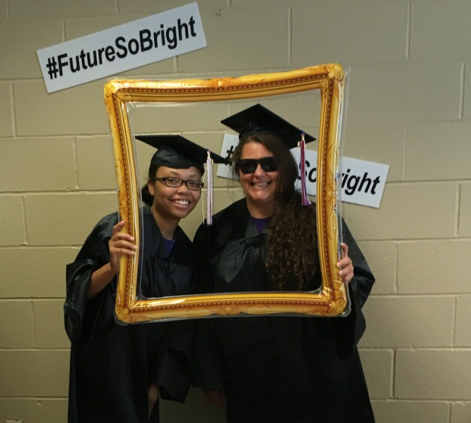
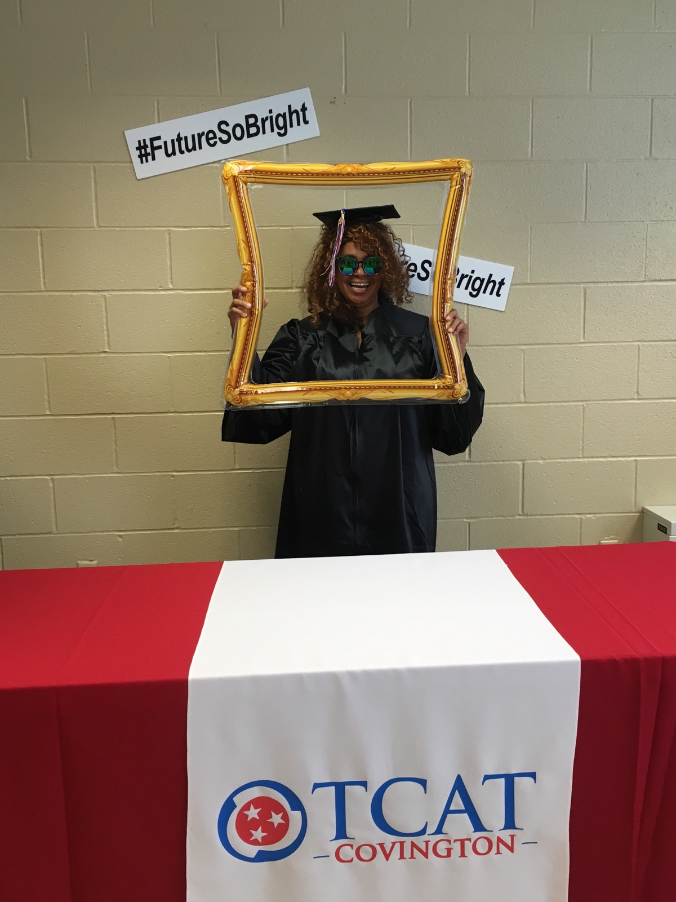
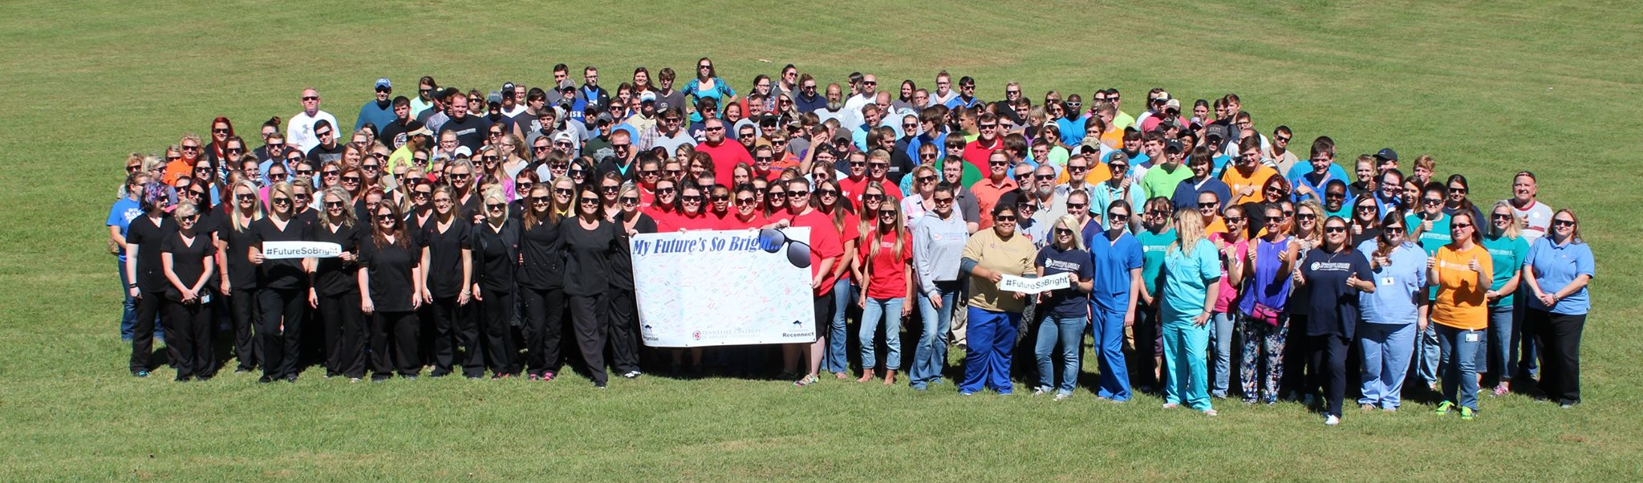
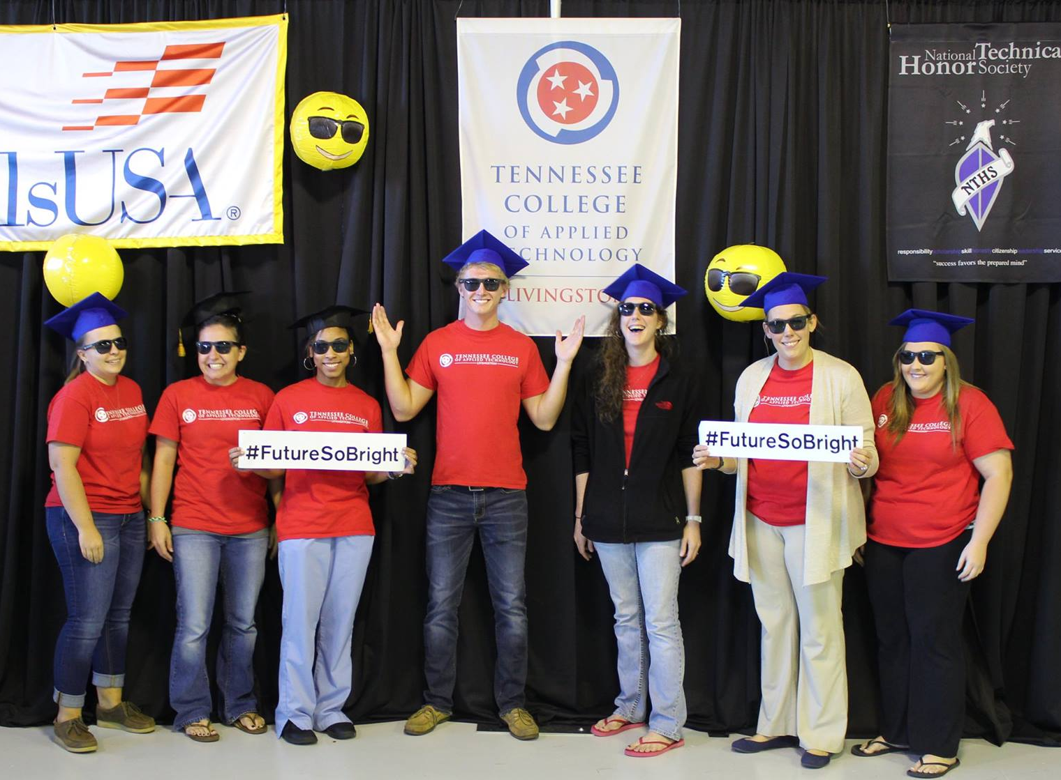
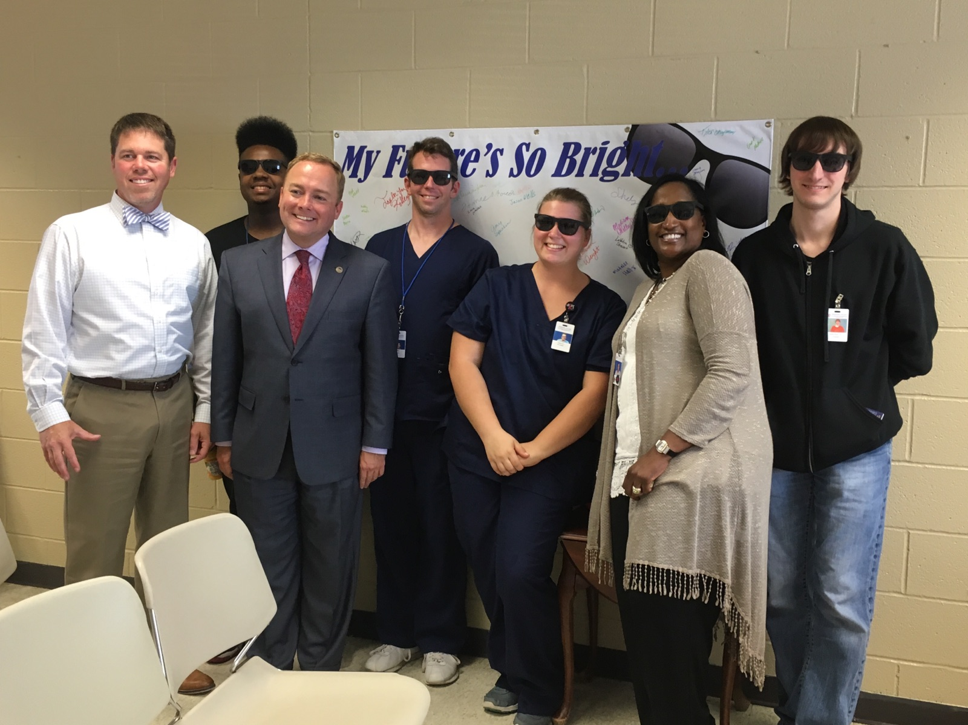

Future So Bright

Slide 47
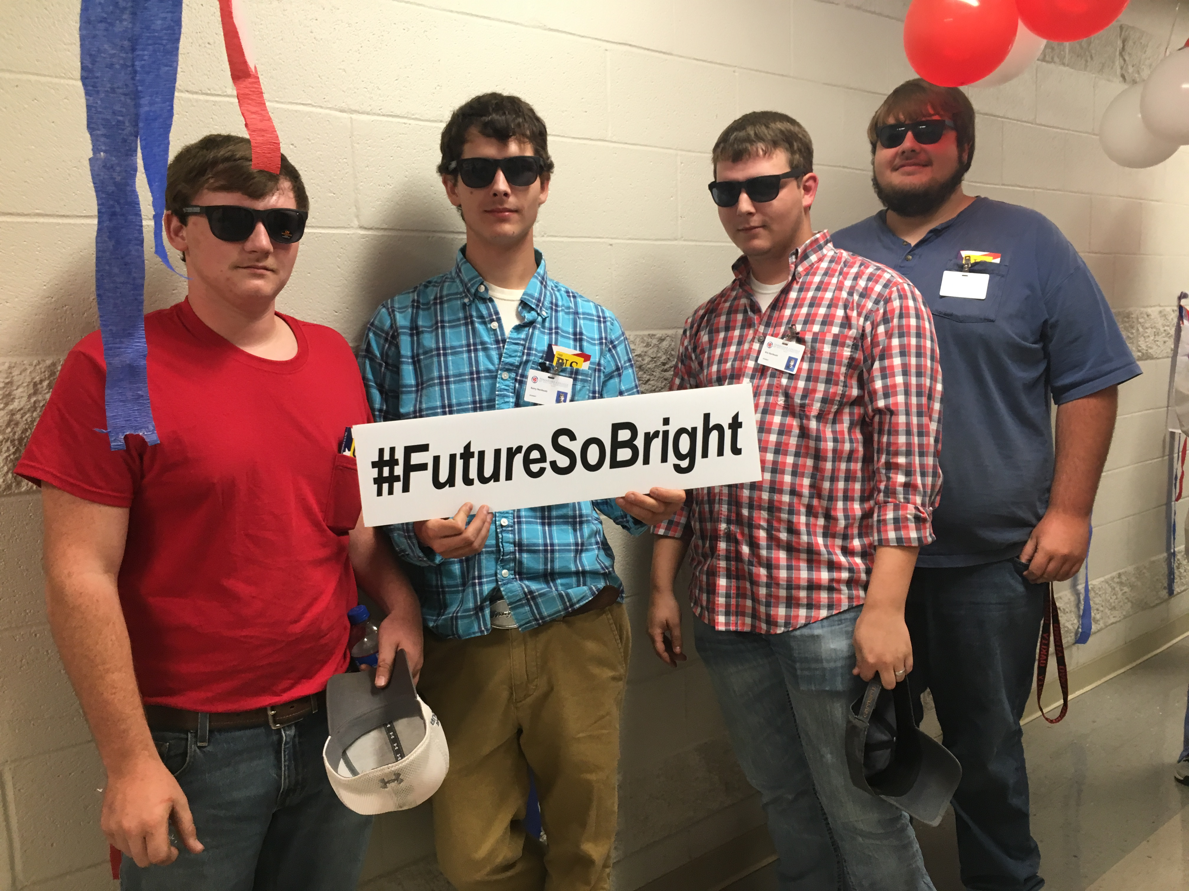
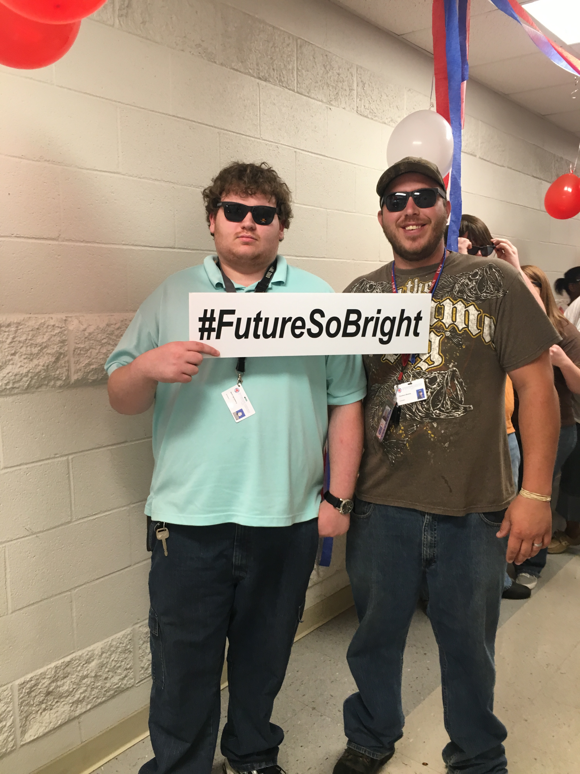
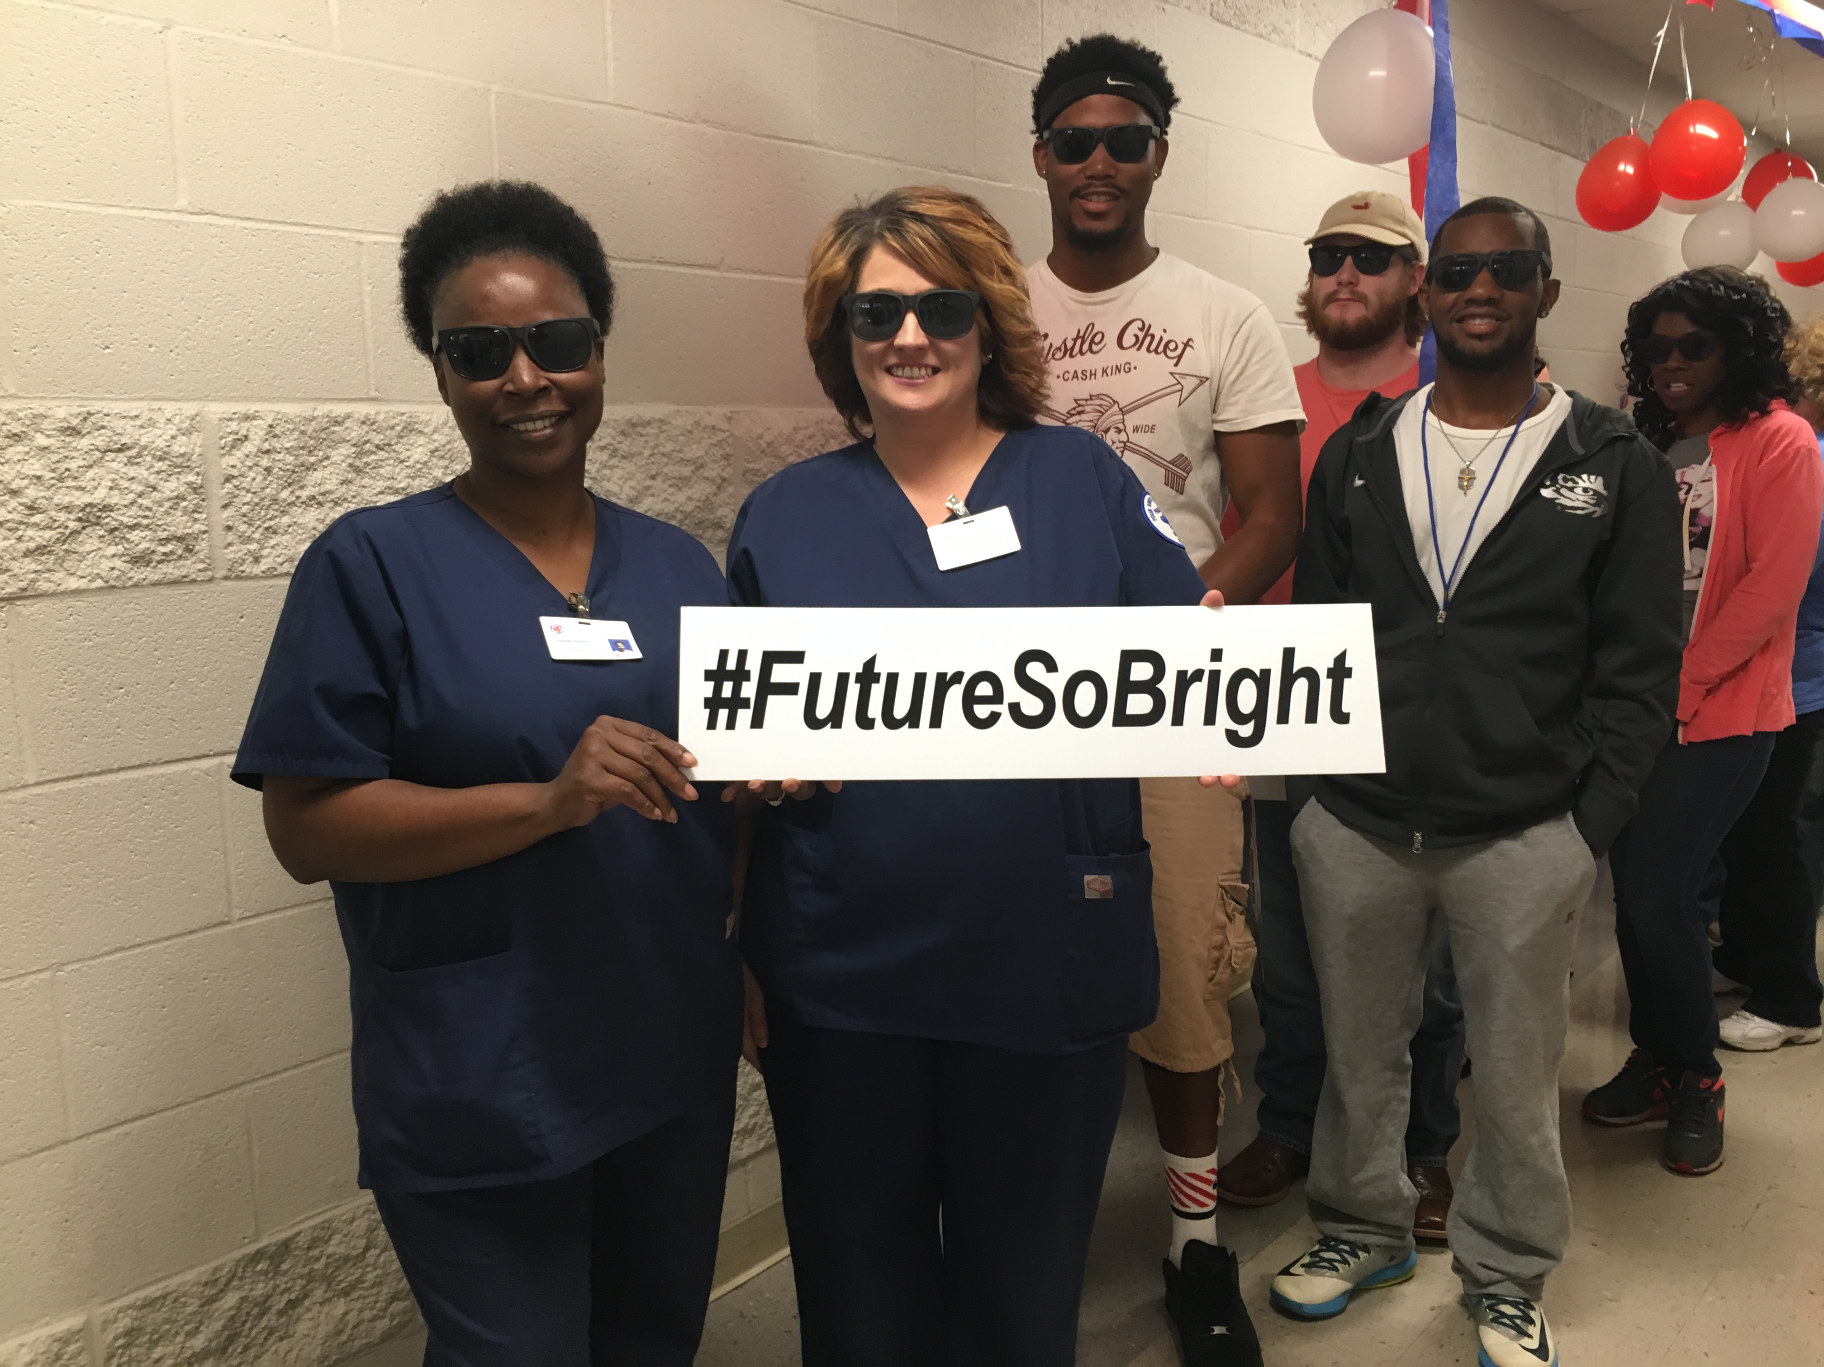
Future So Bright

Slide 48
TCAT Directors Report
National Coalition of Certification Centers (NC3)

Slide 49

NC3 Train the Trainer

Slide 50

Roger Tadajewski, NC3 Executive Director

Slide 51
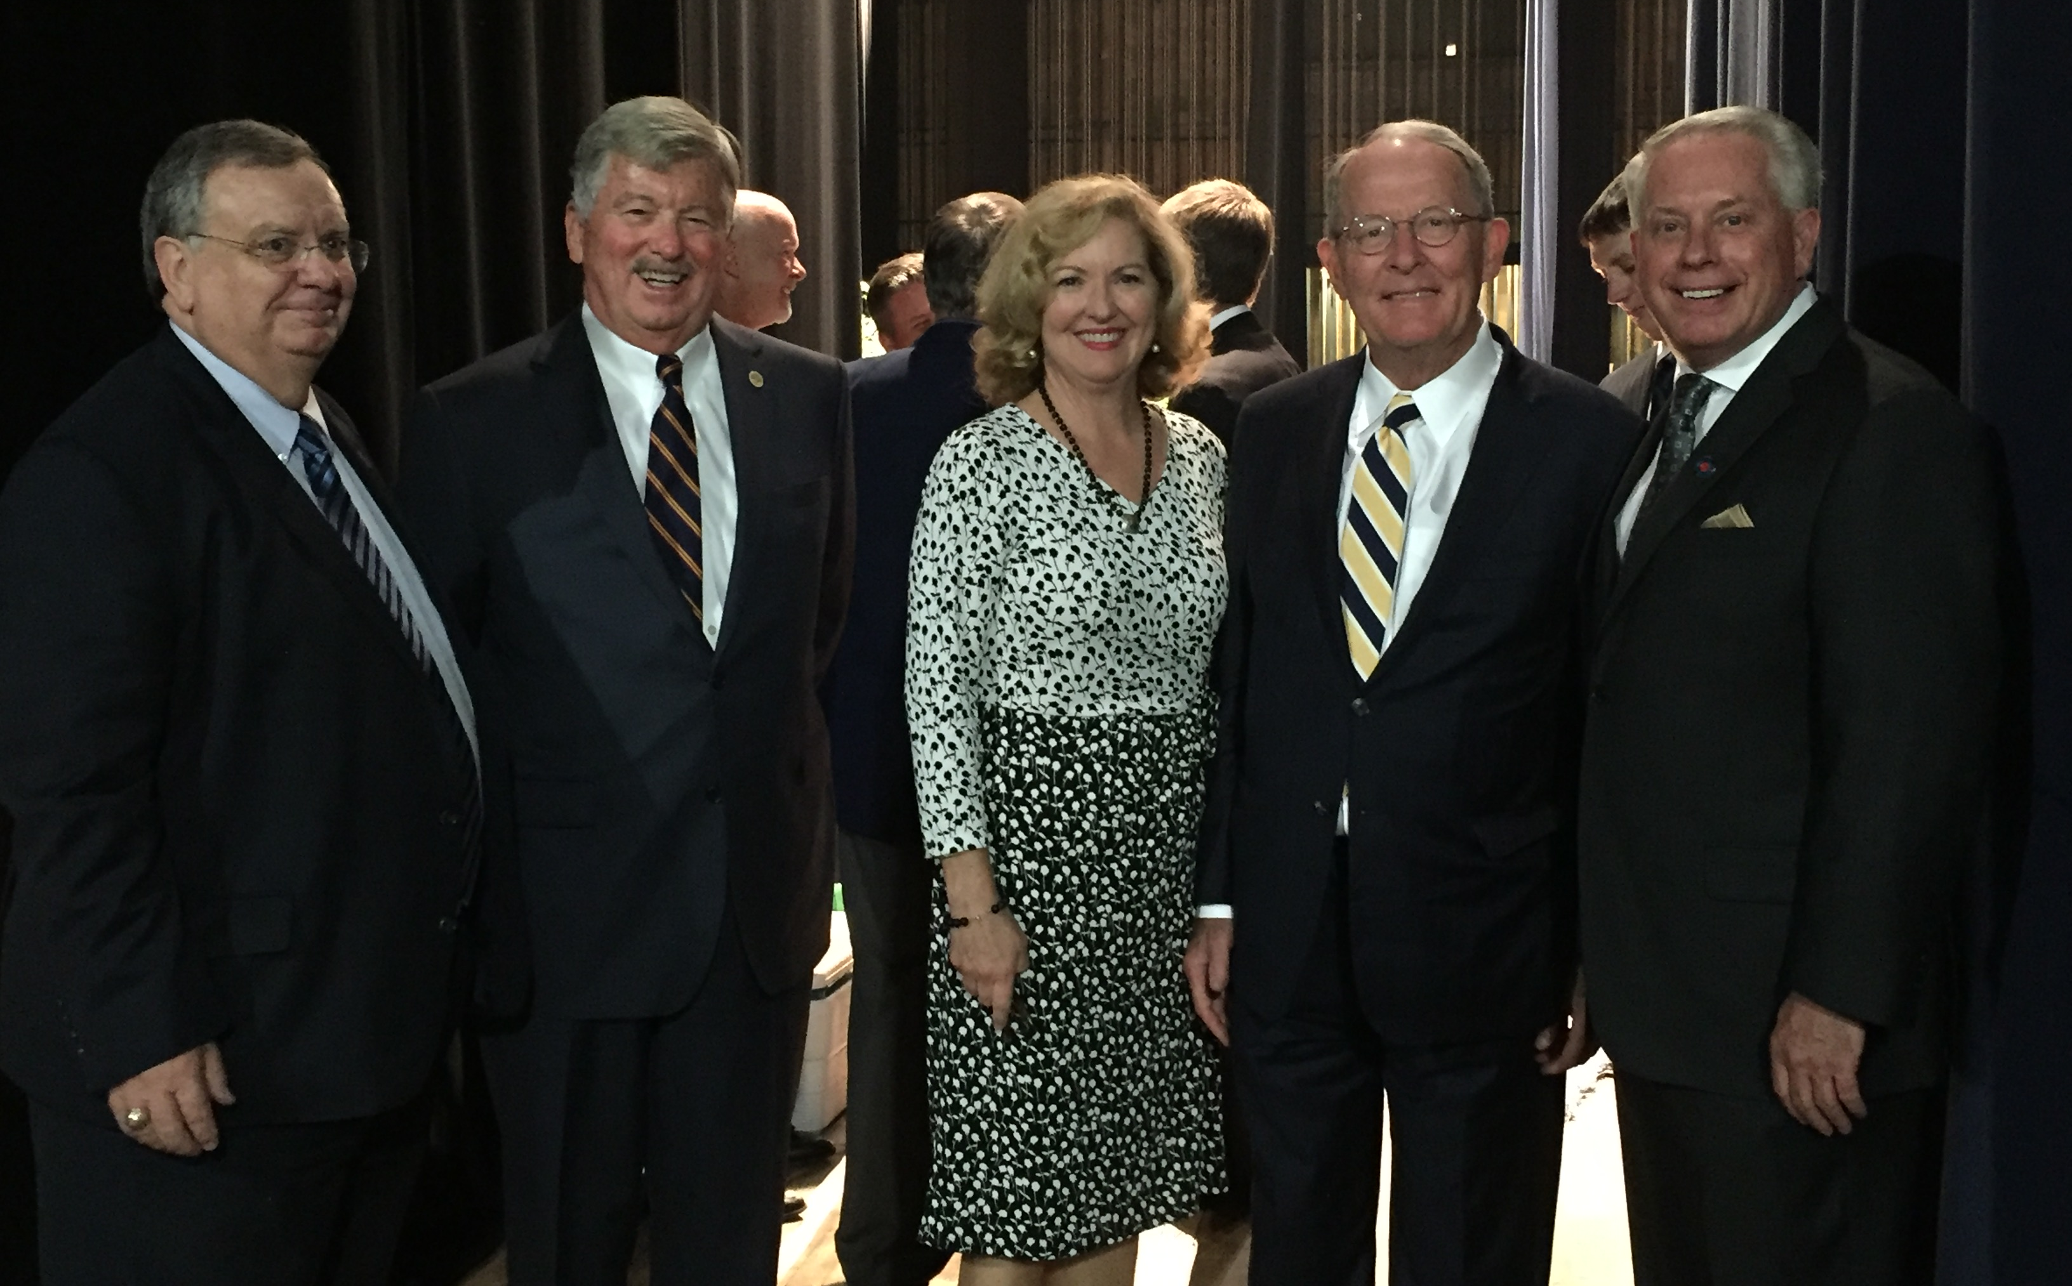
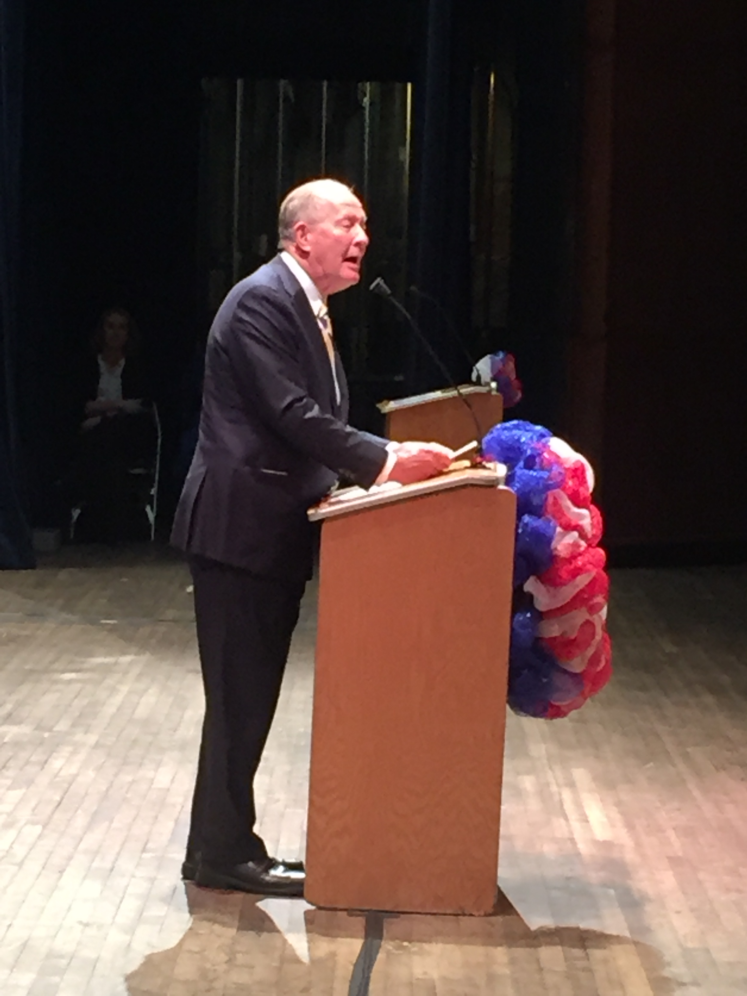
Senator Lamar Alexander Speaks at TCAT-Knoxville Graduation

Slide 52
University Presidents’ Report

Slide 53
Unfinished Business
Security and Safety Task Force Report

Slide 54

Tennessee Board of Regents
Campus Safety & Security Task Force
September 2016

Slide 55
Charge to the Campus Safety and Security Task Force
In March 2016, acting Tennessee Board of Regents Chancellor David Gregory created the Campus Safety and Security Task Force.
The task force was composed of 18 members representing the TBR campus and system office staff.
Chancellor Gregory appointed the task force in order for the TBR system to be proactive in maintaining campus safety across the system.
The committee was charged with the following:
Examine best practices around the country;
Review current campus practices and resources;
Identify areas of greatest need for support; and
Make recommendations for realistic opportunities for improvement.

Slide 56
Task Force Members
  Dr. Rebecca Ashford, Vice President for Student Affairs, Pellissippi State Community College, Co-chair
  Dr. Lynn Goodman, Associate Vice Chancellor of Operations for the Tennessee Colleges of Applied Technology, Co-chair
  Bruce Harber, Chief Operations Officer and former Chief of Police, University of Memphis, Co-chair
  Jack Cotrel, Chief of Police & Director of Public Safety, East Tennessee State University
  Tom Stufano, Chief of Police, Roane State Community College
  John Edens, Chief of Police, Northeast State Community College
  Tony Nelson, Chief of Police, Tennessee Tech University
  Dr. Debra Sells, Vice President for Student Affairs, Middle Tennessee State University
Patrick Wade, Assistant Director, TCAT Knoxville
Virginia Moreland, Associate Director, Communications and Marketing, TBR
Dr. Karen Eastman, Professor and Department Head, Life Sciences, Chattanooga State Community College
Mary Cross, Vice President of Finance and Administrative Services, Nashville State Community College
Dr. Curtis Johnson, Associate Vice President for Administration, Tennessee State University
Stacie Ioane, Graduate Student, Austin Peay State University
Dr. Heidi Leming, Assistant Vice Chancellor for Student Affairs, TBR System Office
Ginger Hausser, Director of External Affairs, TBR System Office
Heather Stewart, Associate General Counsel, TBR System Office
Monica Greppin-Watts, Communications Director, TBR System Office

Slide 57
Vision and
Mission
The VISION of the TBR Campus Safety and Security Task Force is for all TBR campuses to be safe and secure for all students, faculty, staff, and visitors in order to focus on student success.
The MISSION of the TBR Campus Safety and Security Task Force is to explore the external environment for lessons-learned from acts of violence and identify best practices, assess the internal environment for security strengths and gaps, and make system-wide recommendations to enhance ongoing campus safety and security.

Slide 58
Task Force
Process
Members of the Task force sought out best practices applied by higher education systems across the country.
Specifically, the task force:
  Examined best practices around the country;
  Engaged in a thorough review of our entire systems’ campus practices, polices, and resources in order to identify areas of weakness;
  Conducted a survey of over 15,000 campus employees and students by gauging their experiences and perceptions of campus safety and security;
  Reviewed crime data from TN college campuses; and
  Identified areas of greatest need for support and make recommendations for improvement.

Slide 59
Campus Survey
Results
Faculty, staff and students generally feel safe on campus.
Few students have been a victim of crime on campus and when it occurs, many don’t report it.
Despite feeling safe, between 21%-37% of students believe the college officials could do more to protect them.
Students are most concerned about:
  being on campus after dark
  parking areas
  property crime, and
  being the victim of a personal crime, like sexual assault or domestic violence.

Slide 60
Campus Survey
Results
12% of faculty/staff were a victim on crime on campus. Almost all reported the crime and were satisfied with the result.
The top 5 most concerning personal safety issues to faculty/staff:
  Being a victim of an angry or hostile student
  Being a victim of an active shooter
  People other than law enforcement carrying a gun on campus
  Being on campus after dark
  Parking areas
Faculty and staff would like to: (1) improve safety in academic buildings and (2) improve the presence of law enforcement/security personnel.

Slide 61
TBI Crime on Campus Report - 2015
Overall crime decreased 7% on college campuses in TN in 2015 (5945 total offenses) compared to 2014.
The most common offenses: (1) larceny/theft, (2) liquor violations, (3) drug violations, (4) assault, and (5) vandalism.
Community colleges and colleges of applied technology have far fewer reported crime than universities and very few violations related to alcohol or drugs.

Slide 62
TBI Crime on Campus Report - 2015
Category of Crime | Number of Offenses in 2015
Larceny/theft | 1718 (Mostly from a building during the day)
Liquor law violations | 927 (Most often Friday - Sunday)
Drug/narcotics and Drug equipment violations | 836
Assault | 630
Destruction/damage/vandalism | 598
Category of Crime | Rate* |  | Incidents
 | Statewide | Campus | Statewide | Campus
Murder | 6.2 | 0.0 | 406 | 0
Forcible Rape | 30.8 | 15.6 | 2,020 | 56
Robbery | 115.1 | 66.1 | 7,537 | 238
Aggravated Assault | 459.1 | 14.5 | 30,068 | 52
*per 100,000 population

Slide 63
Recommendations:
Safety & Security/Police System Structure Standards & Policies
Establish a TBR Safety and Security Department with a TBR Safety and Security Director.
Create a TBR Compliance Officer located at the TBR System Office.
Every community college should employ a certified police chief. Four community colleges do not have a certified policy chief. (Columbia, Dyersburg, Motlow, and Nashville State).
All TBR institutions with law enforcement agencies should become accredited through the Tennessee Association of Chiefs of Police (TACP).
As needed, TBR institutions with campus law enforcement/security should enter into memoranda of understanding (MOUs) with local law enforcement agencies with concurrent jurisdictions.

Slide 64
Recommendations:
Security/Police Staffing Levels
Each institution should have a security/police staffing level of one officer to 625 students.
Each institution should employ at least one security/police officer responsible for campus safety.

Slide 65
Recommendations:
BIT - Behavioral Intervention Teams & Counseling
TBR should create a system-wide behavioral intervention team (BIT) policy.
TBR should create a system-wide structure for counseling staff and behavioral intervention team members.
Each institution should establish a behavioral intervention team.
TBR should identify and secure a database for tracking of BIT cases at each TBR institution.
TBR should explore inter-institutional sharing of conduct records for students who are expelled or dismissed from a TBR institution for behavioral issues.
Campuses should examine the need for minimum staffing levels and establish credentials for mental health providers employed at TBR institutions.
  Where necessary, establish MOUs with local community mental health agencies and crisis teams.

Slide 66
Recommendations:
Campus Grounds
& Facilities
All classrooms and lecture hall doors must be lockable from within and meet code requirements.
Replace older, handle-type “panic bars” on exterior doors with flush mount releases to prevent chaining of doors, as occurred at Virginia Tech in 2007.
Consider establishing a procedure by which all classroom doors are left in the locked position at all times.
Perform threat assessments for all buildings and grounds using Crime Prevention Through Environmental Design (CPTED) strategies. Establish system-wide, CPTED assessment teams.

Slide 67

Door Locking System
 | Sample locking system: Is code compliant Has a deadbolt throw for additional security Can be locked from inside by thumb latch Has a small switch (lower right – see “A”) that allows locking without a key Costs approximately $450 (excludes labor, door replacement, etc.) Is available from multiple vendors

Slide 68
CPTED
Strategies
Design Out Crime
Crime Prevention Through Environmental Design
Natural Surveillance
  Entrances, doors, walkways and parking lots are visible
Natural Access Control
  Highlight main entrance, directional signage, limit the number of entrances and exits to buildings and parking lots, walkways and shrubbery “funnel” pedestrians
Territorial Reinforcement
  Signage designates special places, transition from public to institutional property, mark parking spots and drive lanes
Maintenance
  Landscaping follows 3’-7’ rule, stairwells and parking lots are clean, remove graffiti within 24 hours (someone controls and cares)
Management
  Employees and students are familiar with security systems, processes and usage patterns promote safety (e.g., night employees park closer)

Slide 69
Recommendations:
Training Security/Police Officers
All security/police officers should receive annual training commensurate to their respective duties and responsibilities.

Slide 70
Recommendations:
Training
Faculty, Staff, & Students
Train students, faculty and staff on how to respond to critical incidents on campus.
Notify all students, faculty and staff of all alert systems available for their use.
Provide on-going training to the campus community regarding recognizing and reporting behaviors of concern.

Slide 71
Recommendations:
NIMS Training
Each campus should ensure campus executives and other designated personnel receive the appropriate level of NIMS training.
  Security/police administrators and respective supervisory personnel should complete NIMS IS100, IS200, IS700, IS800, at a minimum.
  Campus executives and senior officials should complete NIMS G-402 (ICS Overview for Executives and Senior Officials), at a minimum.

Slide 72
Recommendations:
Emergency Preparedness
TBR should develop an emergency preparedness template and require peer audit on a 3-5 year cycle to ensure compliance.
Each campus should ensure basic emergency preparedness plans, trainings and processes are in place.
Each campus should establish an annual marketing and educational campaign for students on emergency preparedness.
Each campus with safety and security/police should have radio interoperability with local first responders.
Each campus should explore cellular agreements with major carriers to provide portable, emergency systems and campus-use only emergency phones.

Slide 73
Recommendations:
Emergency Preparedness Emergency Notification
System
Each institution should have a functioning emergency notification system.
Template messages should be developed and maintained to accelerate distribution (e.g., “canned” messages for more common events such as tornado warnings).
Where possible, emergency notifications should be “opt out,” i.e. automatic enrollment.
Social media should be a component of all campus emergency notification systems.
Institutions should consider the use of a panic-button type smart phone app.
Where applicable, systems should also include in-building notification systems and outdoor warning systems.

Slide 74
Recommendations:
Legislation
TBR should advocate to the General Assembly to amend TCA 49-7-118 to clarify that TBR university governing boards may establish certified police forces.
TBR may consider advocating to the General Assembly to amend TCA 39-17-1309 to clarify that no adverse action will be taken against an employee who lawfully exercises his/her right to carry a handgun on campus if in compliance with law and policy.
TBR may consider advocating to the General Assembly to amend TCA 39-17-1309 to require that lists of individuals authorized to carry a handgun on campus shall be shared between local law enforcement and the institution of the individual’s employment.
TBR may consider advocating to the General Assembly to amend TCA 39-17-1309 to provide increased flexibility for campus personnel to be aware of who is lawfully allowed to carry.

Slide 75
Recommendations
FY 2017-18 Budget
CATEGORY | BUDGET | DESCRIPTION
Campus Grounds & Facilities | $6 million (one-time) | Replace locks (doors if necessary) to ensure all classrooms/lecture hall doors are securable from within. Replace older “panic bars” on academic & residential buildings
Safety and Security/ Police | $343,000 (recurring) | Create TBR Safety & Security Office including a director of safety and security & compliance officer, travel, and statewide training funds.

Slide 76
Recommendations
FY 2017-18 Budget
CATEGORY | BUDGET | DESCRIPTION
Emergency Preparedness | $180,000 (one-time) | Provide a minimum of 1 radio for each CC and TCAT to ensure each campus with police/security has radio interoperability with local responders.
Safety and Security/ Police | $2,024,000 (recurring) | Add 34 security/police officers to ensure 1 officer to 625 student ratio and 1 officer at each institution. Ensure each CC has POST-certified police chief. (4 currently do not)

Slide 77
Recommendations
FY 2017-18 Budget
CATEGORY | BUDGET | DESCRIPTION
Emergency Preparedness | $16,770 (recurring) | Emergency Notification Systems for each TCAT
Behavioral Intervention Team (BIT) and Counseling | $420,000 (recurring) | Database to track cases within an institution (e.g., Title IX, BIT) $10,000 per year for each CC & TCAT. $20,000 system-wide training/consultants for behavior health evaluation, monitoring and education.

Slide 78
Recommendations
FY 2017-18 Budget
TOTAL | RECURRING | ONE-TIME
$8,983,770 | 2,803,770 | $6,180,000

Slide 79
Comments
Questions
Discussion

Slide 80
Quarterly Board Meeting
Chattanooga State Community College
September 15, 2016

